Slide 1
Update on Canadian Visas and Finance for International Students
Martine Gagnon
Senior College Counsellor
UES Education

Slide 2
Oh, Canada… what happened?
In October 2023, the government of Quebec announced that out-of-province and international students enrolling at English-speaking HE institutions would pay higher tuition fees.
In January 2024, Immigration, Refugees and Citizenship Canada (IRCC) introduced a cap on study permits issued to international students.

Slide 3
Why were these measures implemented?
“These changes aim to protect foreign nationals studying in Canada and improve overall program integrity.”
“Correct the financial imbalance that exists between the French-speaking and English-speaking networks in HE in Quebec.”

Slide 4
Je ne sais quoi… Québec
The Government of Quebec imposed a 33% hike in tuition fees for out-of-province and international students at English-speaking institutions: McGill, Concordia, Bishop’s.
French language courses are also now mandatory.
McGill and Concordia are taking legal action against the gov’t of Quebec. Stay tuned.
Bishop’s University was granted an exemption due to its unique situation.
The increase will not apply to students already enrolled and from France/Belgium.

Slide 5
How will this affect international students?
Designated Learning Institutions (DLI), i.e., universities and colleges in Canada, delivering LOA (letters of acceptance) must issue a PAL (provincial attestation letter) to students so they can apply for a study permit.
Additional bureaucratic step for university admissions offices.
A similar system was already in place in Quebec: CAQ (certificat d’acceptation du Québec) - McGill, Bishop’s, and Concordia.
If a study permit is refused, a reason will be provided, and students have option to decide whether to correct and reapply.
Both Concordia and McGill are currently offering bursaries/scholarships to alleviate the increased financial burden.

Slide 6
What will the SP application process look like?

Slide 7
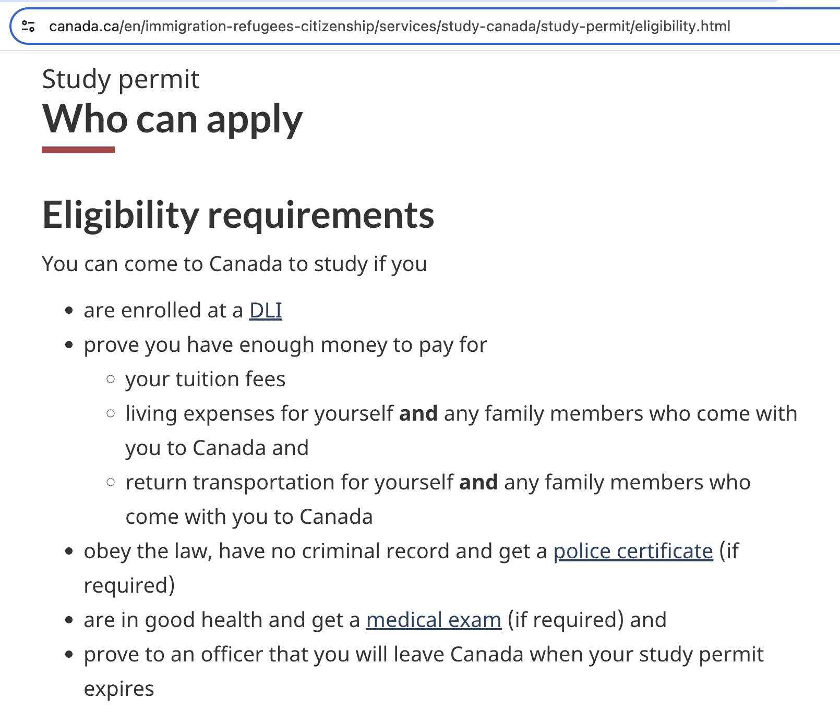
Study Permits CAD $150 Approx £86

Slide 8
How can you best advise students?
Do your research
Financial fit is essential
Apply early
Only accept ONE offer
DLIs have deferral policies in place in case of study permit delays/refusals (with some competitive program exceptions)
Always check institutions’ websites for most up-to-date info
Apply for housing early

Slide 9
Further Reading & Resources
https://www.cbc.ca/news/canada/toronto/international-student-study-permits-data-1.7125827
https://monitor.icef.com/2024/04/canadian-immigration-minister-releases-official-cap-figures-and-targets-for-2024/
https://www.statista.com/statistics/555117/number-of-international-students-at-years-end-canada-2000-2014/
https://wenr.wes.org/2024/05/canadian-policy-changes-leave-international-education-leaders-apprehensive-but-with-muted-hope
https://thepienews.com/tv-documentary-warns-recruitment-indian-students-canada/
https://thewalrus.ca/the-shadowy-business-of-international-education/
https://gem.cbc.ca/the-fifth-estate/s48
https://students.ubc.ca/international-student-guide
https://future.utoronto.ca/apply/applying/international-study-permits/
https://thepienews.com/international-fee-quebec-french/
https://www.bbc.co.uk/news/world-us-canada-68362462
https://www.ubishops.ca/future-students/no-tuition-increase/#:~:text=Therefore%2C%20while%20tuition%20rates%20are,exemption%20from%20the%20increased%20rates.

