Slide 1
Reverse Admissions
Notes:
Thank you everyone for joining! Today we'll be talking about Reverse Admissions with our Match program.

Slide 2
Meet Your Presenter
Rebecca Kelley Senior Manager, Counselor Engagement
rebeccakelley@eab.com

Slide 3
What We’ll Cover
What is Reverse Admissions?
The History
Reverse vs. Direct
Benefits of Reverse Admissions
Notes:
Agenda-
But before we dive in- who is in here? HS counselors? IECs? Universities? Other orgs?

Slide 4
What is Reverse Admissions?
Notes:
You may have heard the terms "reverse admissions" or "direct admissions" floating around, but I want to dive in and explain what the reverse admissions process is and why it's very different from direct admissions.
Reverse admissions is the idea of universities applying for students. A power shift- a flip of the script- something radically different- that frankly, makes universities a little nervous.

Slide 5
A Solution to Two Problems
Students are anxious and stressed about the college process. Information asymmetry and the complexity of the existing application process create inequity.
Higher Education Institutions (HEIs) need better tools to find, attract, and enroll a diverse body of students in an increasingly competitive landscape.
Notes:
I’d be preaching to the choir if I sat here and told you all how stressful it is for students these days to apply to college. NACAC put out a paper last year that showed more than 70% of high school students reported the college application process as being the most stressful part of their lives- We know this process weighs especially heavily on first generation students and their families but also very much so on the counselors working with them.
So Concourse set out to really solve two problems. One is missed opportunities. There are thousands of universities around the world, and students have so many options to consider, there isn’t enough time to evaluate all of them, so students tend to leave opportunities on the table because they don’t have enough time or resources to consider all of them.
The second problem we set out to solve was the need for HEIs to find students who are a good fit for their institution, and enroll a diverse body of students in an increasingly competitive landscape.

Slide 6
Back in 2018…
Notes:
In order to better appreciate what Reverse Admissions is and how we, at Concourse, came up with it- I think it's helpful to share a really pivotal moment in our history.
Those of you who have been in Education for a few years years will probably remember this... In mid April, 2018- a university in Texas took a look at their finance report and realized they had financially overextended themselves- and their solution was to revoke the full ride scholarships of more than 60 incoming international students. All 60 of those students happened to come from Nepal.

Slide 7
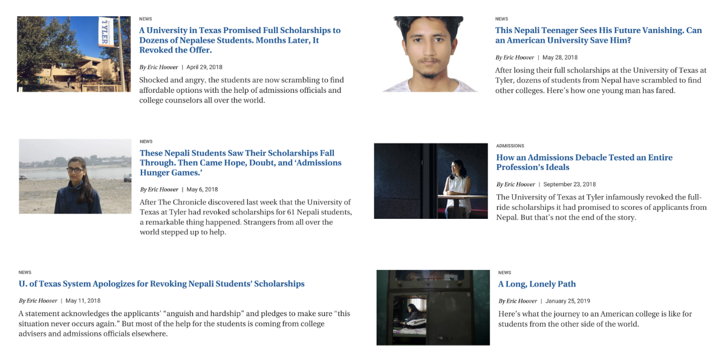
Back in 2018…
Notes:
So on Friday, April 13, 2018, 6 years ago today- the university sent the students an email informing them of the issue, letting them know that they would no longer be able to offer them the Presidential Scholarship they'd been awarded months before.
As education experts, you all know what mid-April means... If you have experience in INTERNATIONAL admissions, you know that this issue is escalated for a student dealing with immigration and visas. What you may not know, and certainly this university didn't... is that April 14th, the day this email would land in these students' inboxes, was Nepali New Year- the biggest celebration of the year.
In the following days, there was a flurry of activity stemming from the Fulbright Commission and EducationUSA based in Kathmandu- There were posts all across social media- calls for universities around the world who still had open spaces to raise their hands and try to find funding for these students. When we think about low-income, first generation, and under-represented students--- This was it.

Slide 8
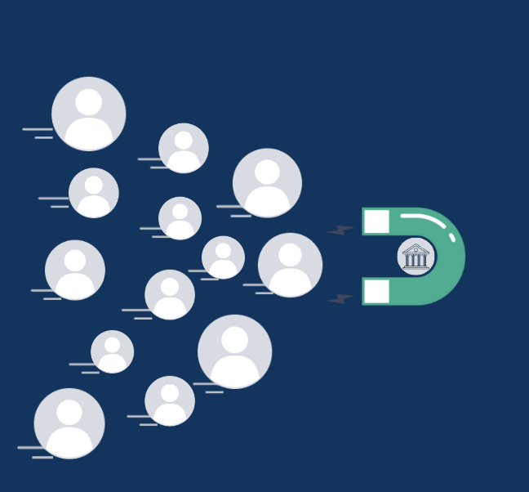
Back in 2018…
Notes:
A few universities with means came forward- raising their hands, some even announcing on Twitter that they would offer a full scholarship for one of the affected students. Seems like a nice gesture, right?
Guess what happens when 60 students are frantically looking for university placement at the 11th hour and someone TWEETS "I will take ONE of you!"
<click>
Not only did ALL 60 students rush to apply, (regardless of whether or not the university was a good fit or had the program they were interested in....) OTHER students started to come forward and claim to be one of the original 60... In short... It was a mess.

Slide 9
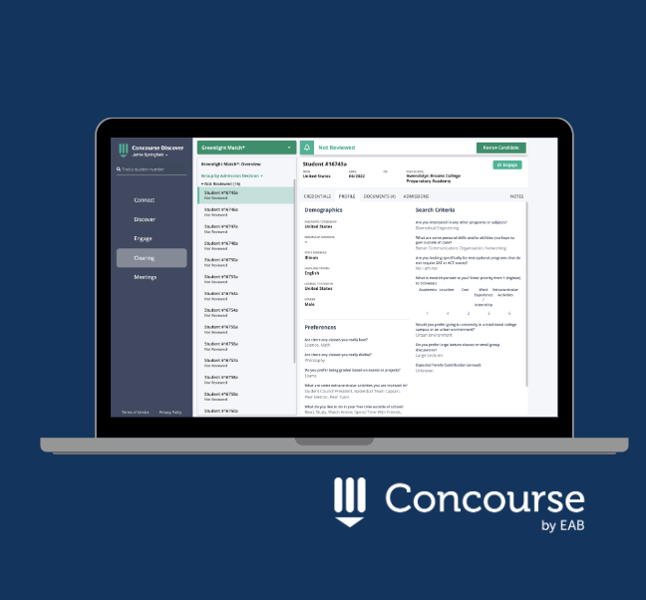
Back in 2018…
Notes:
In 2018, Concourse was a platform, but it was more of a messaging platform ... It was a way for universities to hand select who they wanted to engage with based on some basic profile statistics- and there are a lot of platforms today that do this kind of thing.
We heard this call for help from EducationUSA in Kathmandu on social media- and we reached out immediately to try to help put a process in place. We got the nod from the US State Dept (who oversees EducationUSA) and we worked with the Fulbright office to put the affected students on the platform.

Slide 10
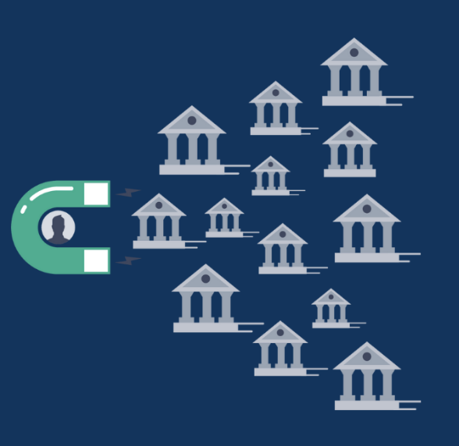
Back in 2018…
Notes:
Then, we opened the platform to any institution around the world who thought they might have space and potentially funding for these students. (It's a lot easier to advocate space and funding when you have a particular student in mind that fits your institution- than it is to give a blanket yes without first vetting the students.)
The universities would filter the students and focus in on particular programs, or particular attributes- and they made their offers ONLY to the right students. (Vs. having all students applying to several unis with no regard for fit- and no guarantee of being admitted – spending loads of money and time on applications and supplemental requirements)... In this situation, the students filled out a simple profile authentically--- and basically said "Here I am. Who wants me?" They had no idea who might come forward and look at them. They had no sense of how many unis looked at them. And if an institution looked at a promising student but realized their career aspirations weren't a good fit for their programs, they simply moved to the next student. No rejection was sent. No notification at all. Students only heard yes.
It took months- and a small army of dedicated counselors-- but eventually, all of the students were placed in new university homes. And last year- they graduated.----- And as we looked back at what had transpired- we realized- holy crap....
This is how it should work. This is what admissions SHOULD be- And that was really the first version of what we now call Reverse Admisisons- This is why we call it flipping the script... And, after many iterations and enhancements- thi is what has now become known as EAB's "Match" program.

Slide 11
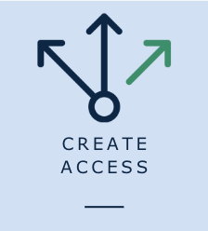
A Solution to Two Problems
Students receive legitimate admission offers from HEIs they likely never would have considered due to a number of limiting factors.
HEIs are able to connect with well-matched students and counselors they may have never crossed due to proximity, logistics/travel, cost of acquisition, or lack of familiarity around a particular region or population.
Notes:
So Reverse Admissions- really solves the two problems we talked about earlier- - and it became our mission---- To bring opportunities to those who likely wouldn't have found them in the first place.... and that mission translates to both students- who likely would never have even known about a particular university- let alone receive an offer from them- as well as to universities who wouldn't have crossed paths with a particular student because of proximity, logistics/travel, cost of acquisition or lack of familiarity around a particular region or population. And this is particularly true if you happen to be on an ISLAND. …. So we articulate this often - focusing on creating access for students, and in some ways, too, helping create access for the institutions as well.

Slide 12
Reverse vs Direct Admissions
Reverse Admissions
Direct Admissions
No applications needed for admission
Invitation to apply with guaranteed admission
Range of country and state options
Primarily US and state-based
Students create profiles with personalized information
Less contextual information available about the student
Students expect to hear from new schools
Students don’t know or expect to receive offers of admission
Student profiles are affiliated and vetted by a counselor or IEC
Little to no counselor involvement
Notes:
There is a big difference between what we call reverse admissions and direct admissions. Direct admissions isn’t really something new- in fact you could argue it’s almost 10 years old- as the State of Idaho rolled out it’s version back in 2015- under the Idaho model, colleges contacted all seniors in the state with specific GPAs and let them know that they were eligible for admissible- upon application submission. And this is similar to what we are seeing a number of states rolling out across the country right now as a major initiative to keep more students in-state. The original Idaho experiment yielded kind of mixed results- but the biggest benefit that was really seen was an overall 8% increase in in-state enrollments but mostly at 2-year colleges- Under direct admissions processes, students typically still need to submit some type of application to receive their official offers.

Slide 13
Reverse Admissions is NOT Direct Admission
Less Impact
Most Impact
“You qualify for admission”
”If you apply, you will be admitted”
“Congratulations- you are admitted!”
Notes:
I want to be clear- today… Every step- every step taken to move the needle on this process is a good one. So whether it’s a state-run initiative, an application delivery system, or a platform that bridges students, counselors and universities- It’s ALL better than the status quo… These are ALL steps to improving access- and we’re here for it. Are we biased about our own solution? Heck yea we are. But all of us in this growing space are working to make things legitimately more student-centric.

Slide 14
The Transformative Impact of Match
136K+ total admission offers
Student Results
2021-2024
$7.4B in scholarship offers
42,000+ Total Students
180+ participating universities
650+ participating schools
We college counselors do our best to encourage our students to apply to schools that fit them academically and socially, and where they have a chance of receiving offers, yet we work with teenagers who don’t always listen to our advice. Early on, when some of the students I was concerned wouldn’t get offers from applications they were submitting started getting [Match] offers, I was relieved—they’d have university homes that suited them well.
Melissa Meltzer Warehall
Head of College Counseling, Daystar Academy, Beijing
Notes:
Since we landed on our reverse admissions idea, the platform has grown tremendously.
In 2021, we partnered with EAB to focus our attention on the US- and piloting Greenlight Match- which focused on CBOs in the Chicagoland area- In 2022, we went nationwide and were acquired by EAB-
So far we have had over 42,000 students on Concourse, 100,000 plus admissions offers, over 7 billion dollars in merit-based scholarship offers.

Slide 15
August 2023 – May 2024
Match Results
78,240
4.6+ Billion
Offers of Admission
Scholarships Delivered in USD
Notes:
Combined totals – for just this year so far. All of this without a single application, without a single application fee.

Slide 16
Participating Universities
17
48
66
180+
2020
2021
2022
2023
Countries represented include:
🇦🇺 Australia
🇨🇦 Canada
🇫🇷 France
🇩🇪 Germany
🇮🇹 Italy
🇯🇵 Japan
🇵🇹 Portugal
🇹🇷 Türkiye
🇬🇧 United Kingdom
🇺🇸 United States
Notes:
We now have over 180 participating universities from countries all over the world including Canada, Japan, NZ, the UK and the US.
Our Match program serves both students based in the US who want to study in the US, as well as students who want to study outside of their home country.

Slide 17
University Application Process
1
2
3
4
5
6
Aug/Sept
Oct/Nov
Dec/Jan
Feb/March
April
May
The Match Difference
Students solidify lists and materials
Finalize essays and recommendations
Submit EA/ED applications
Students submit regular decision applications
EA/ED decisions released
Regular decision begin releasing
Rolling admission applications submitted
Students begin deliberating about offers
United States commitment deadline
Students receive admissions and scholarship offers
Students receive admissions and scholarship offers
Students receive admissions and scholarship offers
Students receive admissions and scholarship offers
Students receive admissions and scholarship offers
Students receive admissions and scholarship offers
Notes:
Helps to expand student tunnel vision since they will be receiving admission offers each month and exposed to other universities through this process
As you can see, students can participate at any point in the year.
A few ways counselors can use Match –
Onboard kids in time for August. They’ll have university offers before they even submit a single application
Onboard kids after they’ve submitted their applications and perhaps have a bit more time, feel less stressed
We all know that unfortunately there are students who will not be admitted to the schools they’ve applied to. With Match, students can create their profiles in the spring and our universities will continue to send offers through the end of June for a Fall start.

Slide 18
Low Lift, No Risk
Students will:
Focus on getting to know the institution versus navigating the application process
Already know if a university is an affordable option
Gain confidence and minimize their anxiety over being accepted into university
Only receive acceptances, no rejections

Slide 19
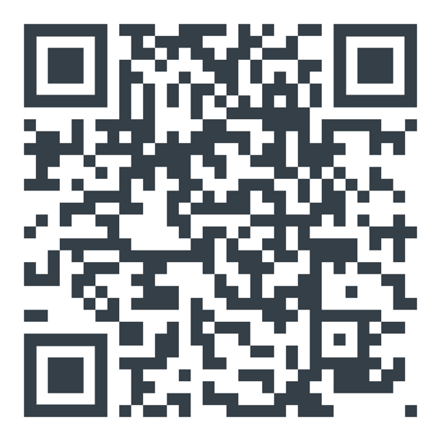
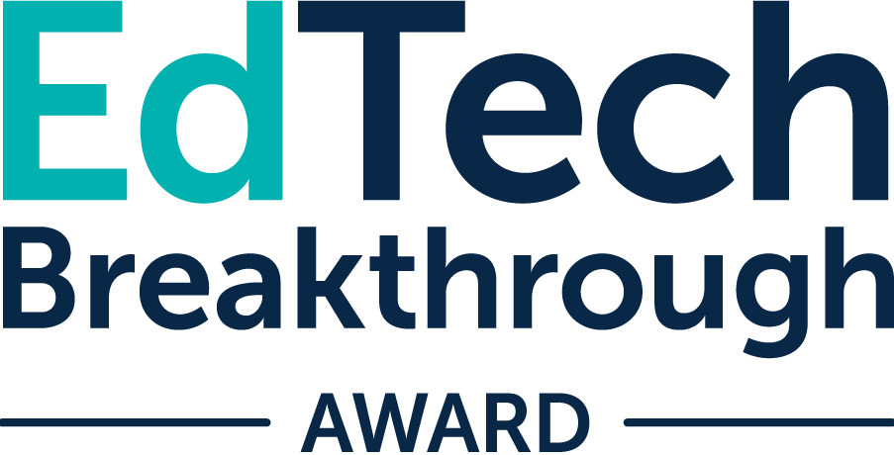
Interested to learn more?

