Slide 1
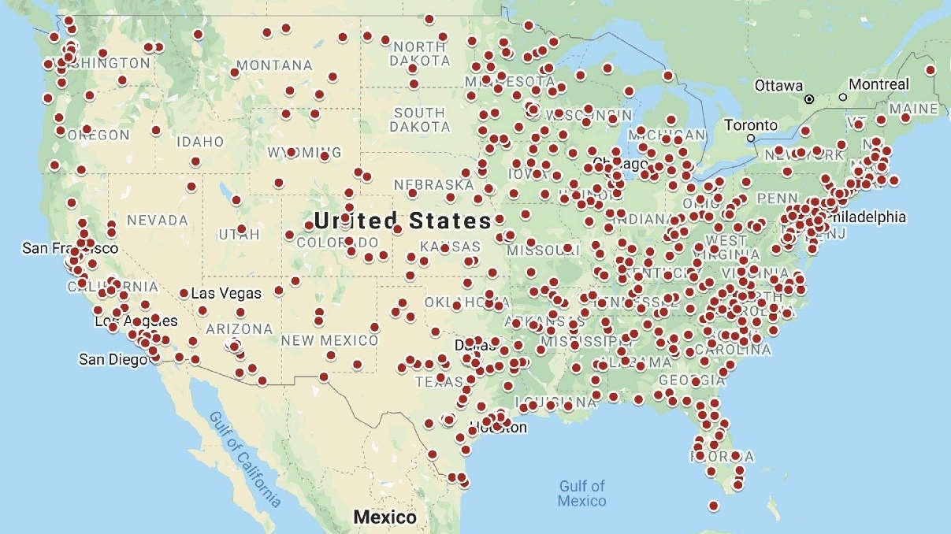
Intro to US Community Colleges
Global Community College Transfers: Leia Yen and Nicholas Shafer
Source: Center for Community College Student Engagement, University of Texas

Slide 2
What are Community Colleges?
A community college (also known as an associate’s college) is a higher education institution that offers two-year programs leading to the Associate of Arts (AA) or Associate of Science (AS) degree. These colleges have technical and vocational programs with close links to secondary/high schools, community groups, and employers in the local community
Source: US Department of State, EducationUSA

Slide 3
Community College Pathways: 2+2 Model
~2 years at community college
~2 years at a 4 year university
Source: US Department of State, EducationUSA

Slide 4
Why Community College?
Cost
Open Admission
Academic and English language assistance
Connection to local communities
Professional certification and vocational training
Established pathways to 4-year universities
Source: US Department of State, EducationUSA
Notes:
2022-2023 average cost: $3860 vs 10,940

Slide 5
Our Community College Journeys

Slide 6
Diversity of CC Students
30% First Generation to attend college
16% Single parents
9% Non-US citizens
5% Veterans
21% Students with disabilities
Source: American Association for Community Colleges 2023
Notes:
38% of all US undergraduates

Slide 7
Ethnic Diversity at Community Colleges
52% Native American
48% Hispanic
39% Black
34% Asian Pacific Islander

Slide 8
GCCT: Our Vision
To close the knowledge barrier to access global education opportunities for community college students and transfer students, especially from underrepresented backgrounds, while building a platform to connect current community college and transfer students with recruiters, stakeholders, and participants within the foreign affairs, public service, and scholarship landscape.
This Photo by Unknown Author is licensed under CC BY

Slide 9
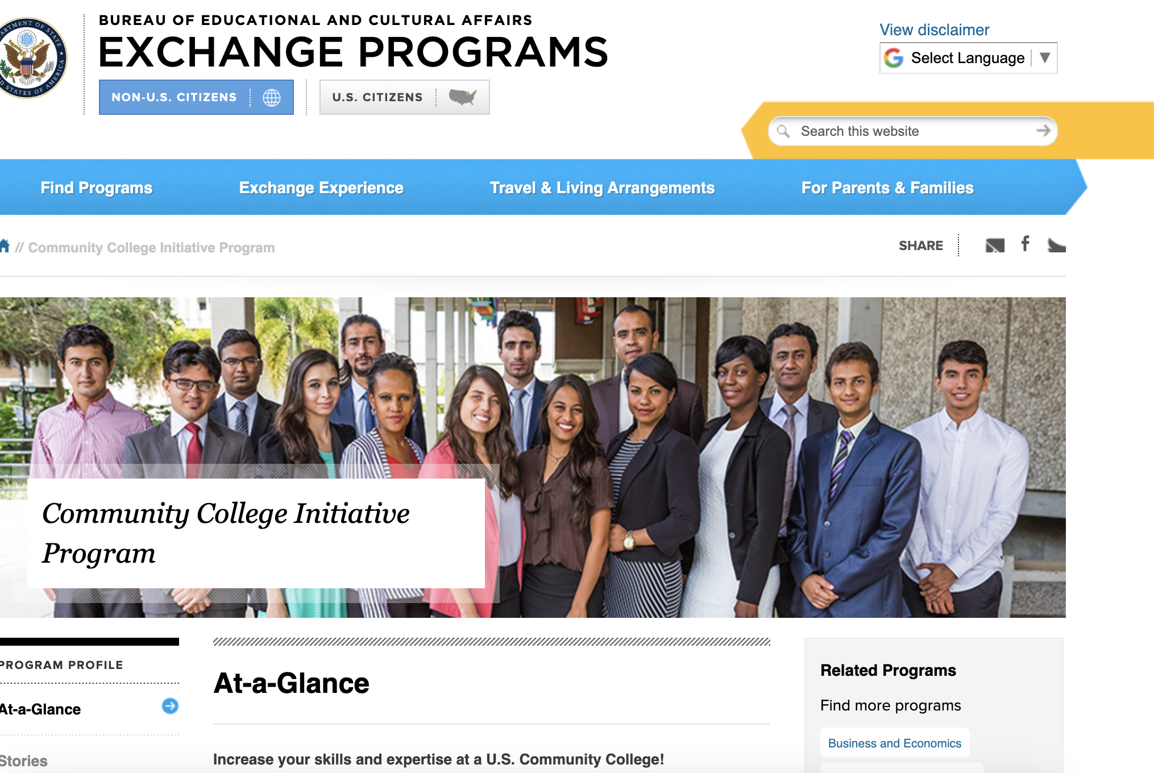
International Students at Community College

