Slide 1
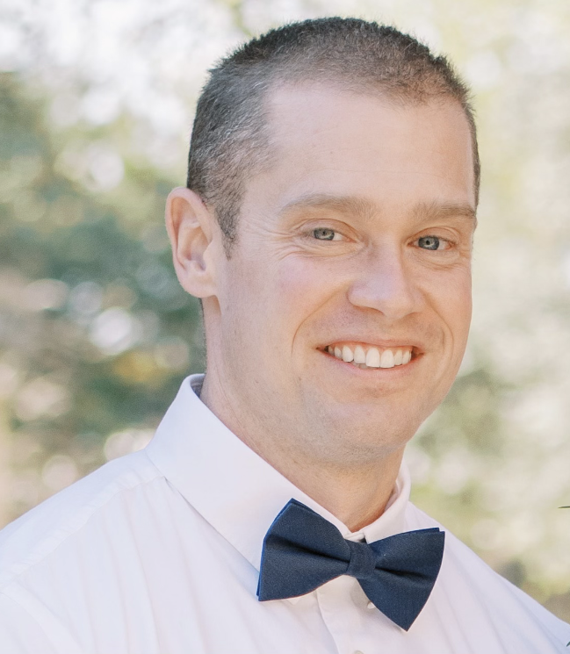
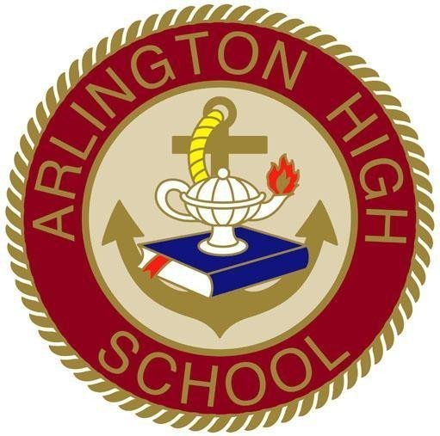
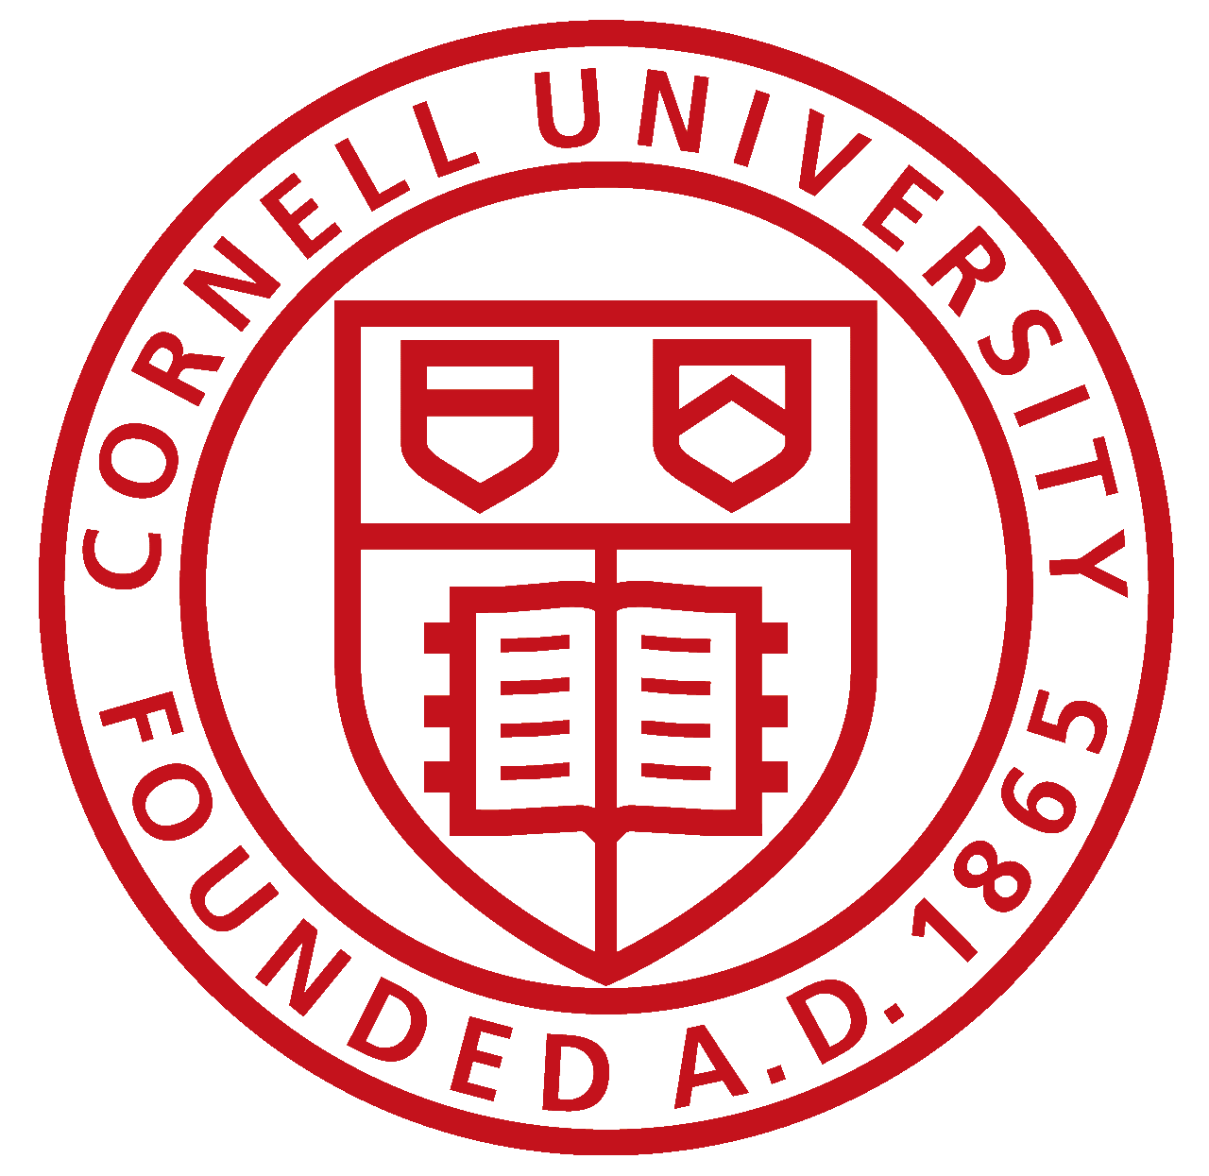
Brian Gouldsbury, Senior Manager, European & WTR Supply Chains
Educational Journey
2003 | 2004-2005 | 2005-2006 | 2006-2008 | 2008-2009 | 2010 | 2010-2015 | 2015-2016
High School Diploma
AOS
Culinary Arts
Pre-requisites & gen-ed classes
BS
Food Science
Internship
Gap Year
BS
Food Science
Full Time Employment
MBA
Work Experience Highlights
Personal
13 years with Hershey
Held multiple roles across Supply Chain
Brief time spent in Research & Development
Currently the Manager for the European & World Travel Retail supply chains
One son (Jackson – 7)
Three cats (I was conned)
Bodybuilding for ~20 years
Foodie & traveler (favorite cuisine – Asian or Hispanic; favorite city – Rome)
Notes:
Brian Gouldsbury is currently the Senior Manager for the European and World Travel Retail Supply Chains for The Hershey Company. Originally from New York state, Brian has been with the company for approximately 13 years (~14 if you include his internship with Hershey). Brian has multiple degrees from several American institutions, including an Associates of Occupational Studies (The Culinary Institute of America), a Bachelor's of Science (Cornell University), and a Masters of Business Administration (Pennsylvania State University).
Brian Recently moved to London, UK this past November with his wife Crystal, son Jackson (7), and his three cats (Marcus, Marley, & Margo). On a personal level, Brian has been bodybuilding for over 20 years and has competed in several competitions in the past. With the proximity to mainland Europe, Brian & his family have become avid travelers, and plan to check off all their European bucket list countries while living and working in the UK. Although removed from the culinary world, Brian is a foodie at heart, with Asian and Hispanic cuisines ranking high on his list.

Slide 2
Hershey is a global company, with multiple offices or manufacturing sites across the world

Slide 3
“Doing Well by Doing Good” A Purpose Driven Workforce Creating Moments of Goodness
19,000 Employees
11
Countries
25+ Locations in US
$10B
Net Sales
48% Women
27% People of Color
8X
Voted Best place for LGBTQ+ equality
90%
EC Promoted from within
And Making Hershey A
Leading Snacking Powerhouse

Slide 4
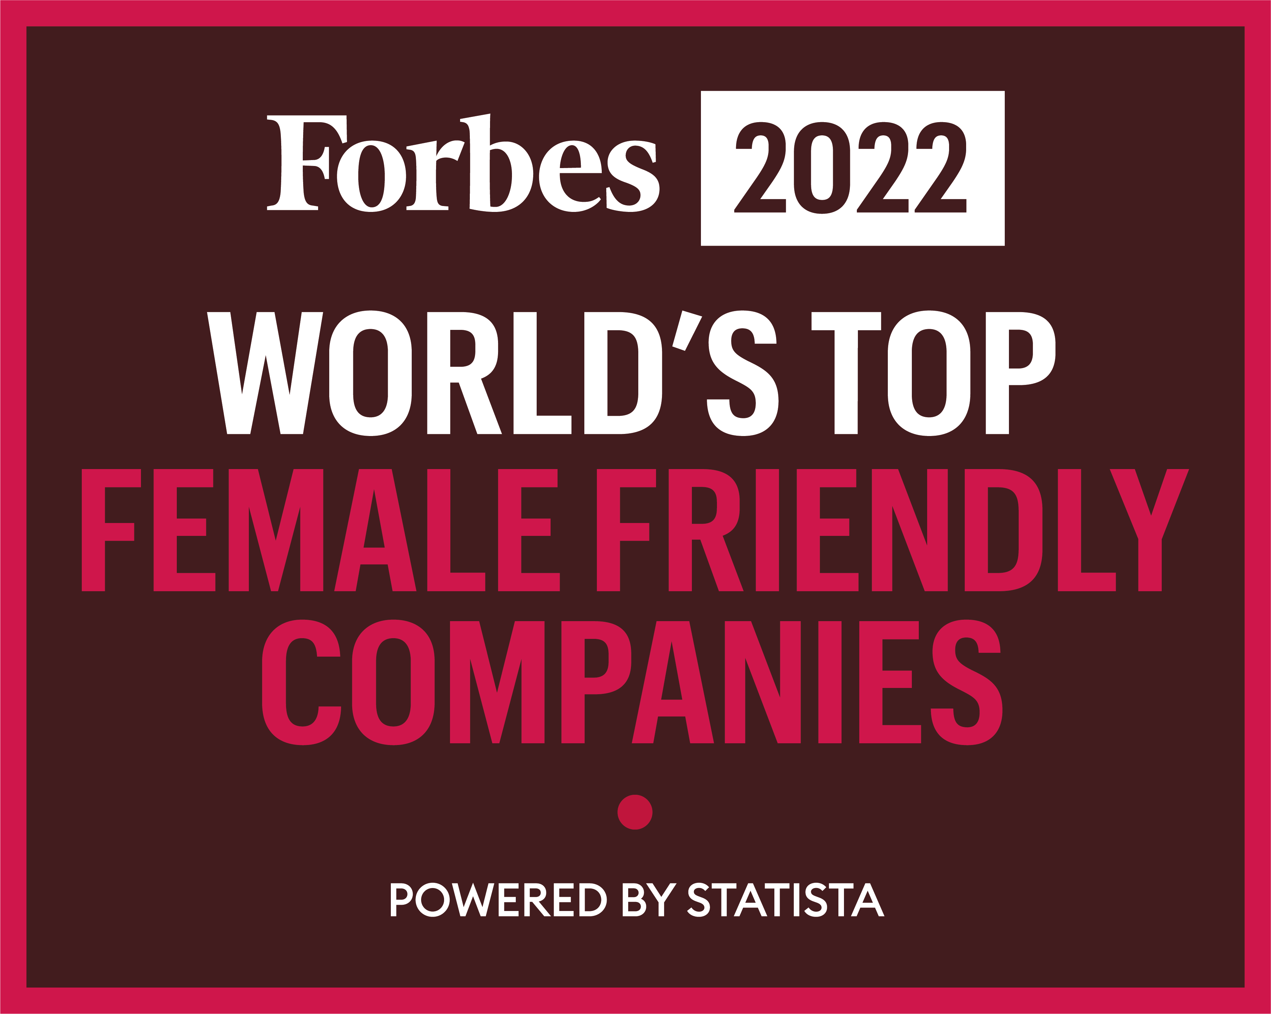
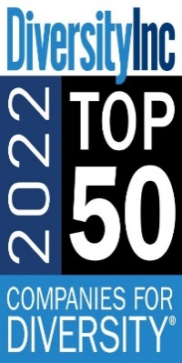
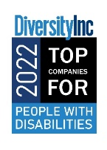
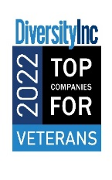
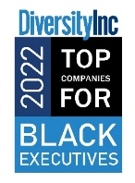
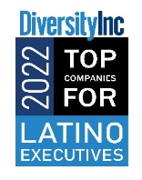
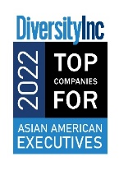
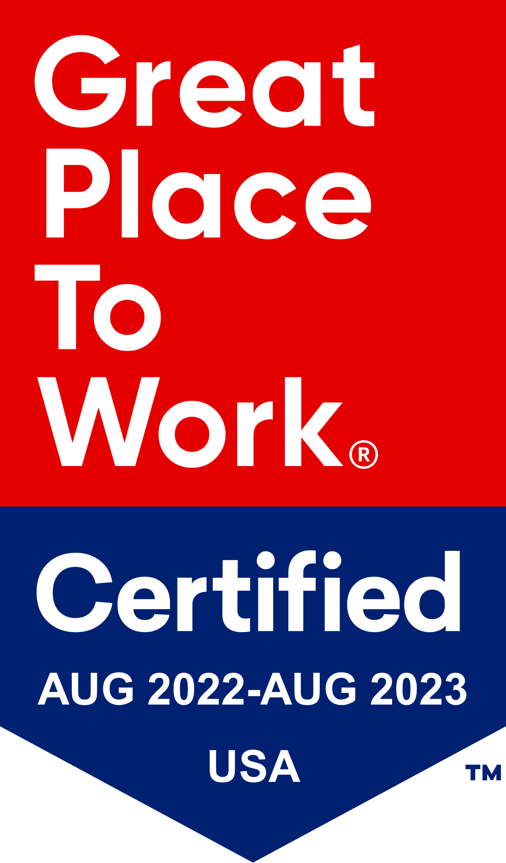
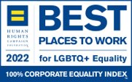
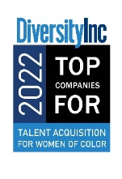
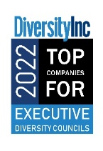
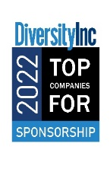
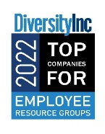
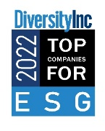
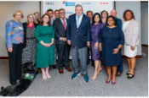
Hershey Has Earned Recognition As A Top Company For People
2021 Named #1 World’s Top Female Friendly Company
2022 Named Best Employer for Women by Forbes
Named a Great Place to Work in U.S., Mexico, Brazil, India and Europe
HSY Brazil ranked 18th across medium-sized Brazilian organizations
8X 100% rating on HRC Corporate Equality Index and 2022 Best Places to Work for LGBTQ Equality
#6 on DiversityInc’s Top 50 Companies for Diversity
10 Top Company Designations
2022 Named Canada’s Top 100 Employers
2021 Named America’s Most JUST Companies
Lead Sponsor of NOD’s 40th Anniversary event honoring Governor Tom Ridge
7x Leading Disability Employer Seals
Recognized on the Civic 50 list as Consumer Staples Sector Leader by Points of Light for the 10th straight year
2x Named Top Employers in Toronto
Wall Street Journal Management Top 250:
#28 in 2022
2022 #49 on the Workforce Equity and Mobility Ranking

Slide 5
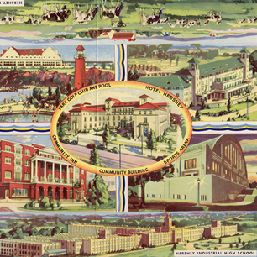
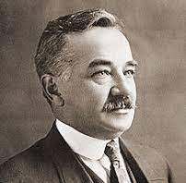
A History of goodness: What Is Unique About The Hershey Company?
1894: Hershey Company founded
1909: Milton Hershey School founded
1918: Milton Hershey School Trust Fund established
1930-45: The Great Works Project
2000: World Cocoa Foundation started
2015: Project Vivi: Fortified Peanut Butter in Ghana
Milton Hershey
Personal Values
Future Goals:
2025: 100% child labor free cocoa sourcing
2025: 100% sustainable sourcing
2030: 100% recyclable/sustainable packaging material
Hershey’s Legacy

Slide 6
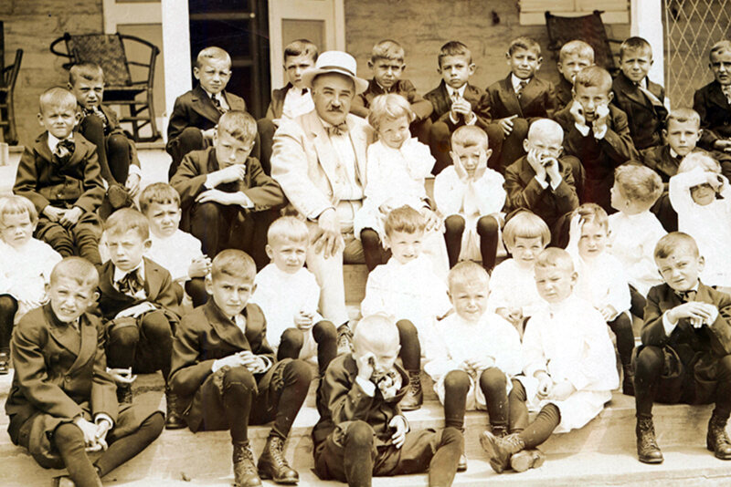
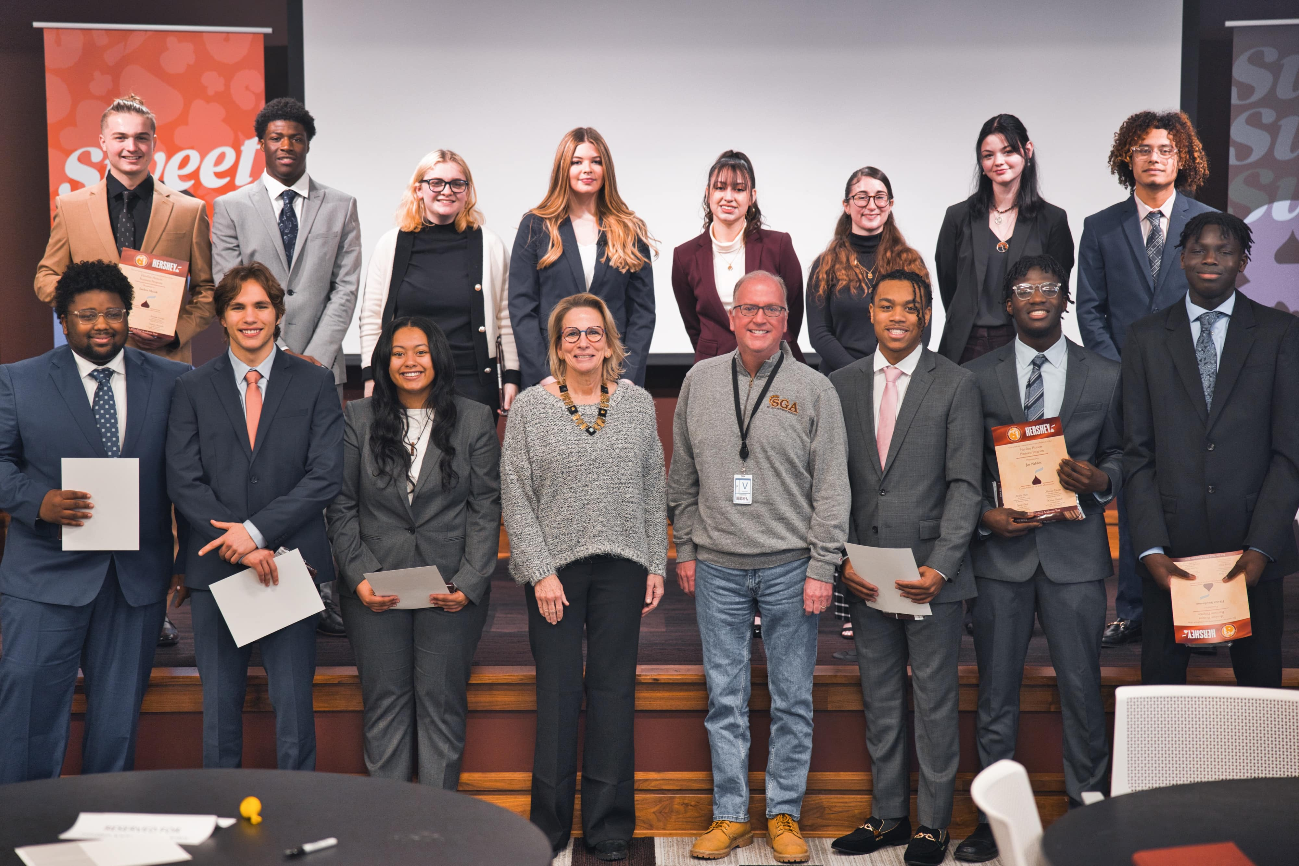
“Doing Well by Doing Good” is a core value that’s continued for over 100 years
Milton Hershey & MHS then
Hershey Company & MHS now
Milton and wife Catherine loved children, but were unable to have their own
Originally founded in 1909 as a home & school for orphaned boys as “Hershey Industrial School”
In 1918, Milton donated his entire fortune ($60M) to the school, and established the Hershey Trust Fund
Milton Hershey School Trust has controlling majority of Hershey common stock (~30% of shares)
Continued legacy of engagement through alumni career program & internships
~50 new hires between 2021-now are MHS alumni

Slide 7
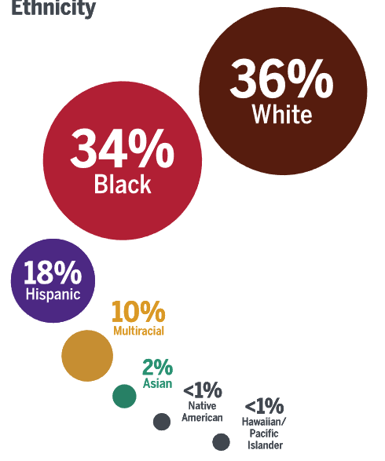
The Milton Hershey School Today: “Greater Together” by continuing to “Do Good”
Demographics
Student Population
~2,000 students
49% male / 51% female
22% from regional counties
Mission Statement
To nurtures and educates children in social and financial need to lead fulfilling and productive lives
48% from other PA counties
Avg family income $24,000
($3,000 below federal poverty line)
30% from other states
~50% experienced a traumatic childhood event
Whole Child Care Approach
Each student receives…
Best in class medical & dental coverage, & psychological & behavioral care
Food, clothes, shelter, and all transportation costs covered
All education resources covered
Continuing Hershey’s legacy of producing productive members of society
Each alumni receives…
College application assistance (for those continuing their education)
Tuition & room & board coverage at any private college
1:1 professional support for the working world

Slide 8
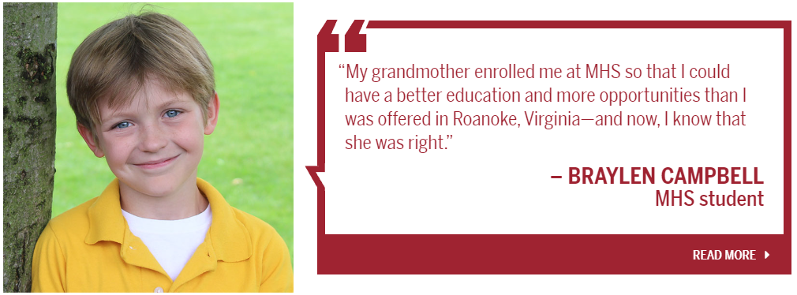
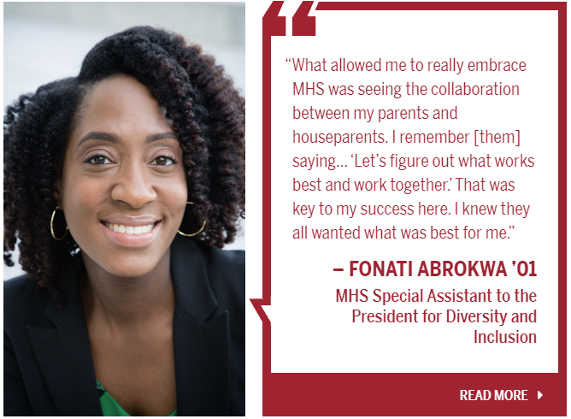
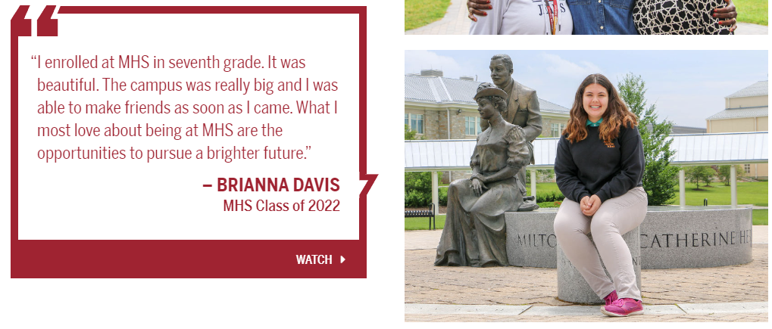
MORE OPPORTUNTIES
BEST FOR ME
DOING WELL BY DOING GOOD
FOR ME TO BE
SUCCESSFUL, I NEEDED TO TAKE ADVANTAGE
PRODUCTIVE
MEMBER OF A COMMUNITY
BRIGHTER FUTURE
GROW AS A
PERSON

