Slide 1
The Digital SAT/ACT in 2023
In Most Cases, Take the Test & Prepare Adequately
Dan Escott, Academic Director UES Education
Member of

Slide 2
What We’ll Cover
Quick intro to the Digital SAT
SAT & ACT Test Taking Trends in Test Optional Era
Implications of these Trends for UK Students (should my student sit the test?)
How to Best Prepare for the Test
A New Spicy Signature SAT Problem (if time permits)

Slide 3
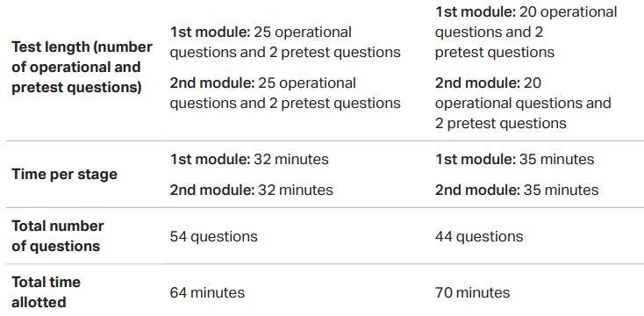
Digital SAT
1 Passage = 1 Question; Desmos; 1/3 Verbal Questions New; Adaptive by Module; No Imaginary #s

Slide 4
Number of Senior Class Test Takers (United States)
High School Graduating Class | ACT | SAT
2018 | 1,914,817 | 2,136,539
2019 | 1,782,820 | 2,220,087
2020 | 1,670,497 | 2,198,460
2021 | 1,295,349 | 1,509,133
2022 | 1,347,644 | 1,737,678
My position for UK Test Takers: ACT or Digital SAT?
Notes:
Anticipate that SAT Test Takers will Continue to Rise Close to Pre-Covid Levels. Nothing to lose from taking the test and much to gain.
My position: ACT fits quick processing speed, literal STEM students. Time restraints put a ceiling on most other students. Digital SAT is very coachable.

Slide 5
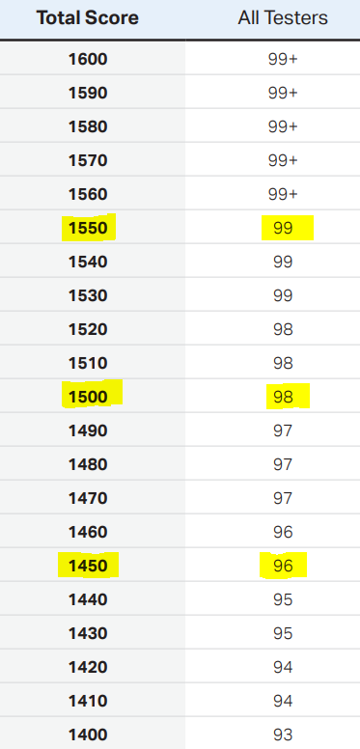
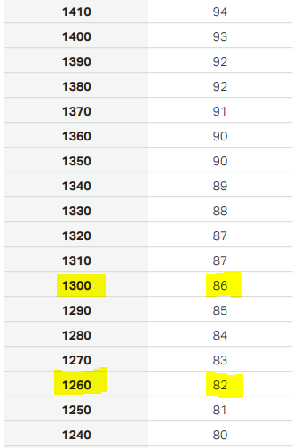

Slide 6
Test Optional & Covid
University | SAT Submitted 2021 | ACT Submitted 2021 | SAT Submitted 2022 | ACT Submitted 2022 | Median SAT Score
Princeton | 56% | 35% | 71% | 50% | 1520
Purdue | 62% | 31% | 67% | 29% | 1330
Yale | 54% | 35% | 59% | 29% | 1540
Michigan (Ann Arbor) | 54% | 32% | 54% | 24% | 1470
Emory | 37% | 27% | 41% | 29% | 1500
Boston | 32% | 13% | 23% | 12% | 1430
Notes:
Scores in the 90+ to 95th+ percentile are expected at the most competitive schools. The real question is which members of the incoming class are not submitting scores.

Slide 7
SAT by US Demographics
Notes:
More applicants, stiffer competition. Many of the non-test submitted spots go to historically disenfranchised minorities that test would’ve blocked in the past. Test becomes that much more important for everyone else in many cases.

Slide 8
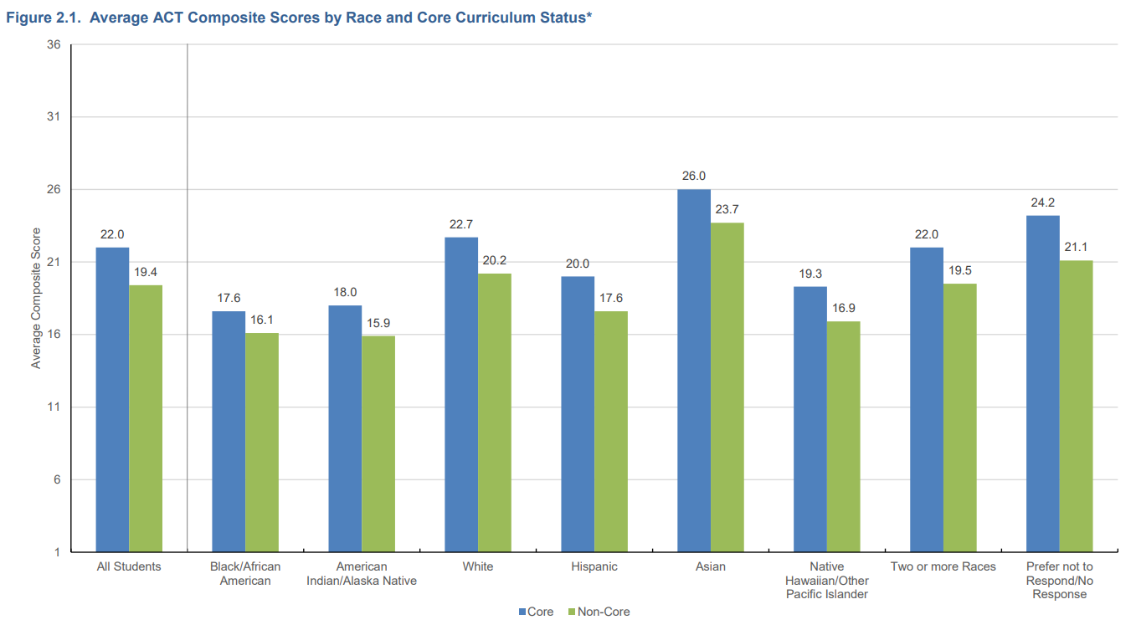
Performance Pattern Holds for the ACT

Slide 9
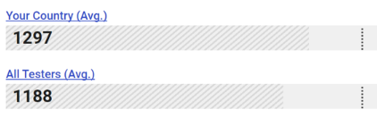
March May
UK Test Takers Are 85th Percentile
United States Average (2022): 1050

Slide 10
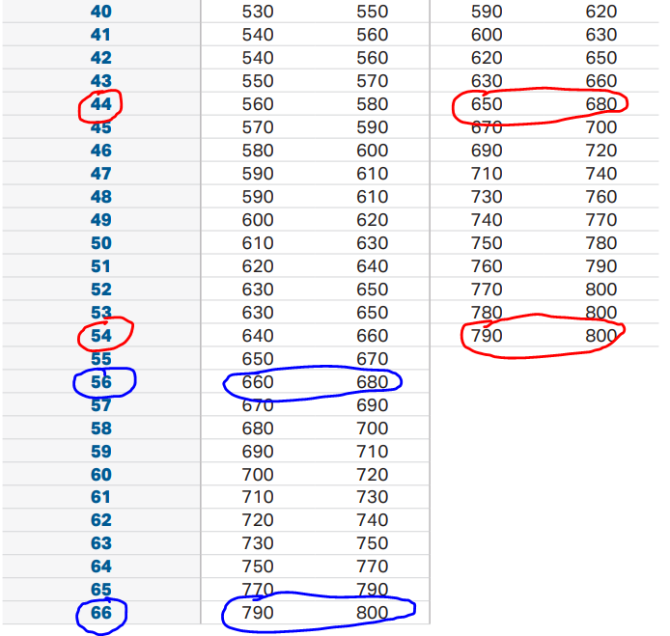
Notes:
Only 54 Verbal Questions and 44 Math Questions. There are very tight margins that create big swings with very real implications. A shorter test means each question becomes that much more impactful. Fortunately, there’s a clear, familiar path to closing the gap between starting score and aspirational score.

Slide 11
How Coachable is the Digital SAT?
Content is Finite & Defined
Content Appears in Predictable Ways: SAT has a clear Signature
Muscle-Memory Through Repetition: Problem-Solving Becomes Rote, Reduces Test Anxiety
Know exactly what you’ll see and how you’ll see it
Notes:
Discuss Each bullet point. For 2 be sure to mention no solution, infinite solutions, and more on signature with grammar problems later.

Slide 12
Digital SAT Feedback Initial Mock VS Test After Prep
Mock “Information overload”
Mock “Not sure what this question was asking”
Mock “Ran out of time on the Math Module 2”
Post Test “I felt very comfortable on how to navigate each problem”
Post Test “I think some of the exact questions we practiced appeared on the test”
Post Test “The last 2-3 questions on Math Module 2 were quite difficult, but I’m pretty sure I nailed Module 1 and all other questions on Module 2”

Slide 13
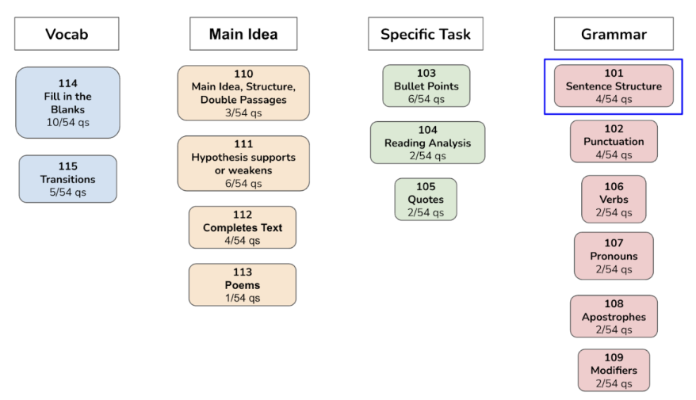
Notes:
Discuss prep tactics, amount of time needed for prep, benefit of working through packets and what it means for those with 1450+ aspirations.

Slide 14
About UES – other services
Advice and information on testing and applications
Week-long, weekly, and school courses for the SAT and ACT
ueseducation.com/courses
Private Tuition for SAT, and ACT
SAT/ACT Diagnostic Test: ueseducation.com/diagnostic
Application Support – college counselling for all parts of the process
info@ueseducation.com
+44 20 7724 8333
www.ueseducation.com

Slide 15
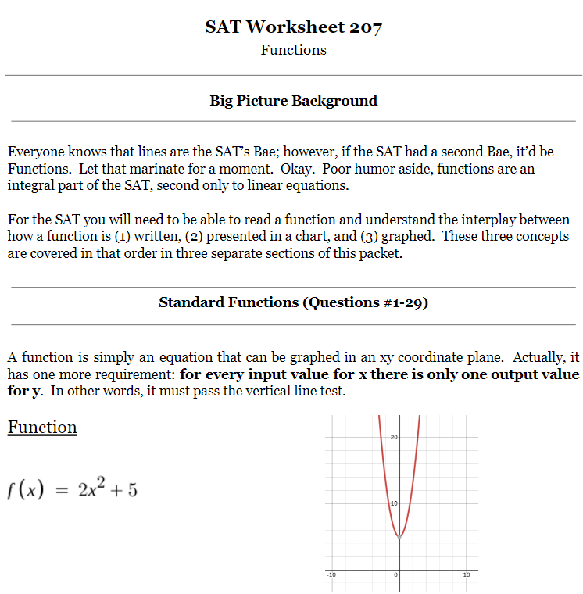
Math Coverage
201 Ratios: Unit Conversion, 2-3 Dimensional Conversions
202 Algebra: Single Variable, Systems, Linear w/Quadratic, Systems Word Problems
203 Polynomials: Quadratic Formula, Discriminant, 3 Common Quadratics, Matching Coefficients, Sum & Product of Solutions
204 Lines: y=mx+b, Linear Word Problems, Graphs, No Solutions, Parallel & Perpendicular Lines
Specific Content Changes:
2D-3D Conversions, Signature Tricky Linear Word Problem, Sum & Product of Solutions, Could be/Must Be with Vertex Form, Linear & Quadratic Translations, ASS
Desmos: Game-Changer but must be learned to utilize
Notes:
Detail of worksheets, thoroughness, critical number of practice problems to build muscle-memory. Materials from many companies just show a concept vaguely, lack nuance, and lack critical number of practice problems to create muscle-memory and confidence to perform at highest level on test day stage.

Slide 16
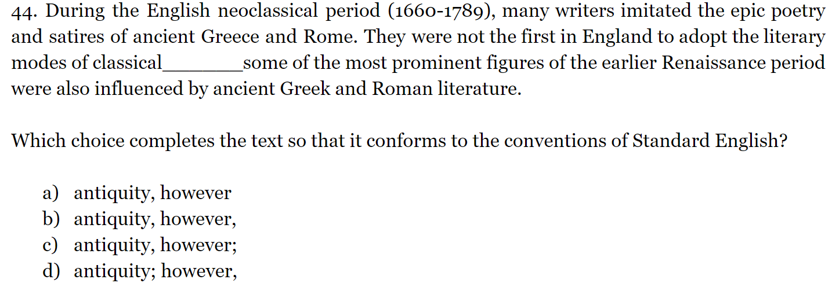
Notes:
Example of signature

Slide 17
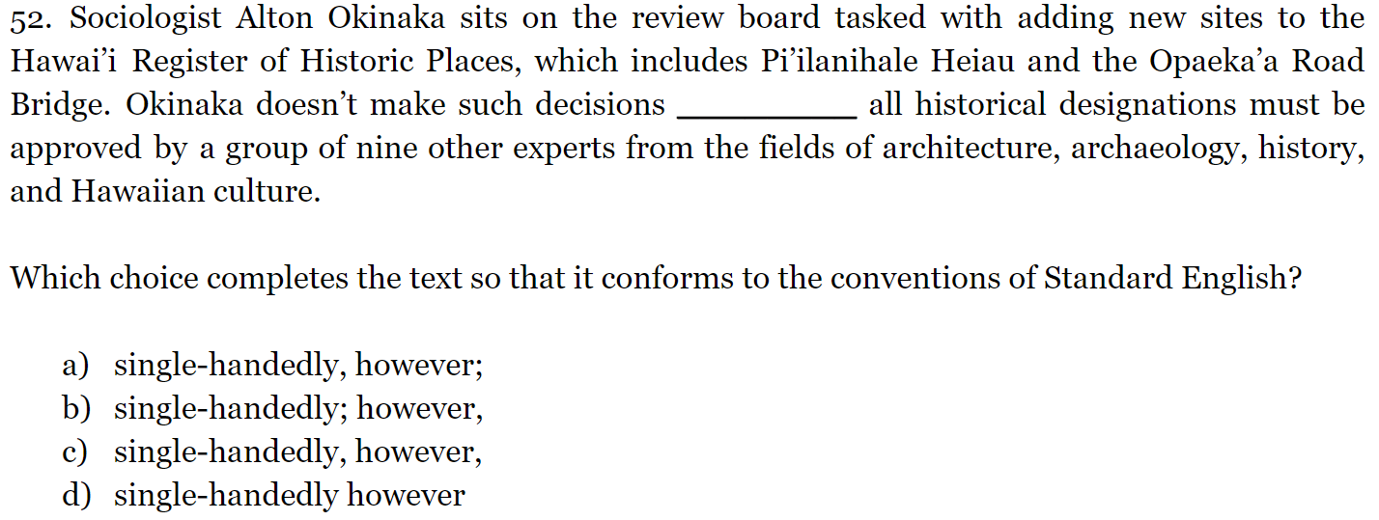
Notes:
Example of Signature

Slide 18
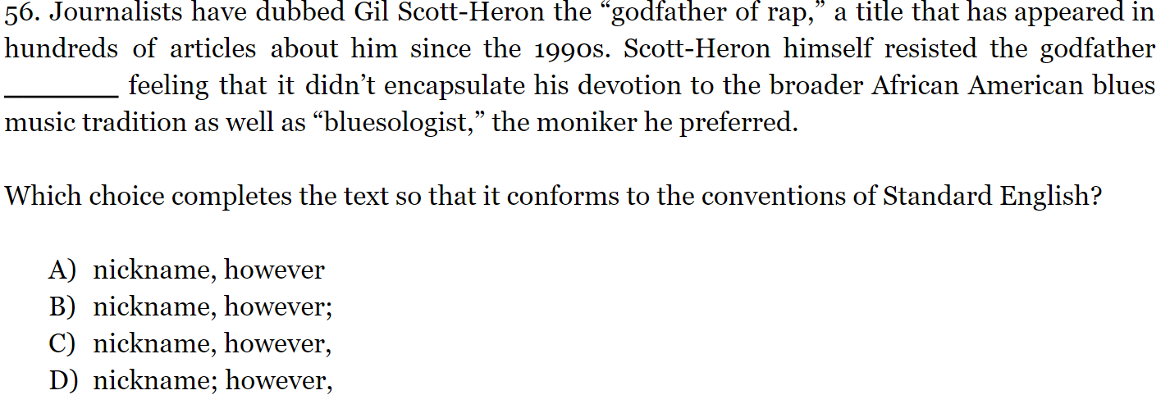
Notes:
Example of Signature

Slide 19
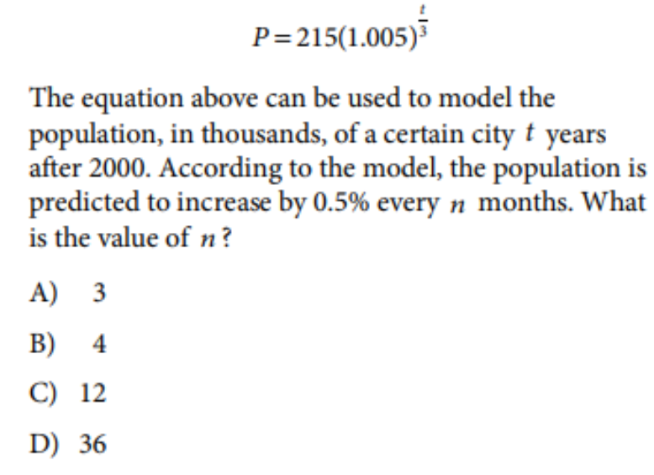
Notes:
Won’t get to this but still want it here to have option to show people at lunch who are curious.

Slide 20
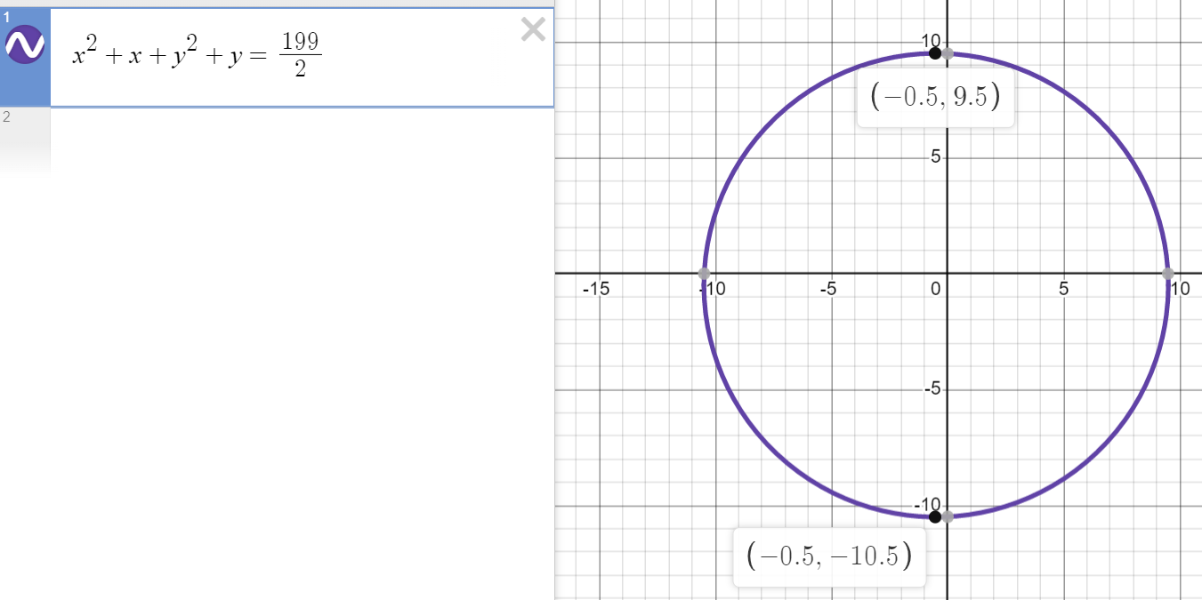
Notes:
Won’t get to this but still want it here to have option to show people at lunch who are curious.

Slide 21
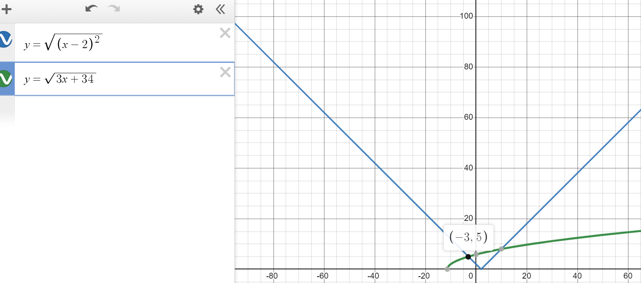
Notes:
Won’t get to this but still want it here to have option to show people at lunch who are curious.

Slide 22
Notes:
Won’t get to this but still want it here to have option to show people at lunch who are curious.

Slide 23
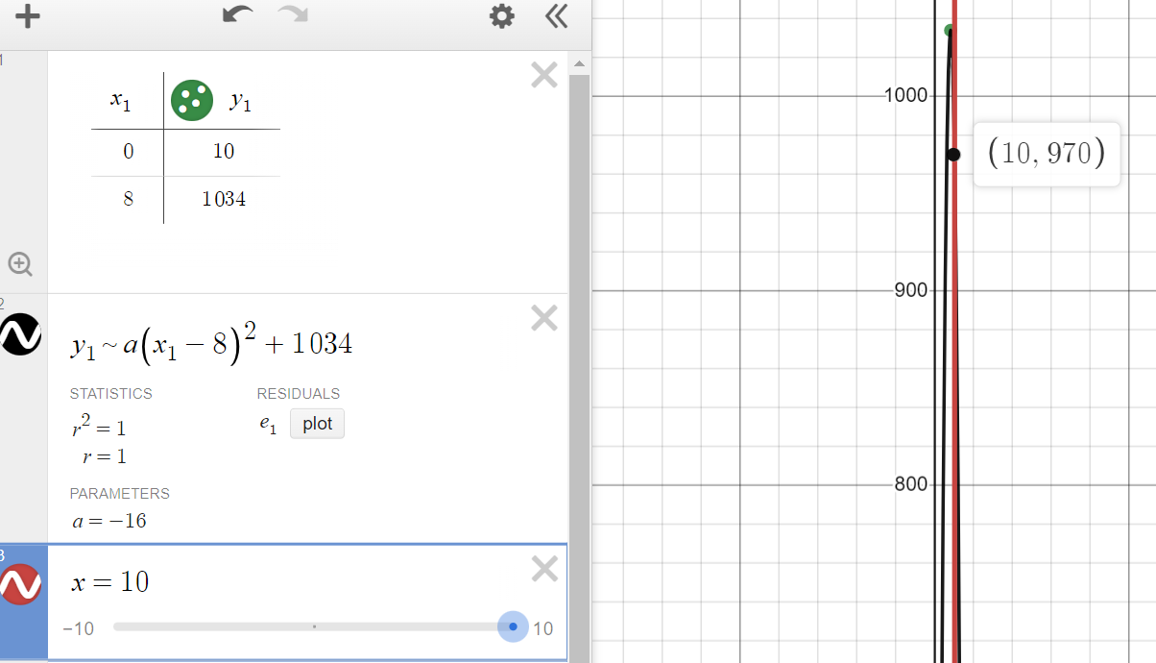
Notes:
Won’t get to this but still want it here to have option to show people at lunch who are curious.

