Slide 1
Donald Lush
Careers Consultant for Researchers
King’s College London
@donald_lush
donald.lush@kcl.ac.uk

Slide 2
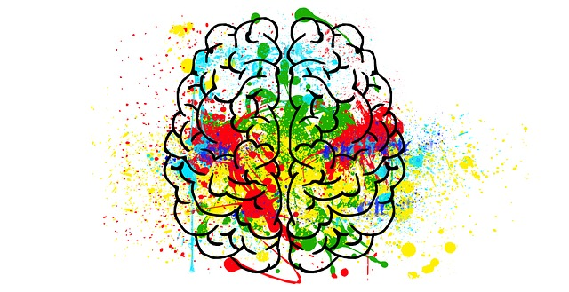
The One Over Many Problem

Slide 3
Apple

Slide 4
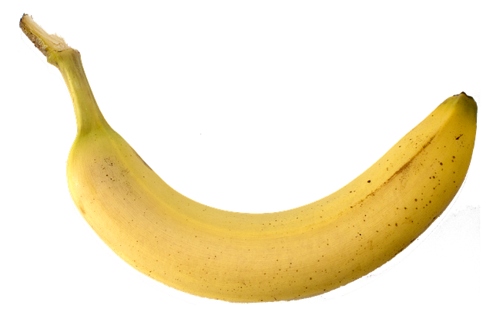
Banana

Slide 5
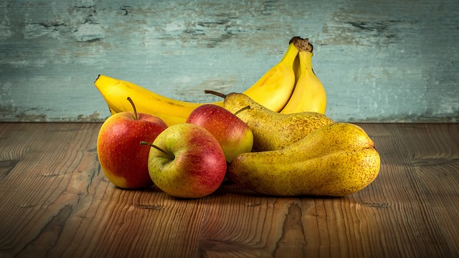
Fruit

Slide 6
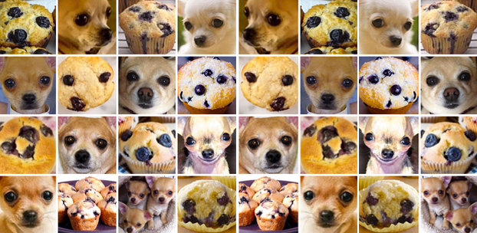
Dog or cake?

Slide 7
How do we classify things?
We say apples and bananas are the same kind of thing
We don’t say that chihuahuas and muffins are the same kind of thing

Slide 8
If we can’t sort things into categories we cannot claim to know anything. Imagine trying to identify an apple, each time you see one, without having the concept of ‘apple’ or ‘fruit’.

Slide 9
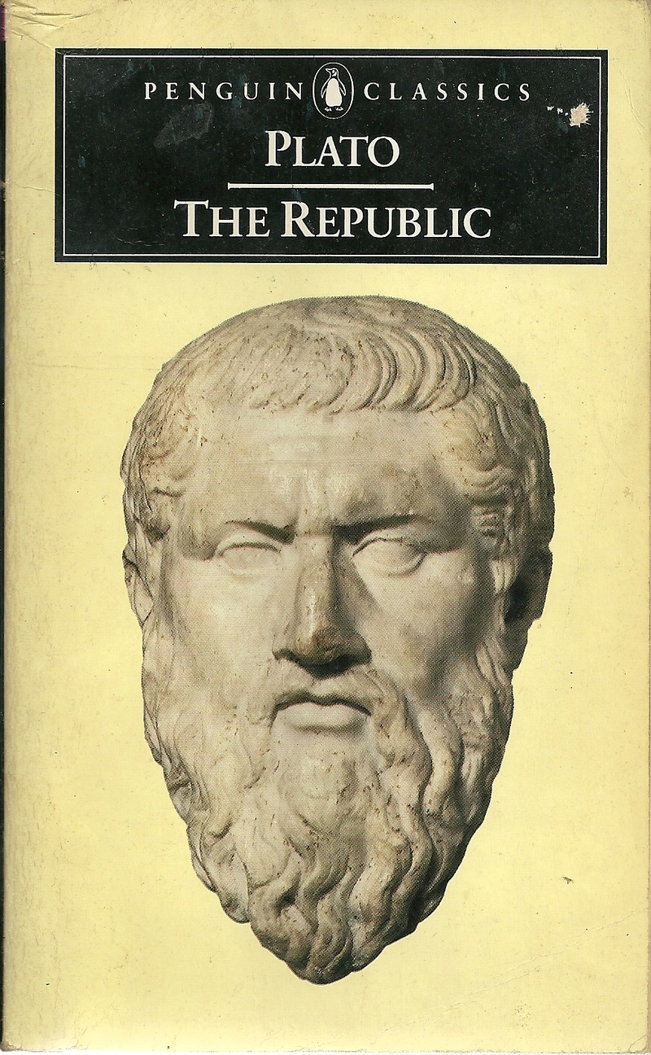
We customarily hypothesize a single form in connection with each collection of many things to which we apply the same name.
Plato: Republic

Slide 10
Form – Somehow apples and bananas are material manifestations of a divine, non-physical, perfect prototype version of themselves, according to Plato.

Slide 11
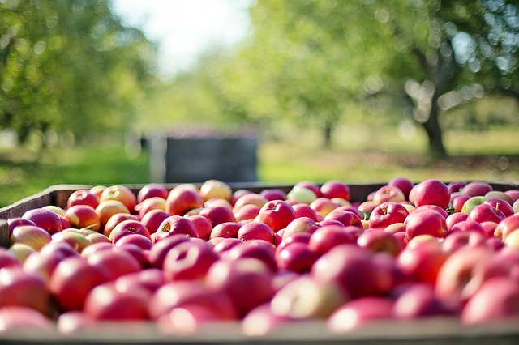
You may have some questions about how this works
You wouldn’t be alone in that

Slide 12
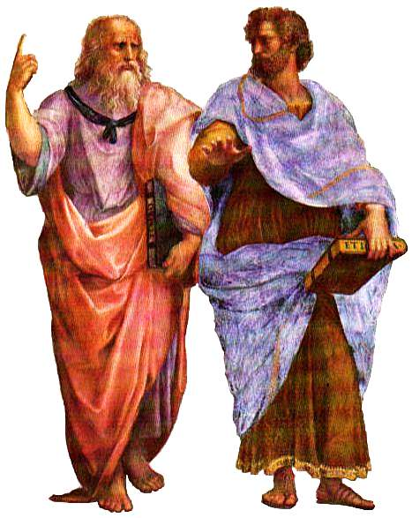
Plato and Aristotle
Aristotle didn’t agree with Plato
He said the form of an object was contained within it. An apple contains the essence of apple-ness and so on
He preserved our ability to think about things in groups without mysticism
In doing so, he was thinking in a way that has much in common with modern science

Slide 13
What’s the connection with our work?

Slide 14
Our modern process of recruiting solves the one over many problem by looking for people who match the form (essence) of the ideal candidate as far as possible. We’re all followers of Aristotle.

Slide 15
But remember this? It was the result of an AI programme trying to classify things according to an Aristotelian concept of forms, using visual similarity as a way of finding a match

Slide 16
Is there a hidden epistemology* problem in careers advice?
*theory of knowledge

Slide 17
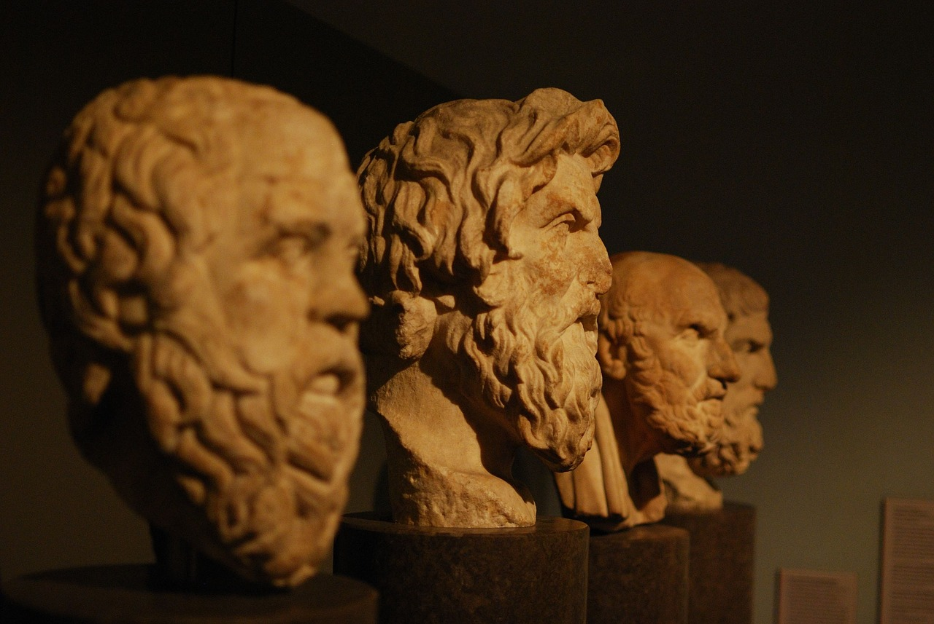
Plato – knowledge as justified true belief

Slide 18
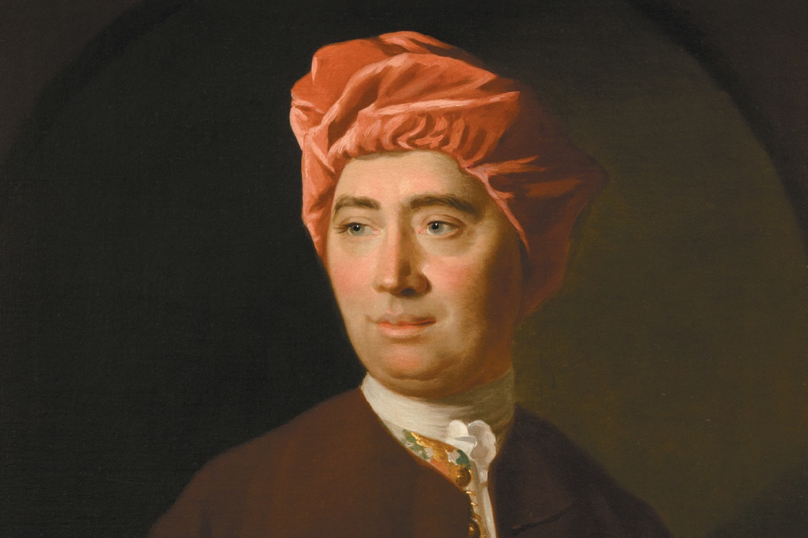
Hume
Reason is a slave to passion
David Hume

Slide 19
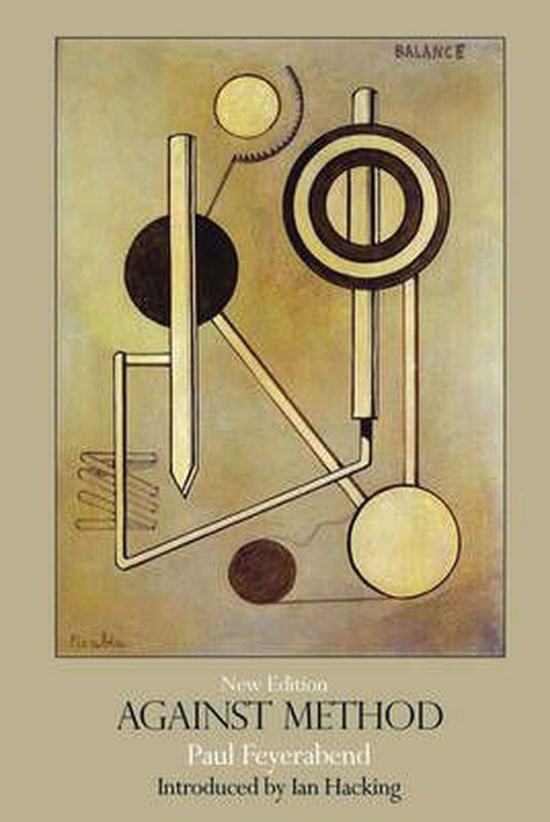
Science blooms by wild ideas and is not different from ideology and myth
The questions you ask determine the answers you get – method is a limiting process
Science doesn’t follow the processes it claims to follow to gain knowledge

Slide 20
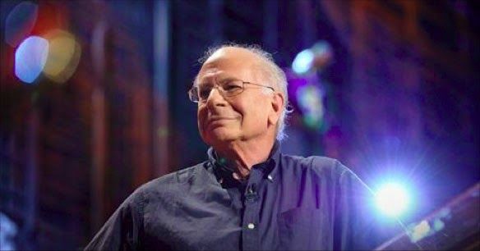
Daniel Kahneman – Nobel Prize winner in Psychology
Began work helping the Israeli army identify candidates for officer training
Created what we now call job descriptions and person specifications
Improved officer selection but eventually decided he wasn’t measuring what he thought he was measuring
Concluded that confident, motivated people do well in any job and his system was measuring those qualities without realising

Slide 21
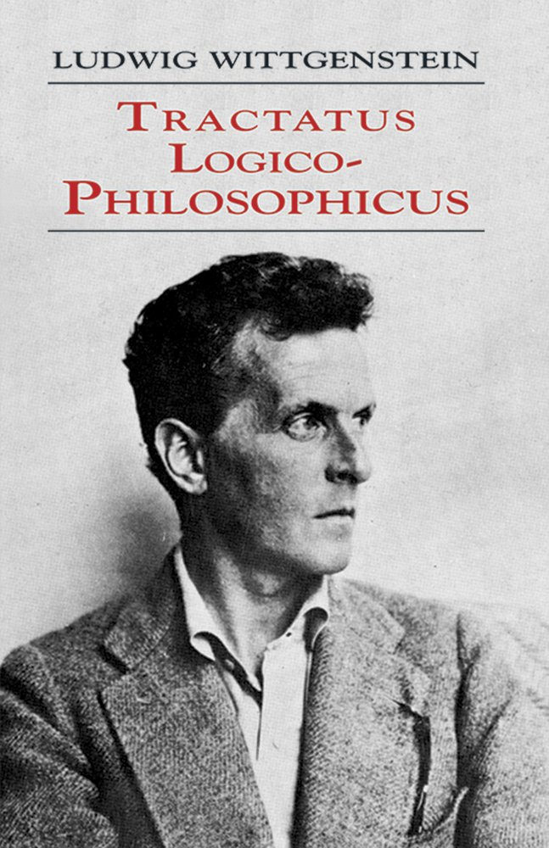
How might you offer careers advice to Ludwig Wittgenstein?
A philosopher who believed philosophy was worthless
An engineer who abandoned engineering
An academic who only published one book, which he despised
A porter at Guy’s Hospital
Long periods of despair and inactivity

Slide 22
Provocations
Our work is a solution to the one over many problem
But is it the ‘right’ or the only one? Are we really doing the things we think we’re doing?
What if we used wild ideas or emotions or confidence or motivation as our focus?
What would a careers service look like that did this?
What would a recruitment process that did this look like?
In what ways would things be different or better?

