Slide 1
HESCU Research Project – Conceptualisations of employability from FE and HE cohorts at Writtle University College
Mark Yates
Careers Adviser

Slide 2
Objectives for today
How did it come about? – Context is everything?
Findings and recommendations
Further research?

Slide 3
How did it come about? Context is everything?
Various reasons for research topic
Small number institutions with FE and HE cohort
Most college staff predominately work with FE or HE
As the only adviser working with both cohorts – common issues?
Need for research based practise, how to ‘promote’ the service internally

Slide 4
National parallels between cohorts
FE careers landscape
Gatsby Benchmarks
CEC
Careers Development Institute
Destinations measure/Ofsted
Research focus
11% FE taught in HE
HE careers landscape
- TEF/REF
- HEPI, Wonke, Prospects
- AGCAS
- DHLE/LEO/GO
- Research focus
- Small number of HEI’s have FE cohort

Slide 5
Research process
Sept-Dec - literature review and identifying issues
December – construction of staff and student surveys
January/February – survey completion (134 students, 50 staff)
April/May – analysis and additional lit review
July-Sept – Write up

Slide 6
Issues explored
Definitions of employability – what students and staff thought
Identity – is it an issue?
Part time work – usefulness for employability
Employability – whose responsibility is it anyway?

Slide 7
Employability definitions
FE/HE cohorts and staff ranked definitions…..
1) developing the skills/attributes to help them move from education to work,
2) developing the skills/attributes that employers want
3) developing the right identity
4) just about getting a job straight after studying
Notes:
What does this mean?
Longer term than immediate outcome
About their skills/attributes more than employers views
Tied in with this, ‘identity’ - slightly

Slide 8
What does employability ‘look like’? Student view
A good CV
A successful transition to working
Getting a ‘good’ job after studies
Better student outcomes for the university college
A successful transition to further studies
A linkedIn profile 22% of FE, 54% of HE

Slide 9
Staff
Practical outcomes of employability – descending order
Students moving onto a successful outcome
Increased % getting ‘good’ outcome
A good CV
TEF/Ofsted outcomes
LinkedIn profile
Notes:
Staff views on employability similar

Slide 10
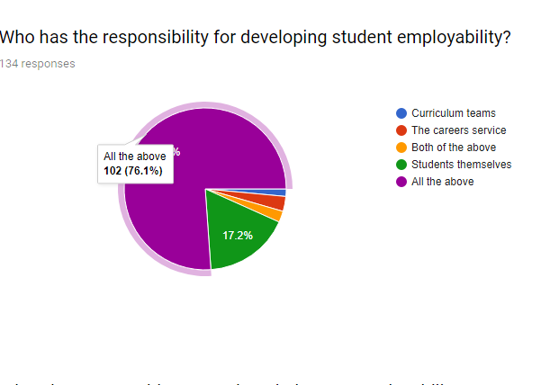
Whose responsibility is employability?

Slide 11
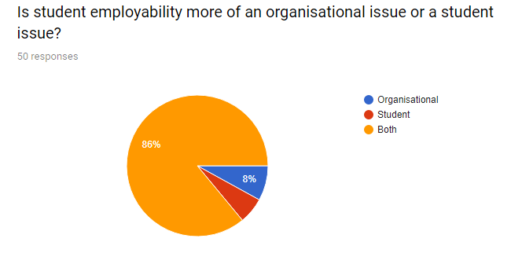
Whose responsibility is it? Staff view

Slide 12
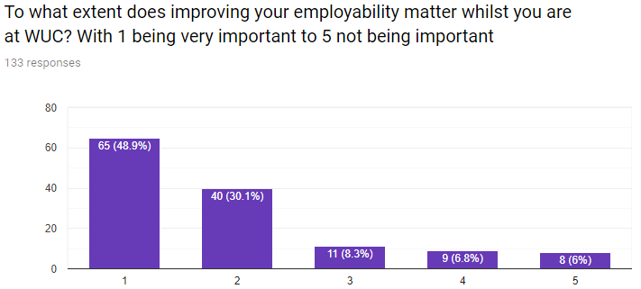

Slide 13
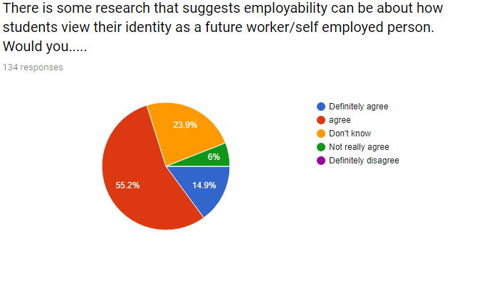
Identity – student view
Notes:
70% agree/strongly

Slide 14
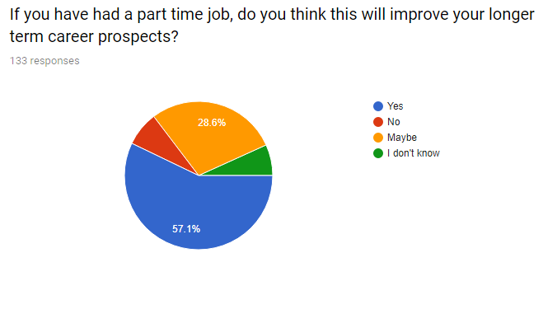
Part time work - does it help?

Slide 15
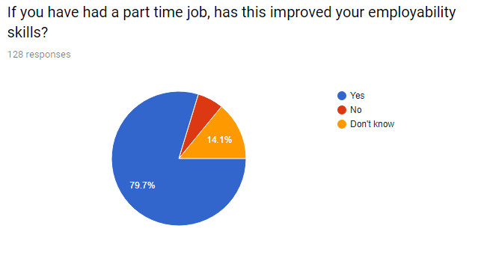
Part time work, does it help?
Notes:
57% part time job helps longer term career aspirations
79.7% part time job helps employability
Why? – Students not sure what longer term career ideas are, but employability is more about developing skills/career management skills now, combined with identity dev

Slide 16
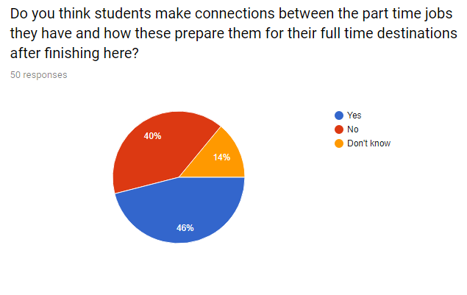
Part time work - staff

Slide 17
Qualitative answers
These provided ‘richness’ to findings, e.g.
‘within my friend groups it is very obvious who works and who doesn’t when it comes to client communications and confidence’
‘my confidence would be nowhere near where it is now was I not working in a shop 2 days a week’
‘its given me more insight into working in a business’
‘gives you an understanding in the work place and what’s expected of you’

Slide 18
FE vs HE
More HE students could see the value of world of work experience, and transferability
FE students viewed work more as ‘separate’ to current learning and less useful if not in vocational/curriculum area
Similarities – all wanted more employability inputs, e.g. employer contact, employability advice, guidance support

Slide 19
Staff
Staff think students didn’t always made the connection between world of work and learning
Staff were very sure that developing employability is everyone’s responsibility, not just WUC’s or students
Issues around what employability means for different cohorts
2/3’s of staff thought that identity development was important as an employability issue, the research and students agreed

Slide 20
Recommendations
Self audit of skills/attributes – start, middle and end of course
- would be invaluable to show ‘distance travelled’/learning gain
Part time work/work experience evaluation
- More evaluation of the impact of part time work/work experience, as a continued process would be useful
Employability workshops
- students claimed they wanted more optional workshops, but experience of student engagement issues?

Slide 21
More findings
Early student engagement with employability crucial
- employability skills, social capital, evaluation takes time
Preparing students better for developing ‘working’ identity
- likely to need specific acitivities for this, consultancy projects, client work etc.
Non careers staff engagement
employability skills enhance learning skills, academics engagement helps to improve student’s employability

Slide 22
Wider findings
AGCAS 1st year career readiness survey and HEFCE Careers Registration – both provide invaluable insights
Mapping of links between Gatsby Benchmarks, CDI framework, HEA employability framework, and research findings across FE/HE
Informing practise and knowledge exchange between FE and HE careers sectors important, FE careers patchwork vs HEI provision

Slide 23
Further research questions
The relevance, usefulness and evaluation of part time work/WRL aspects of a student’s career development thinking/planning
Identity and how this can be developed for leaving study, and how HEI careers services/graduate employers could develop their practises to help
To consider if FE cohorts has differing employability issues when progressing onto HEI’s in comparison to 6th form or independent school students

Slide 24
If you want to read the report
The report will be published in full soon, and be available at
https://luminate.prospects.ac.uk/tag/reports

Slide 25
QUESTIONS?

