Slide 1
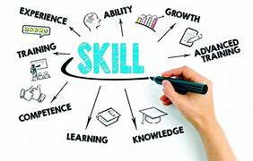
Careers
In Careers, Magpies 1 have been discussing possible jobs for the future, how you can access these jobs regarding the relevant qualifications and looking into a standard working day in some of these roles too. As a class we discuss the skills needed to be able to work as part of an effective team in the workplace, and important components for a CV and covering letter.
As a class we discuss current skills we have and how they can be implemented into the workplace.

