Slide 1
Practice Nurse IPC Forum
Speakers:
Sharon Egdell Strategic System Lead IPC
Erika Bowker Quality Lead Primary Care
IPC queries syheartlandsicb.shipc@nhs.net

Slide 2
Agenda
National IPC manual
Norovirus
Top Tips for Staying well this winter

Slide 3
Let's not forget the basics – Standard Infection Control Precautions are an essential part of day-to-day practice ( for ALL staff)
NHS England » Chapter 1: Standard infection control precautions (SICPs)

Slide 4
Norovirus:
Spread by faeco- oral route
Only takes a very small amount of virus particles to make you unwell
Higher than normal number of confirmed cases this year ( compared to same period)
Virus can be shed by people who are not yet displaying symptoms
Environment can very easily become contaminated :
Vomiting Larry - A demonstration and explanation from his creator - YouTube

Slide 5
Staying well this winter:
Top Tips for staying well this winter:
Workstation Hygiene
Hand Hygiene
Food/ beverage hygiene

Slide 6
Think about how many hands touch a workstation in one day :
Workstation hygiene:
Use a combined detergent and disinfectant wipe (e.g. Green Clinell or similar) to clean your keyboard, mouse, telephone and headset at the beginning and end of each shift/ working day. (Remember to use 1 wipe per surface (do not clean multiple surfaces with the same wipe)
Clean using an “S” shape motion to avoid cross contamination
Allow at least 60 seconds contact time and allow the surfaces to air dry
Keep your workstation clutter free and clear away personal items at the end of each day. This will ensure that the workstation area can be cleaned properly
Avoid consuming food at your workstation:
If there is no alternative – clean your workstation and wash your hands before eating. Avoid touching any workstation equipment or mobile devices whilst you are eating

Slide 7
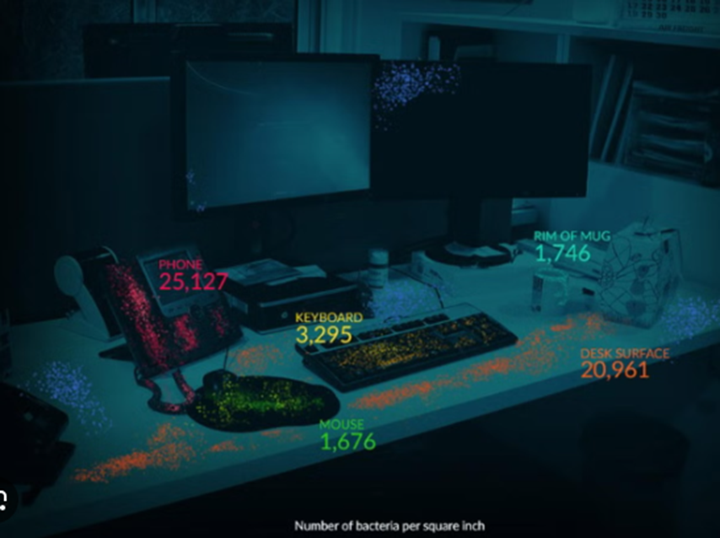

Slide 8
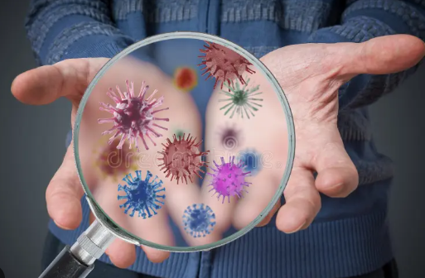
Hands are the most efficient way to spread infections:
Hand Hygiene:
Wash hands with soap and water for at least 20 seconds:
On arrival at work
After cleaning your workstation
After using the toilet
After coughing/ sneezing into a tissue
Before and after using PPE
Before and after refreshment breaks
Before preparing food

Slide 9
Food/ beverage hygiene :

Slide 10
MPox
NHS England » Clade I mpox (MPXV) pathway actions: patients self-presenting in general practice
Do you know what to do if you had a suspected case?
We have had a suspected case in Surrey recently

Slide 11
Hydrate to Feel Great- why is this so important ?
powering people to self-care with person-centredmprovement Lead
Notes:
Thank you for inviting me to join the meeting today to give an update on this project

Slide 12
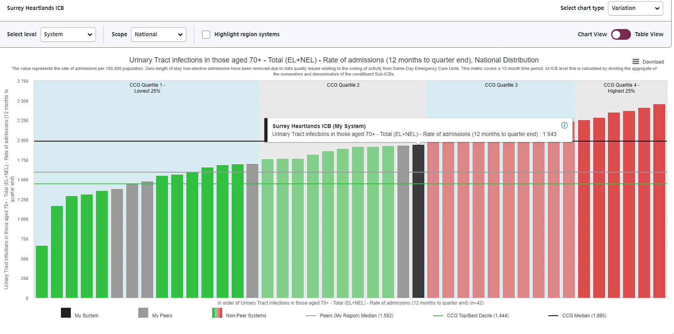
Urinary Tract infections in those aged 70+ - Total (EL+NEL) - Rate of admissions (12 months to quarter end). Data accessed November 2024
Surrey Heartlands ICS continues to experience the highest rate of hospital admissions for UTI’s in the over 70’s and for those age 65+ living with dementia, when compared with the other 5 ICB’s in the Southeast Region
These patients are mostly admitted from their own home
We CAN reduce these rates- UTI’s should not be accepted as an inevitability of aging

Slide 13
Urinary Tract Infections - Non-elective - Rate of admissions in those aged 65+ with dementia coded in any position in spell (12 months to quarter end). Data accessed November 2024

Slide 14
Rate of community-onset community-associated E.coli bacteraemia per 100,000 age-sex weighted population (12 months to quarter end). Data accessed November 2024

Slide 15
Hydrate To Feel Great resources:
For further information on Hydrate to Feel Great contact:
Email: sxicb.sehydratetofeelgreat@nhs.net
www.sussex.ics.nhs.uk/hydrate-to-feel-great
For more advice on dehydration including a useful video:
www.nhs.uk/conditions/dehydration
For advice on incontinence and Urinary tract infections:
www.nhs.uk/conditions/urinary-tract-infections-utis
www.nhs.uk/conditions/urinary-incontinence

Slide 16
Video Resources:
https://www.dropbox.com/scl/fo/wv2zc5m8dzd07yxxv8kfb/ABo85hpLqTsJEsRk6z-3eko?rlkey=ss27p60e29y0w689oaq2yq3r3&dl=0

Slide 17
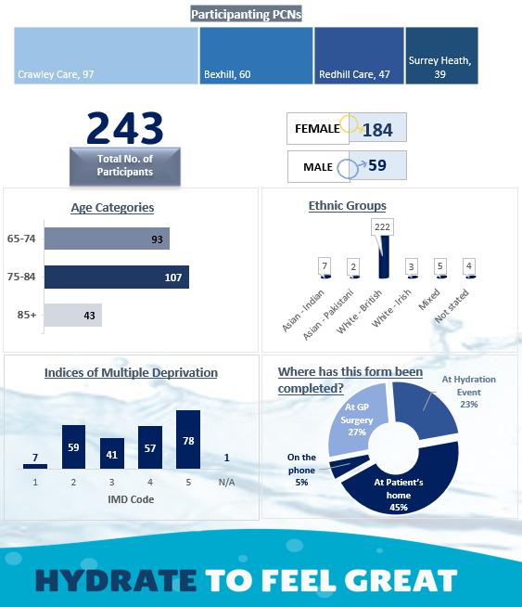
PDSA 2 demographics
Notes:
I want to share the PDSA 2 data with you now that is complete
The age and gender profile is similar across all PCNs
We have looked in more detail at the ethnic groups as we were concerned by the low numbers of non-white ethnic groups. We found is that this is very similar to the ethnic group profile seen in the PCN level data on over 65 year olds diagnosed with a UTI, which is the group of people who were invited to take part.

Slide 18
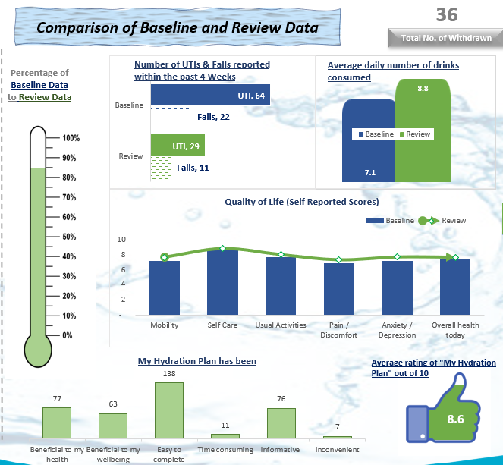
PDSA 2 impact
Notes:
We can see a reduction in self-reported UTIs and a drop in the number of falls experienced over the 4 weeks
On average participants increased their fluid intake by 1.7 drinks per day
We saw small improvements in the standardized QOL scores – the green line is above the blue bars – we have some more specific data on how participants felt they benefited in a moment

Slide 19
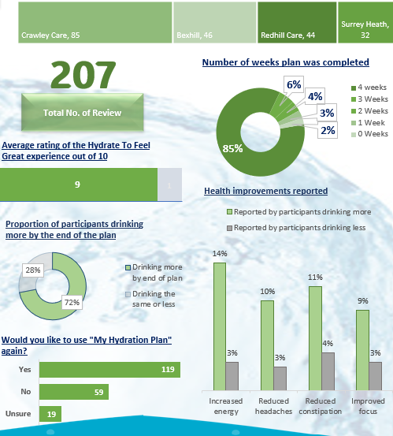
PDSA 2 evaluation
Notes:
Here we can see the participants rated their experience highly = 9/10, in fact over half would be happy to complete Hy Hydration plan again.
Nearly ¾ of those who took part reported drinking more by the end of the 4 weeks & those participants who increased their fluid intake over the 4 weeks were more likely to report a reduction in headaches & constipation and increased energy & ability to focus.

Slide 20
Questions
Please email to:
syheartlandsicb.shipc@nhs.net
Thankyou for your support to achieve continuous IPC improvements within the system

