Slide 1
Improving Hydration in the community
Sharon Egdell IPC Lead for the Integrated Care System
IPC queries syheartlandsicb.shipc@nhs.net
October 2025

Slide 2
Why is hydration so important ?
Reduction of Urinary Tracy Infections ( UTI’s):
  Reduces the need for antibiotics- antibiotics increase the risk of developing C.diff infection ( associated with increased mortality) , resistant organisms ( less choices of antibiotics available to treat severe infections, e.g. Sepsis)
  UTI’s increase your risk of developing a Blood Stream Infection (BSI)
Reduces likelihood of falls- less Ambulance attendances, increased confidence and independence, better quality of life :
  Reduces hospital attendances/ admissions ( hospital admissions increase the risk of developing Healthcare Associated Infections
    Individuals decondition from the moment they go into hospital – increasing the likelihood of needing increased levels of care on discharge

Slide 3
Surrey Heartlands position:
E Coli Blood Stream Infection (BSI) rates- 414 cases reported so far, this financial year ( against an NHSE Standard Contract threshold of 714) .
Klebsiella Blood Stream Infection (BSI) rates- 115 cases reported so far, this financial year ( against an NHSE Standard Contract threshold of 216)
Both organisms are associated with UTI’s
The highest numbers of cases are reported in the Community Onset Community Acquired (COCA) UKHSA defined category- important to note patients with BSI will be admitted to hospital. (i.e. Any case reported by an NHS acute trust not determined to be Hospital-Onset Healthcare Associated but where the patient has not been discharged from the reporting organisation within the past 84 days, to the current specimen date (Where date of discharge is day 1).

Slide 4
E Coli BSI reported cases to date ( Sept 2025) :

Slide 5
Klebsiella BSI reported cases to date ( Sept 2025)

Slide 6
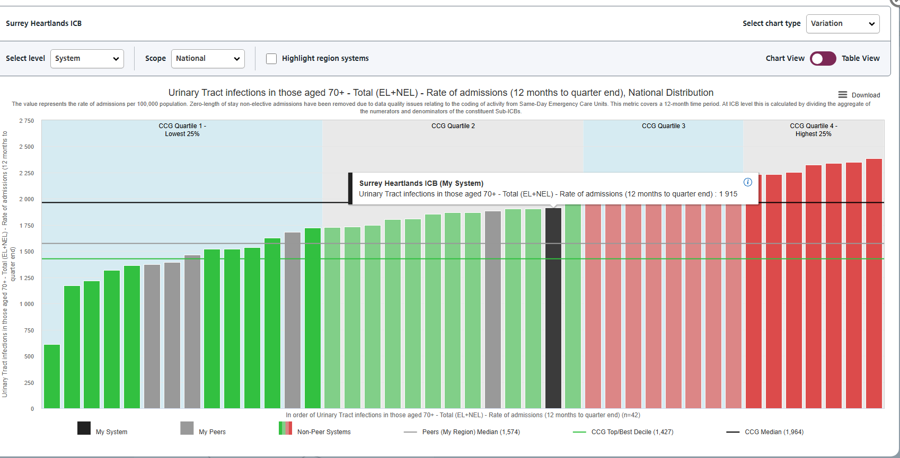
Urinary Tract Infections – UTI Model Hospital data:
Urinary Tract infections in those aged 70+ - Total (EL+NEL) - Rate of admissions (12 months to quarter end)

Slide 7
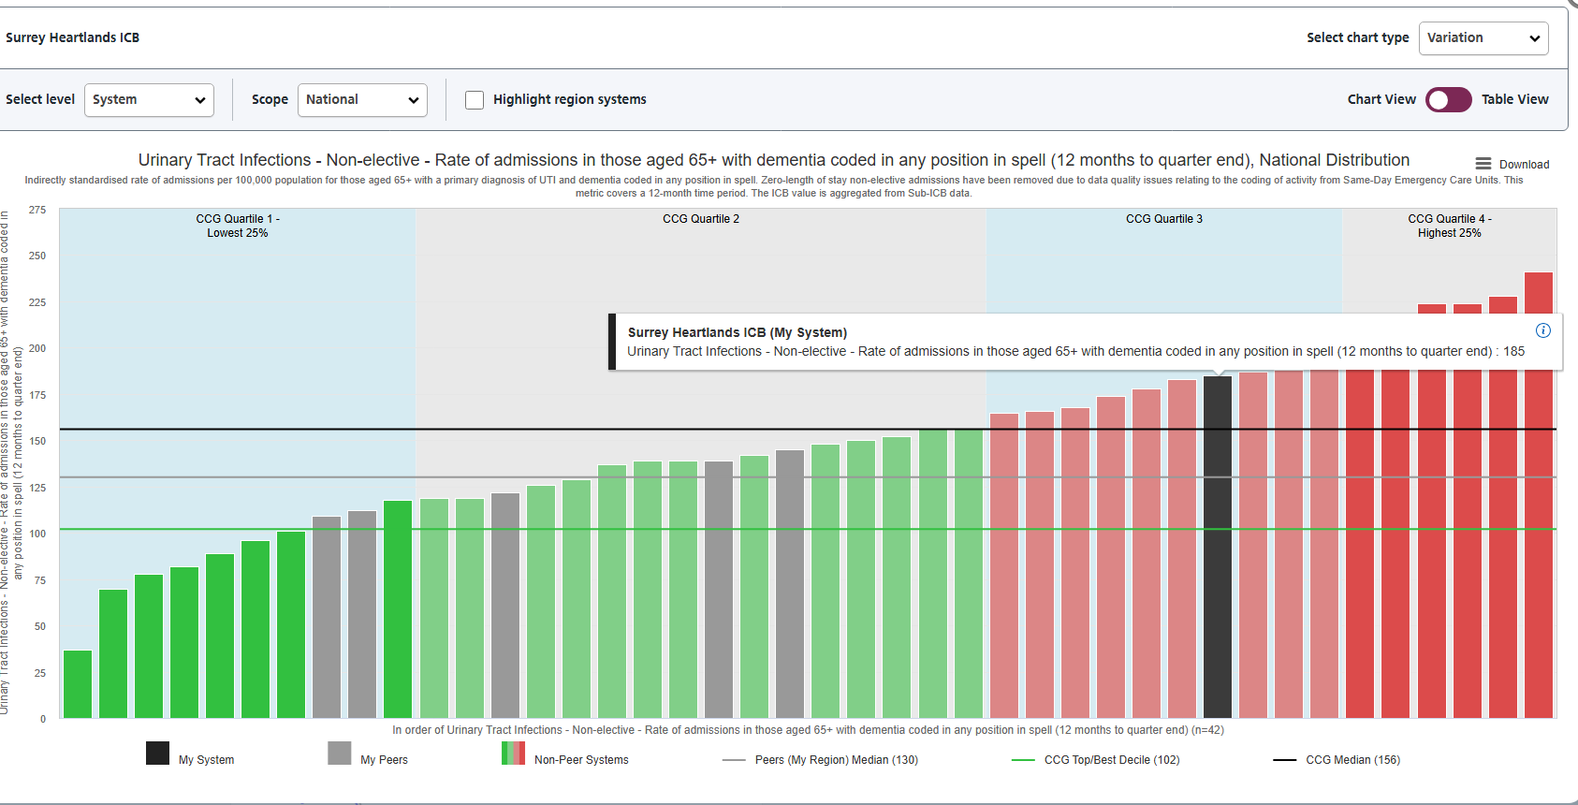
Urinary Tract Infections - Non-elective - Rate of admissions in those aged 65+ with dementia coded in any position in spell (12 months to quarter end)

Slide 8
Hydrate to Feel Great
Empowering people to self-care with person-centredmprovement Lead
Notes:
Thank you for inviting me to join the meeting today to give an update on this project

Slide 9
Project summary:
In 2022, NHS England’s Antimicrobial Resistance (AMR) Programme funded a series of hydration pilots to support the development of a knowledge base regarding which hydration interventions can effectively increase fluid uptake in older people.
Improved hydration was expected to prevent or reduce the incidence of urinary tract infections (UTIs), and antimicrobial resistance which is a core priority of the AMR National Action Plan.
The Southeast regional Hydration project was undertaken collaboratively by NHS Surrey Heartlands, NHS Frimley, and NHS Sussex. Pilot was a 2-year programme with a dedicated financial envelope.
The aim of the improvement project was to:
  Empower people to self-care with person centred hydration planning.
  To improve hydration in the over 65 years population, living in their own homes in the community within the Southeast Region.
  To support the reduction in Urinary Tract Infections (UTIs) by improving hydration status.
  The tool had to be easy to use across communities, and effective at improving fluid intake.

Slide 10
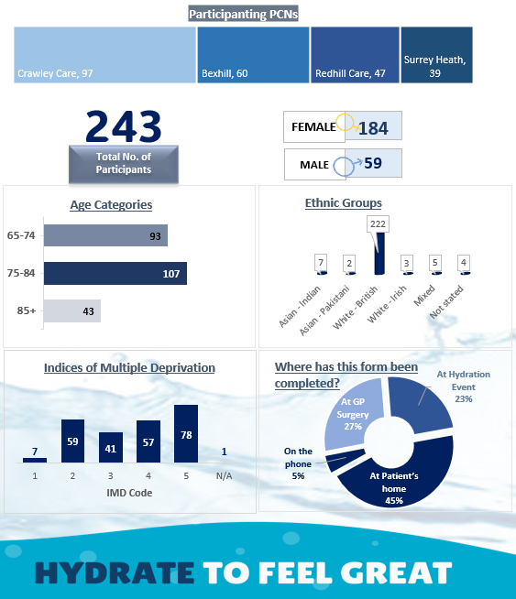
PDSA 2 demographics
Notes:
I want to share the PDSA 2 data with you now that is complete
The age and gender profile is similar across all PCNs
We have looked in more detail at the ethnic groups as we were concerned by the low numbers of non-white ethnic groups. We found is that this is very similar to the ethnic group profile seen in the PCN level data on over 65 year olds diagnosed with a UTI, which is the group of people who were invited to take part.

Slide 11
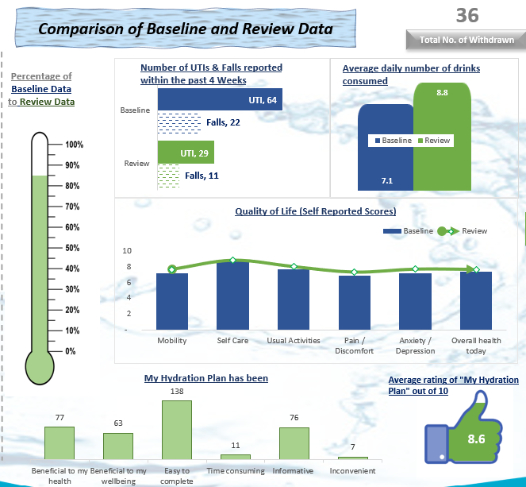
PDSA 2 impact
Notes:
We can see a reduction in self-reported UTIs and a drop in the number of falls experienced over the 4 weeks
On average participants increased their fluid intake by 1.7 drinks per day
We saw small improvements in the standardized QOL scores – the green line is above the blue bars – we have some more specific data on how participants felt they benefited in a moment

Slide 12
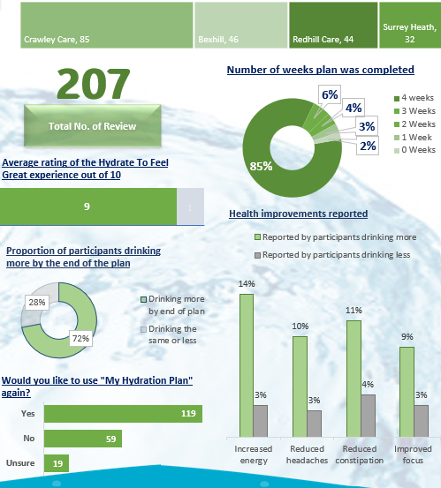
PDSA 2 evaluation
Notes:
Here we can see the participants rated their experience highly = 9/10, in fact over half would be happy to complete Hy Hydration plan again.
Nearly ¾ of those who took part reported drinking more by the end of the 4 weeks & those participants who increased their fluid intake over the 4 weeks were more likely to report a reduction in headaches & constipation and increased energy & ability to focus.

Slide 13
Participants feedback:
75% of people who took part completed drinks diary for the full 4-weeks.
Participants experience increased through each PDSA cycle.
Participants reported improvement in all quality-of-life indicators.
People told us the plan was:
  Easy to complete
  Beneficial for their health
  Informative
Staff gained a better understanding of the link between hydration, UTIs, and patient well-being.

Slide 14
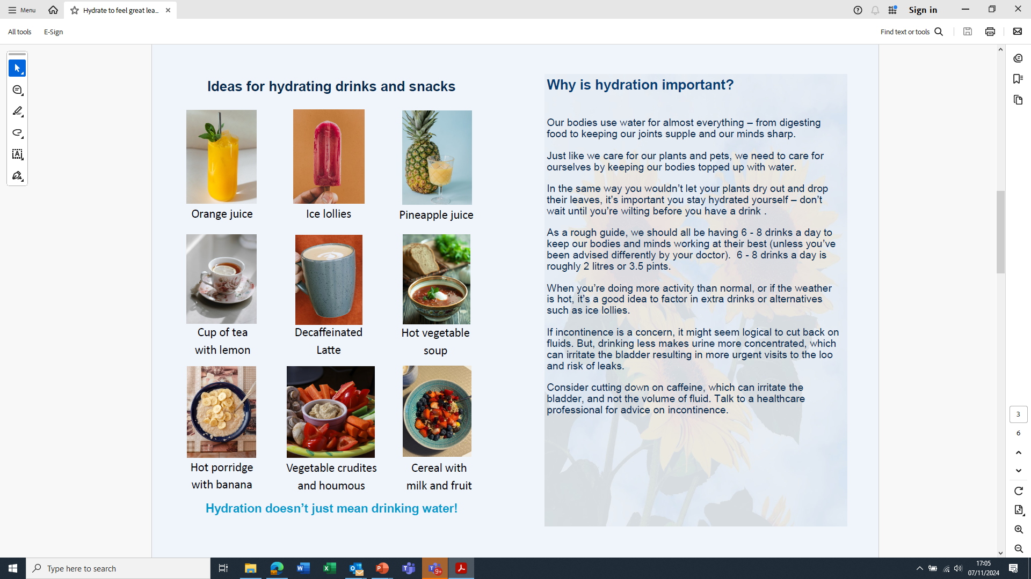
Ideas for hydrating drinks & snacks

Slide 15
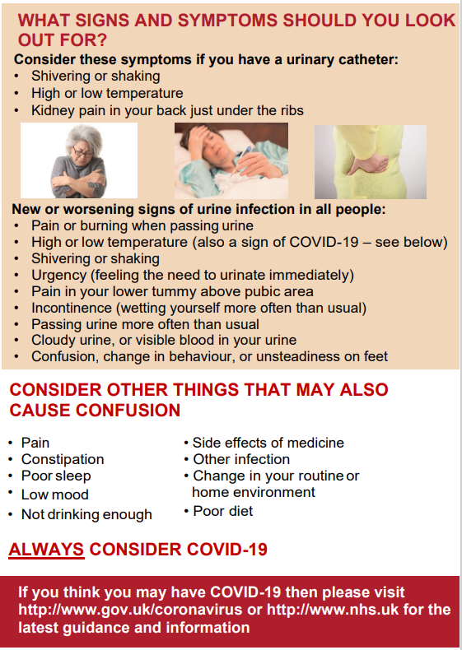
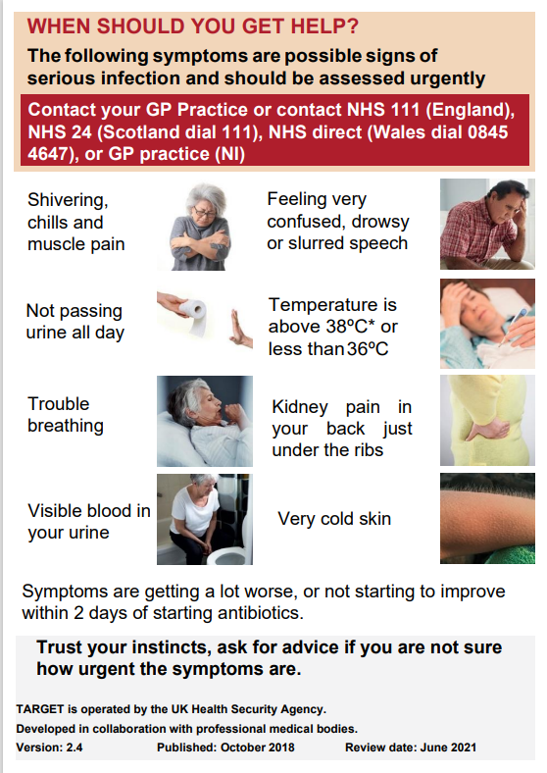
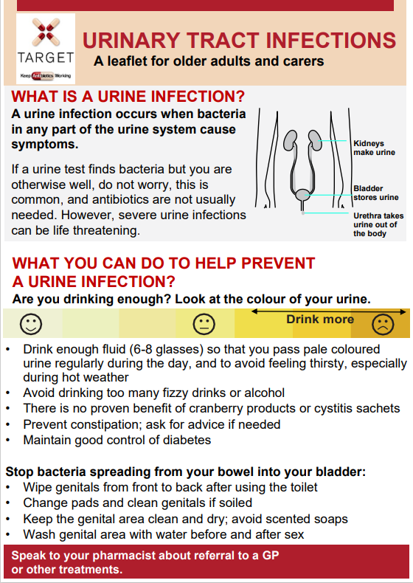
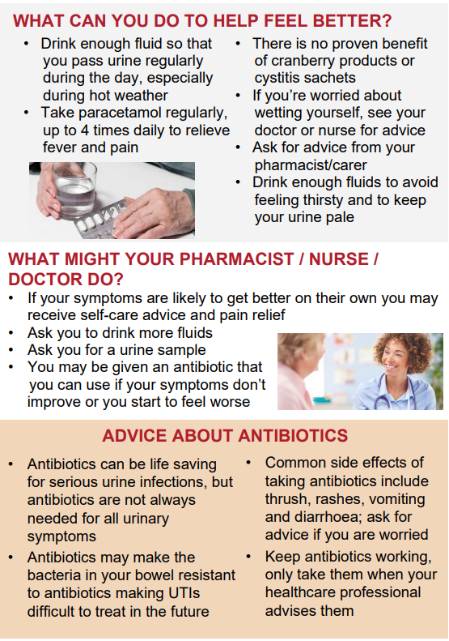
UTI Information Leaflet for Older Adults and Carers
Download at
Leaflets to discuss with patients: UTI Leaflet - Older Adults (rcgp.org.uk)
Available in multiple languages
Developed by RCGP TARGET Antibiotics

Slide 16
Hydrate To Feel Great resources:
https://youtu.be/4IC3vWp5JCk
Southeast hydration project - Antimicrobial Resistance Programme – Futures
Hard copies of the Personal Hydration Plan : wendy.thomas20@nhs.net

Slide 17
Staying well this winter:
Top Tips for staying well this winter:
  Workstation Hygiene
  Respiratory Hygiene
  Hand Hygiene
  Food/ beverage hygiene
  Flu Vaccination

Slide 18
Norovirus:
Spread by faeco- oral route
Only takes a very small amount of virus particles to make you unwell
Higher than normal number of confirmed cases this year ( compared to same period)
Virus can be shed by people who are not yet displaying symptoms
Environment can very easily become contaminated :
Vomiting Larry - A demonstration and explanation from his creator - YouTube

Slide 19
Think about how many hands touch a workstation in one day :
Workstation hygiene:
Use a combined detergent and disinfectant wipe (e.g. Green Clinell or similar) to clean your keyboard, mouse, telephone and headset at the beginning and end of each shift/ working day. (Remember to use 1 wipe per surface (do not clean multiple surfaces with the same wipe)
Clean using an “S” shape motion to avoid cross contamination
Allow at least 60 seconds contact time and allow the surfaces to air dry
Keep your workstation clutter free and clear away personal items at the end of each day. This will ensure that the workstation area can be cleaned properly
Avoid consuming food at your workstation:
If there is no alternative – clean your workstation and wash your hands before eating. Avoid touching any workstation equipment or mobile devices whilst you are eating

Slide 20
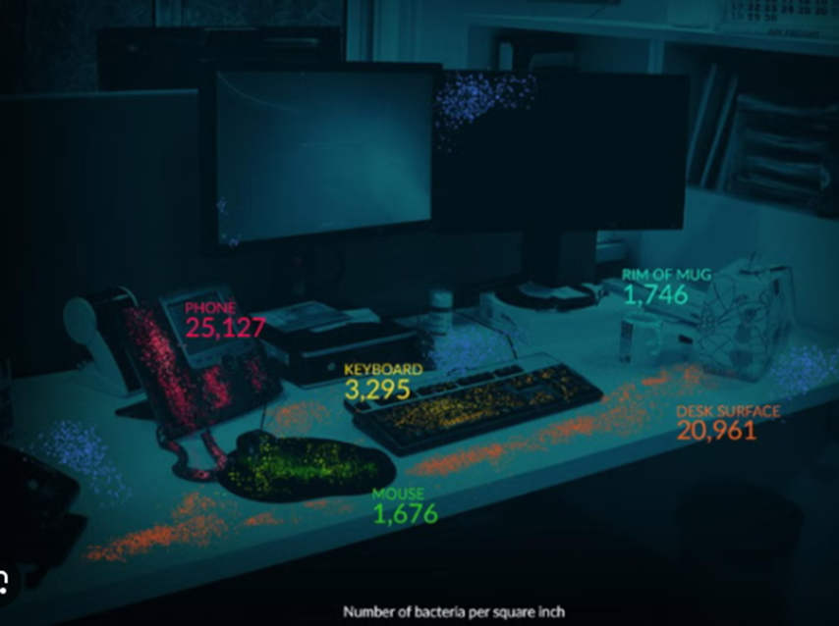

Slide 21
Respiratory Hygiene
Stay at home whilst unwell where possible
Cover nose & mouth when coughing/ sneezing . Dispose of tissues in an enclosed pedal bin.
Wash hands after blowing nose/ putting hands to nose or mouth

Slide 22
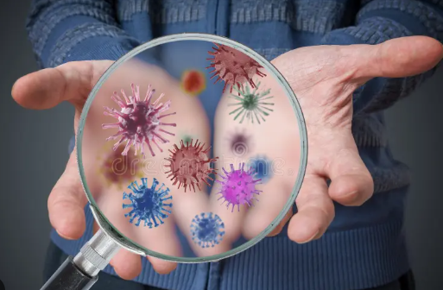
Hands are the most efficient way to spread infections:
Hand Hygiene:
Wash hands with soap and water for at least 20 seconds:
  On arrival at work
  After cleaning your workstation
  After using the toilet
  After coughing/ sneezing into a tissue
  Before and after using PPE
  Before and after refreshment breaks
  Before preparing food

Slide 23
Food/ beverage hygiene :

