Slide 1
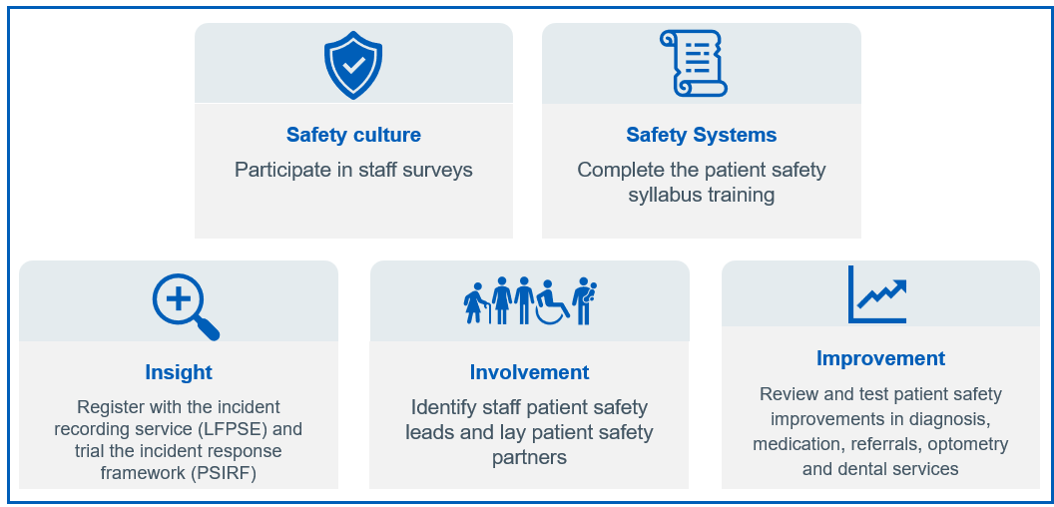

Primary care patient safety strategy

Slide 2


“While the millions of interactions patients have with General Practice, dental, optometry and pharmacy teams each week are safe, the NHS wants to ensure that when things do go wrong, we do everything in our power to ensure patients are supported, the event is responded to, and action is taken to ensure it does not happen again with learning shared between organisations.”
Claire Fuller
National Primary Care Medical Director
Strategy published 26th September 2024
“That’s why the NHS is launching the patient safety strategy for primary care which will enable staff to record incidents on a national platform, receive additional training on how to identify and manage risks, and nominate staff within their organisations who will involve patients in their plans to improve safety.”
Aidan Fowler
National Director of Patient Safety
NHS England » Primary care patient safety strategy
Notes:
The Primary care patient safety strategy was published on 26th Sept 24.
Co-designed with NHS front-line staff and lay patient safety partners, the strategy builds on the wider NHS Patient Safety Strategy and aims to develop a supportive environment within primary care where learning can be shared more widely to benefit patient and staff safety and wellbeing. The intention is to ensure that we manage safety with an approach based on safety science and systems thinking.

Slide 3























Discovery journey
Draft safety plan
Research published
Safety culture focus group
Discovery group
Data analysis
More feedback
Transformation Board
Socialising
Understanding impacts
Revamped strategy
Strategy
published
Notes:
This strategy has been developed over time with primary care providers, commissioners and patients from across general practice, community pharmacy, dentistry and optometry.
It sets the ambition and vision for patient safety in primary care to encourage discussion and exploration. It is not about implementing everything on day one in all sectors of primary care. The strategy draws together best practice, providing a range of ideas and opportunities that can be shared. It is not a contractual requirement on primary care providers, or ICBs.

Slide 4

The impact of patient safety in primary care
90% of all NHS patient interactions occur in primary care
97% of encounters in general practice are safe
0.7% of the 2.4 million patient safety incidents annually recorded nationally
relate to primary care, so there is probably an under-representation of harm
21% of all new claims to NHS Resolution are from general practice
(as reported in the new CNSGP and ELSP claims notified in 2023/24)
Expenditure of £149 million for GP indemnity via NHS Resolution in 2023/34
Avery et al., 2020 estimated there are between 19,800 and 32,200 incidents of avoidable significant harm in general practice in England per year (similar data for community pharmacy, optometry and dental services are unknown): 61% diagnosis; 26% medication; 11% referrals
Every incident of significant harm has a personal cost to patients, service users, families, carers and staff.
Plus the financial cost of incident-related treatments, estimated at more than £100 million per year across the whole of primary care
Notes:
We have some information on the impacts of patient safety in primary care.
Recent research into the incidence, nature and causes of avoidable significant harm in general practice indicates that while the majority (97%) of encounters in general practice are safe, there are between 19,800 and 32,200 incidents of avoidable significant harm in general practice in England each year.
In creating a supportive, learning environment with a just culture we aim to learn more from what goes well, as well as to respond appropriately to things that go wrong.
Why record safety events or incidents - so that nationally we can identify new and under-recognised concerns and so issue timely patient safety alerts and so that locally we can share insight and learn more from each other. So there is a real opportunity to learn more.
So one obvious area for improvement is building a greater understanding of patient safety events (recording them) occurring in primary care,
We have some information on the impacts of patient safety in primary care. Recent research into the incidence, nature and causes of avoidable significant harm in general practice indicates
Data are also available from national incident recording data, however, we know that the culture of incident recording from primary care is relatively underdeveloped
So one obvious area for improvement is building a greater understanding of patient safety events (recording them) occurring in primary care,
so that nationally we can identify new and under-recognised concerns and so issue timely patient safety alerts and so that locally we can share insight and learn more from each other. So there is a real opportunity to learn more.

Slide 5
Patient safety primary care strategy
Developing a supportive, learning environment and just culture in primary care, with sharing across the system so that the services can continually improve.
Ensuring that the safety and wellbeing of patients and staff is central, and that our approach to managing safety is systematic and based on safety science and systems thinking.
Involving patients in the identification and co-design of primary care patient safety ambitions, opportunities and improvements.
Notes:
The strategy is based around the NHS patient safety strategy structure of the 3Is, identifies those areas where improvements are underway and sets ambitions for future improvement. It includes patient stories and examples of good practice and key actions for local and national implementation.

Slide 6

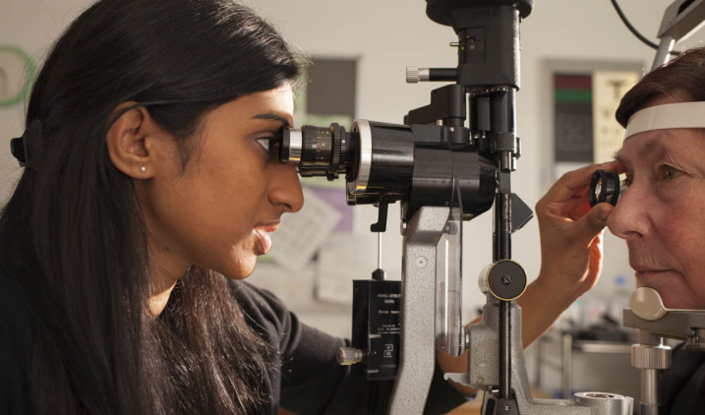
Capacity
Acknowledging the huge pressures in primary care
Suggestions came from primary care to address issues that have arisen locally
Many of the actions are about the process of enhancing safety
Keep bureaucracy to a minimum instead of rather than more of
National commitments to support primary care (ie it is not all directed at primary care frontline teams)
Timeframe for local commitments is iterative and flexible
Implementation is about what we can do well
Share the burden across boundaries and between systems
Notes:
We acknowledge the significant resourcing and capacity challenges currently faced by primary care. These challenges have a direct impact on patient safety, and so we are keen for these recommendations to utilise existing processes and structures for implementation where possible.
Given the capacity pressures in primary care and integrated care boards, this strategy seeks to build on existing safety culture and utilise opportunities to learn and redefine the steps involved. It is intended that the timeframes for the implementation of the local commitments are flexible to allow for piloting different approaches. This strategy is for all areas of primary care, though with some improvements implemented first in general practice to enable the successes and learning to be used in the rollout to community pharmacy, optometry and dental services

Slide 7




Benefits
To patients and families: To staff:
Fewer patients harmed
Fewer complaints
Free, online patient safety training
Opportunity to raise what matters most
Improved primary care patient safety alerts and solutions
Reassurance of ‘3 strikes and we rethink’ principles
Free, online patient safety training
Support from ICB Patient safety specialists
National system (LFPSE) to record patient safety incidents and use as evidence for revalidation and annual appraisals
Enabling demonstration of positive patient safety culture to professional regulators
Using Patient safety incident response framework (PSIRF) to enable learning and sharing
Notes:
Improving patient safety may feel like a challenging task in an already stretched environment; however, there are some significant benefits to these relatively small changes that are intended to reduce rather than increase the workload while improving patient safety. These benefits will affect patients, staff, organisations and systems. We’ve presented some of these here focussed on the benefits to patients and staff. These are very much focussed on fostering a safety culture that moves away from blame, supporting people to do their best and learn from each other when things go wrong.

Slide 8

Implementation
The strategy is about setting the ambition and vision
To encourage discussion and exploration
Not about implementing everything on day one
Provides new ideas and opportunities that can shared
Draws together best practice
No new contractual requirements
Most areas need testing and piloting
Delivery timeframe is iterative
Funded pilot approach for PSRIF for a small number of General Practices supported by the Health Innovation Network
Notes:
This strategy is about setting the ambition and vision for patient safety in primary care to encourage discussion and exploration across all primary care platforms. This is not about implementing everything on day one in all sectors, it is about providing ideas and opportunities that can shared. This strategy draws together best practice. It is not a contractual requirement on primary care providers, or ICBs. NHS England will continuously review its effectiveness and how we can best implement the strategy to improve patient safety.
This is about step by step implementation bearing in mind that GP, community pharmacy, optometry and dental services are at very different stages and have different contractual and regulatory requirements. This is not a sprint, it's a marathon.
Most areas need testing and piloting in primary care before full implementation, so the delivery timeframe is iterative starting with pilot introductions of some projects. For example, the first step towards PSIRF implementation is a funded pilot approach for a small number of General Practices supported by the Health Innovation Network. There is no intention to make PSIRF a requirement for General practice at the end of 12 months.

