Slide 1
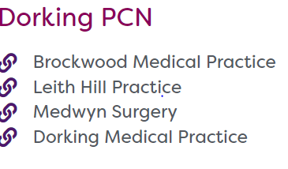

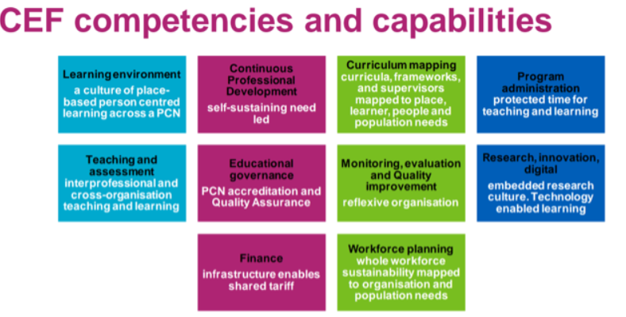
DORKING PCN EDUCATION ACTIVITY 2025
NURSE EDUCATION MEETINGS
Education topics as chosen by group.
Rotating Tues, Wed & Thurs to accommodate more PT staff.
6 meetings in 2025
1 hour alternating F2F & teams.
PCN ACP EDUCATION FORUM
Monthly meetings for the PCNs allied health professional, including first contact practitioners, advanced clinical practitioners and ARRS roles.
Alternates each month between educational topics and support for audit and Quality improvement activities.
PCN PLT MARCH 2025
In collaboration with The Royal Marsden.
Topics including Equality, Diversity and Inclusion, Cancer pathways.
CQC and Teamnet training for non-clinical staff.
Planning PCN PLT for Feb 2026 to focus on MSK conditions, wellbeing and lifestyle medicine .
DORKING PCN STUDENT CAREERS EVENT OCT 2025
Year 12 students across local schools invited to attend 2 day event to explore NHS career options.
Presentations from HCPs across the PCN.
24 young people signed-up. Excellent feedback from students.
LEARNERS ACROSS THE PCN
Undergraduate Student Nurse
Return to Practice Nurse
Work Experience
Physician Associate Students
Medical Students
ST 1 , 2 & 3 Registrars
FY2 doctors.

