Slide 1
Fit for the Future: Genomics and the NHS 10-year plan
Sarah Flack
Medicines Optimisation Pharmacist and Lead Pharmacist Genomic Medicine
NHS Surrey Heartlands sarahflack@nhs.net
Amy Herbert
Head of Medicines Governance & Value
NHS Sussex amy.herbert6@nhs.net

Slide 2
Overview
Introduction to genomic medicine
Use of genomics in healthcare
Introduction to Pharmacogenomics
The future: Genomics and the NHS 10-year Plan
Direct to Consumer Genomic testing
Resources

Slide 3

Genomic Medicine
Your genome is your complete set of DNA
Every cell in your body contains a complete copy of your genome.
99.9% of the genome is the same in everyone
3 million variations between individuals
Genomics is the study of the entire genome
Genomic Medicine uses information held in our genome to help tailor treatment
Recent advances in technology now allows whole genomes to be sequenced in less than a day and costs less than £1000.
Notes:
Genetics is the study of individual genes

Slide 4
Genomics in Healthcare
Diagnosis
Genetic diseases for example cystic fibrosis, Huntington’s which are caused by a known genetic variation
Finding genetic causes for rare diseases that previously has no known cause
Predicting disease
Looking for genetic variants that we know are associated with diseases in the future for example BRCA1 gene and breast cancer
Comparing the genome of people with a disease and people without to find new gene associations
Cancer
Cancer is caused by mutations in our DNA, some are inherited, some occur newly during our lifetime.
Compare the genome of a cancer cell to a normal cell to find the mutations that cause cancer and targets for treatment
Pharmacogenomics
How genes affect the way we respond to medicines
Notes:
Cancer caused by mutations in genes that tell cells when to grow or when to die (oncogenes and tumour suppressor genes)
Traditional cytotoxic cancer therapies indiscriminately targeted all dividing cells
Severe adverse effects
Limited therapeutic benefit
Modern cancer treatments target specific genetic mutations
Target only cancer cells with the mutation
Better outcomes and survival rates

Slide 5
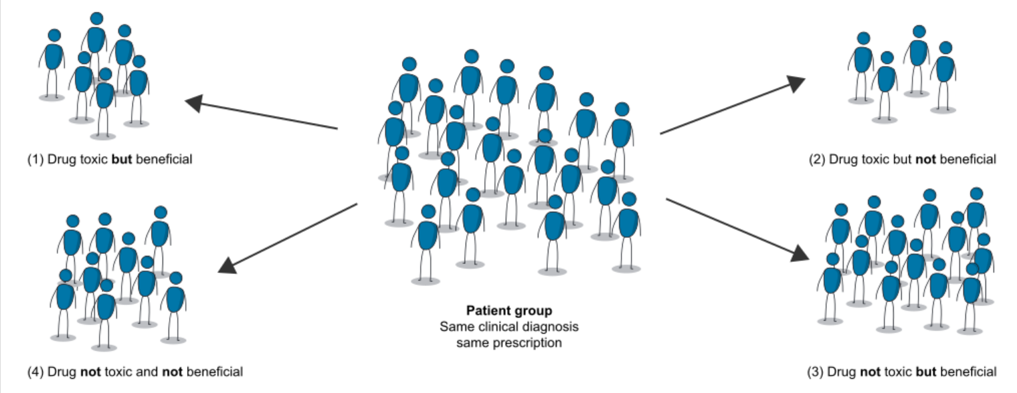
Variation in drug response between individuals
Multiple health conditions
Demographic
Environment
Drug-food interactions
Drug-drug interactions
Renal and hepatic function
Genomic variation
But unlike other factors affecting drug response, a person’s genes do not change during their lifetime
Notes:
It’s thought that drug interventions are effective in just 30%-60% of patients because of the difference in how individuals respond to medication.

Slide 6
Pharmacogenomics (PGx)
The study of the influence of the genome on drug response
99% of individuals carrying a genetic variant relevant to commonly prescribed drugs
Can predict response to treatment
Can predict the risk of serious side effects (Adverse Drug Reactions)
Can tailor doses of medicines depending on how quickly or slowly your genomics tell us you metabolise them
Can tailor cancer treatments to match particular tumour genomics
Can predict antimicrobial resistance and track pathogen outbreaks such as covid
Notes:
Sequencing the genome of infective organisms can identify resistant strains and guide treatment options
Tuberculosis – to identify different strains that are resistant to some antimicrobial treatments
COVID-19 – to identify new variants, management of the pandemic, vaccine development and vaccine resistance

Slide 7
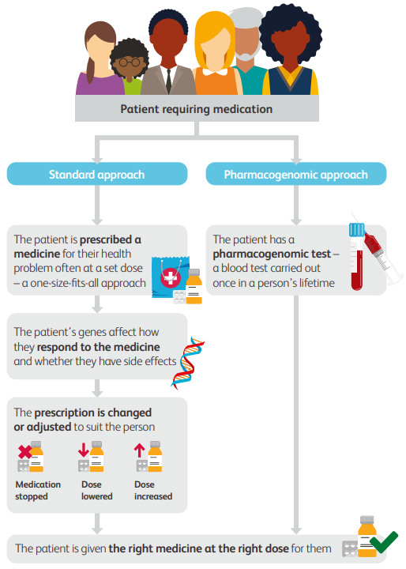

How can we use pharmacogenomics to optimise medicines?
Genetic variants in an individual can be used to predict the likelihood that a drug will be effective, or cause unintended harm through an adverse reaction
Notes:
Pharmacogenetics: Focuses on smaller, more specific parts of the genome

Slide 8
Prescribing: Standard Approach vs Pharmacogenomic Approach cont.
In England, ineffective use of drugs, and patients suffering ADRs account for 6.5% of hospital admissions, and 14.7% of extended hospital stays, equating to 8,000 hospital beds being occupied at any one time, at a cost of £2 billion per year
Use of PGx testing could reduce ADRs by 30%
PGx enables:
Safer, more effective treatment
Value for money for the NHS
Improved outcomes for patients
Notes:
Data provided by NHSE (Dec 2025)

Slide 9
Personalised Medicine through Genomics
Already being used routinely in cancer setting
Soon we will be able to use technology to tailor treatment of more everyday medicines.
Pharmacogenomics will not replace our clinical judgement; it is an additional tool within our medicines optimisation toolbox, still need to consider:
  Renal and liver function
  Drug-drug interactions
  Co-morbidities etc.

Slide 10
CYP 450 isoenzymes (CYPs)
Many drugs are metabolised by CYP450 isoenzymes (CYPs)
Some medicines are pro-drugs which rely on these enzymes for activation (e.g. clopidogrel, codeine), while others rely on these enzymes to break them down and inactivate them (e.g. antidepressants and PPIs).
Individual drugs are not metabolised exclusively by one isoenzyme, although one often predominates.
Notes:
Codeine is metabolised to morphine by CYP2D6
Ultrametabolisers – toxicity
Poor metabolisers – no effect
People don’t currently know their status and so contra-indicated where risk may be particularly high eg in children and babies
25% drugs metabolised by CYP2D6 encoded by CYP2D6 gene
8% UK population lack enzyme due to gene variants (poor metaboliser)
2% have extra copies of the gene (ultra metaboliser)
Clopidogrel
1 in 4 patients exhibit a subtherapeutic response
Pro-drug requiring activation by enzymes including CYP2C19
Multiple variants of CYP2C19 resulting in total non-function, poor or extensive metabolisers.
CYP2C19*2 allele carriers have increased risk of CV events and mortality
Prasugrel and ticagrelor are not affected by CYP2C19 variation.
Antidepressants
Up to 50% of patients do not respond to the first antidepressant and 30% patients discontinue within the first 6 weeks
Evidence that multiple genes and genetic variants play a role in determining response to antidepressants and development of adverse effects
Most antidepressants undergo metabolism by CYP450 notably CYP2C19 and CYP2D6
Serotonin transporter and receptor genes determines response to SSRIs
Carbamazepine – Steven Johnsons syndrome MHRA warning 2008 and BNF Asian Populations – not routinely tested

Slide 11
CYP 450 isoenzymes (CYPs) cont.
There are multiple variants of CYPs resulting in total non-function, poor or extensive metabolisers
The expression and activity of CYPs vary considerably among individuals and ethnicities.
A patient’s metaboliser status for a specific CYP450 isoenzyme is described as:
  Poor metaboliser
  Intermediate metaboliser
  Normal metaboliser
  Extensive / rapid metaboliser
  Ultra-rapid metaboliser
  Four pharmacogenes CYP2C19, CYP2D6, SLCO1B1, HLA-B are responsible for >95% of all drug–gene interactions observed in primary care (Youssef et al 2021 https://doi.org/10.1111/bcp.14704)
  CYP-genotype-informed prescribing is not currently routinely adopted within the NHS.
Notes:
GeNotes (Quick, concise information to help healthcare professionals make the right genomic decisions at each stage of a clinical pathway) has info on what to do for certain drugs with known CYP status

Slide 12
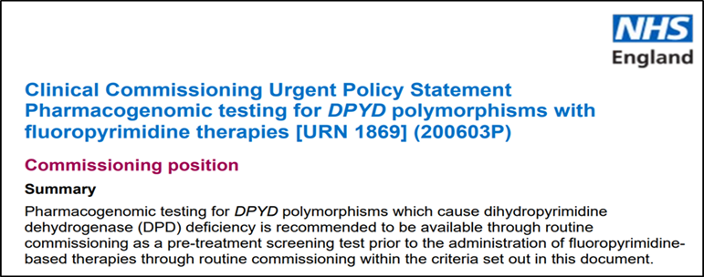
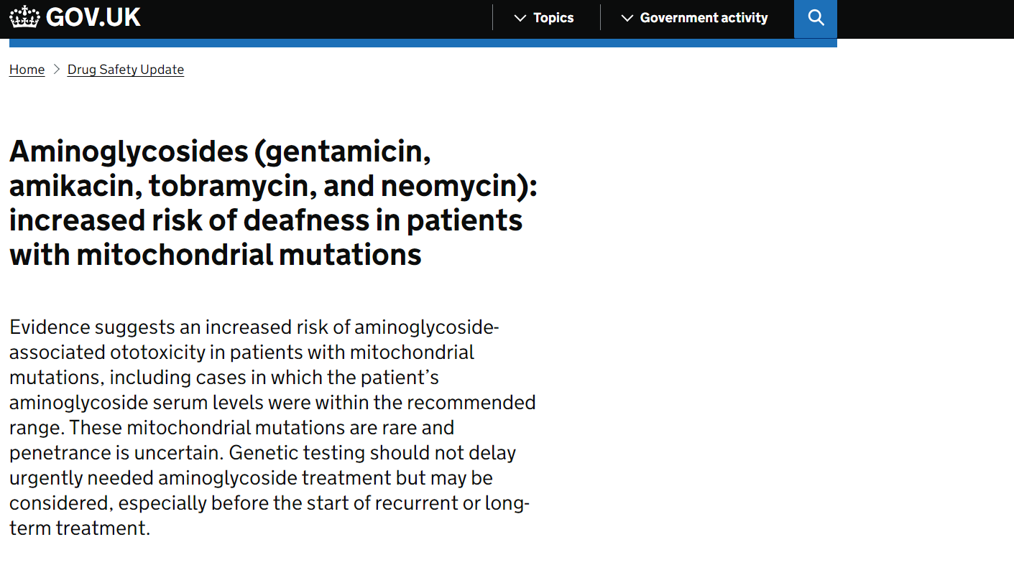

Integrating Pharmacogenomics into routine clinical practice.
Tests
There are currently four pharmacogenomic tests listed in the Genomic Test Directories (single gene testing):
1. DPYD variant detection
For patients planned to receive fluoropyrimidine treatment (chemotherapy used in colorectal and breast cancer – predicts toxicity)
2. TPMT/NUDT15 Targeted mutation testing
For patients with Acute Lymphoblastic Leukaemia and proposed treatment with purine analogue drugs e.g. azathioprine (predicts toxicity)
3. MT-RNR1 Targeted mutation testing (Aminoglycoside exposure posing risk to hearing)
individuals with a predisposition to gram negative infections for OR
individuals with hearing loss who have been exposed to aminoglycosides
4. CYP2C19 genotyping
to determine appropriate dose of mavacamten for symptomatic obstructive hypertrophic cardiomyopathy in line with NICETA913
Notes:
The Genomic Medicine Service is currently delivering over 800,000 genomic tests per year including around 40,000 pharmacogenomic tests.
There are currently only four pharmacogenomic tests commissioned nationally via the National Genomics Test Directory. Each of these are single gene testing.
Other pharmacogenomic tests may be available in practice but not commissioned through this route eg HLA for abacavir
DPYD variant detection: testing predicts toxicity with 5FU (chemotherapy used in colorectal and breast cancer). 10-40% patients develop severe or life-threatening toxicity, mortality 1%
All patients in England to be screened for DPYD variants prior to commencing therapy NHS England Nov 2020
TPMT variant detection predicts toxicity with drugs such as azathioprine
CYP2c19 – Mavacamten used for treatment of hypertrophic cardiomyopathy – poor metaboliser: higher risk of Side effects
Local lab testing: Abacavir
Used to treat HIV
8% of people suffered life threatening side effects
Found that people with a particular gene variant are at risk
Since 2006 all HIV centres have implemented testing and since then the incidence of these side effects has been virtually eliminated

Slide 13
Precision Medicines & The National Genomic Test Directory
To support the adoption of precision medicine – including medicines optimisation informed by genomic testing – a variety of test indications are available to support individualised treatment.
Cancer
Rare & Inherited Disease
Medicine | Indication | Genomic target
Crizotinib | Non-Small-Cell Lung Cancer | ROS1
Quizartinib | Acute Myeloid Leukaemia | FLT3
Avapritinib | Systemic mastocytosis | KIT
Futibatinib | Cholangiocarcinoma | FGFR2
Ivosidenib | Acute Myeloid Leukaemia | IDH1
Dabrafenib/Trametinib | Glioma | BRAF
Cabozantinib | Renal Cell Carcinoma | MET
Olaparib | Breast Cancer | BRCA
Medicine | Indication | Genomic target
Eplontersen | Hereditary transthyretin-related amyloidosis | TTR
Evinacumab | Homozygous familial hypercholesterolaemia | APOB/LDLR/ LDLRAP1/PCSK9
Exagamglogene autotemcel | Beta-thalassaemia | HBB
Burosumab | X-linked hypophosphataemia | PHEX
Ivacaftor combination medicines | Cystic Fibrosis | CFTR
Etranacogene dezaparvovec | Haemophilia B | Factor IX
Notes:
A variety of genomic tests are also commissioned nationally through the test directory to support individualised treatment for various cancers, cystic fibrosis, beta thalassaemia, haemophilia B and homozygous familial hypercholesterolaemia.

Slide 14

Updates to the Test Directory 25/26
  There were no updates to the test directory in 25/26.
  NHS is going through a period of organisational change, and a spending review. Funding for new tests has not been identified within current financial year.
  Implementation of testing remains a priority but must take into account the need to maintain existing services for patients.
  Position is under active review and the Genomic Medicine Service is preparing for a number of potential new tests:
    CYP2C19 genotyping to guide clopidogrel use in ischaemic stroke/TIA
    ACKR1 for clozapine (antipsychotic)
    HLA for antiepileptics (carbamazepine)
    RYR1 for volatile anaesthetics
    UGT1A1 for irinotecan (cancer drug)
Notes:
CYP2C19 for stroke: clopidogrel. St Georges pilot complete (no further funding). Approx 40% patients identified as not suitable for clopidogrel (higher than general population – diverse population). All pilot sites used different alternative antiplatelets. CERSI – PGx (Centre of Excellence in Regulatory Science and Innovation in pharmacogenomics) have just produced UK Guidance which includes advice on a range of alternative antiplatelet options e.g. aspirin and dipyridamole, aspirin monotherapy, ticagrelor (caution bleeding risk), higher dose clopidogrel)
The ACKR1 gene is associated with Duffy-null neutropenia (Duffy-null genotype), a benign condition of low neutrophil counts common in individuals of African and Middle Eastern descent, where the ACKR1 gene variant (rs2814778) is homozygous. Identifying this variant can allow patients with Duffy-null neutropenia to safely start clozapine treatment, even with a lower-than-standard neutrophil count, by adjusting the minimum neutrophil count (ANC) threshold for initiating and continuing the medication. This is because their baseline neutrophil counts are naturally low without an increased risk of infection. Clozapine is prescribed for treatment-resistant schizophrenia. To receive clozapine, a patient’s neutrophil count must remain above a minimum threshold. Some patients present with naturally low neutrophil counts without increased infection risk. These patients may be unnecessarily prevented from receiving clozapine.
Specific human leukocyte antigen (HLA) alleles, such as HLA-B15:02, HLA-A24:02, and HLA-B13:01, are associated with an increased risk of severe cutaneous adverse drug reactions (cADRs) to certain antiepileptic drugs (AEDs), particularly in specific ethnic populations. For example, HLA-B15:02 is a significant risk factor for carbamazepine-induced SJS/TEN in Asian populations, leading to FDA recommendations for preemptive genetic screening in these patients. Other HLA alleles have been linked to different types of cADRs in various ethnic groups, and preemptive screening for these alleles is recommended to prevent life-threatening reactions and guide treatment decisions.
The ryanodine receptor type 1 (RYR1) is the primary calcium-release channel in skeletal muscle that is critically involved in malignant hyperthermia (MH), a potentially fatal reaction triggered by potent halogenated volatile anesthetics. Specific mutations in the RYR1 gene make patients susceptible to MH, causing the channel to become abnormally sensitive to these triggering agents and leading to uncontrolled calcium release, muscle contraction, and heat production.
Irinotecan (brand name Camptosar) is a topoisomerase I inhibitor widely used in the treatment of cancer. It is most frequently used in combination with other drugs to treat advanced or metastatic colorectal cancer. However, irinotecan therapy is associated with a high incidence of toxicity, including severe neutropenia and diarrhea. The risk of irinotecan toxicity increases with genetic variants associated with reduced UGT enzyme activity, such as UGT1A1*28. The presence of this variant results in reduced excretion of irinotecan metabolites, which leads to increased active irinotecan metabolites in the blood.

Slide 15

The Future: Genomics and the NHS 10-year Plan
Genomics features prominently in the NHS 10-year Plan
Vision for future: to provide a healthcare system where everyone can benefit from genomic healthcare across our lifetime
NHSE have predicted that by 2035, genomics could play a role in up to half of all health encounters
Notes:
The NHS 10 year plan sets out the ambitions for a major expansion of genomics in the NHS and includes a number of key initiatives
Vision for the future is to provide a healthcare system where everyone can benefit from genomic healthcare across our lifetime.

Slide 16
The NHS 10-year plan and genomics - overview
  Genomics Population Health Service and Neighbourhood Health
  Polygenic risk scores, predisposition and inherited disease testing
  Integrating Pharmacogenomics into routine clinical practice
  Universal implementation of cancer genomics

Slide 17
Genomics and the 10-year NHS Plan
Expansion of the existing NHS Genomic Medicine Service
Creation of a new genomics population health service.
Neighbourhood health services that will combine with the new genomics population health service accessible to all by the end of 2035.
Training local health professionals as genomic champions to increase uptake of local genomic testing.
Polygenic risk scores, predisposition and inherited disease testing and pharmacogenomics.
Notes:
The existing NHS Genomic Medicine Service will be expanded to create a new genomics population health service - a healthcare system that uses genomic information to improve the health of a large group of people enabling prevention, earlier identification, and better treatment of diseases. By integrating genetic insights with localised, community-based delivery we can achieve more precise, equitable and effective health services across England
The genomics population health service will become integrated into neighbourhood health teams, and genomics champions will work with multiprofessional teams to raise awareness and upskill in the use of genomics. This will enable identification of patients suitable for genomics testing and provide support through their journey.
Genomic testing will also be expanded to include the use of polygenic risk scores which enable us to quantify the cumulative effects in individuals of DNA changes in a number of different genes which individually have a very small risk, but together may substantially increase an individual's susceptibility to disease. It will also involve predisposition and inherited disease testing as well as the use of pharmacogenomic testing to guide effective treatment and manage side effects.

Slide 18
Polygenic risk scores, predisposition and inherited disease testing
Historically, genomic medicine has focused on heritable, often rare, conditions caused by variants in single genes.
Some single (monogenic) genetic variants have a large and significant effect on risk of developing a disease e.g women with BRCA mutations have a lifetime risk of breast cancer ranging from 45% to 85%, while the general population risk is around 12%.
Other genetic variants may have a much smaller effect on risk of developing a disease
  Often common in the population
  Effect on their own may be relatively negligible
Polygenic risk scores (PRS) aim to quantify the cumulative effects of variants in many genes, which individually may have a very small effect on susceptibility.
In some instances, a high PRS may result in a higher risk than a known monogenic variant.

Slide 19
Our Future Health
Our Future Health is a research programme being run in partnership with the NHS.
It aims to recruit 5 million volunteers from all backgrounds across the UK who will share their data to help scientists understand, treat, and prevent common conditions such as cancer, dementia, diabetes and cardiovascular disease.
The research study highlights that for many health conditions genetic risk scores alone may have limited usefulness, because other factors such as deprivation, lifestyles and environment are also important.
Our Future Health plans to develop ‘integrated risk scores’ that include genomic and non-genomic risk factors which can identify people more likely to develop disease
Notes:
Studies are currently underway to evaluate whether polygenic risk scores can help predict and prevent common diseases such as cancer, dementia, diabetes and cardiovascular disease, enabling people to live healthier lives for longer

Slide 20
The HEART Trial: Clinical Trial in collaboration with the NHS with GPs in the North East of England (Nov 2021 – June 2022, n=832)
The The HEART trial (Healthcare Evaluation of Absolute Risk Testing) successfully integrated polygenic risk scores (PRS) into primary care to improve the prediction of cardiovascular disease (CVD)
The aim of the study was to assess the real-world feasibility, acceptability, and impact of an integrated risk tool for cardiovascular disease (CVD IRT, combining the standard QRISK®2 risk algorithm with a polygenic risk score), implemented within routine primary practice in the UK National Health Service.
The Study met the primary endpoint of assessing that PRS can fit successfully into GP workflows
The inclusion of genetic testing was well accepted by both participants and healthcare providers and generated impactful changes in planned clinical decision-making:
  99% of participants reported that they found the inclusion of genetics helpful
  13% of the study population had their management changed by GPs as a result of their integrated genetic risk
Notes:
Integrated Risk Tools have been evaluated in primary care
HEART trial Nov 2021- June 2022 n=832
Heart disease, like many common diseases, is frequently the result of multifactorial inheritance. This means that rather than being caused by a single gene variant, it is caused by many different genetic variants, in addition to environmental factors.
Although these variants can have seemingly insignificant effects when considered individually, when taken together they can make a substantial difference to an individual’s chance of developing the condition.
Polygenic risk scores are a way to measure and quantify the effects of many gene variants on an individual’s phenotype. In other words, they estimate a person’s predisposition to a certain condition or trait based on genetic variants throughout the genome.
Recent studies have been carried out to investigate how combining this type of polygenic risk score with clinical risk scores may provide a clearer picture of who may develop heart disease:
A polygenic risk score added to a QRISK®2 cardiovascular disease risk calculator demonstrated robust clinical acceptance and clinical utility in the primary care setting – PubMed
The aim of the study was to assess the real-world feasibility, acceptability, and impact of an integrated risk tool for cardiovascular disease (CVD IRT, combining the standard QRISK®2 risk algorithm with a polygenic risk score), implemented within routine primary practice in the UK National Health Service.
Amongst HCPs and participants who agreed to the trial of genetic data for refinement of clinical risk prediction in primary care, we observed that CVD IRT implementation was feasible and well accepted. The CVD IRT results were associated with planned changes in prevention strategies.
Also BARCODE 1 study for PSA

Slide 21

Pharmacogenomics and the NHS 10-year Plan
Pharmacogenomics integrated into routine clinical practice.
Pre-emptive testing
Return results to patients through the Unified Genomic Record, linked to the Single Patient Record and the NHS App.
Integration of testing for pharmacogenomic profiles into the NHS over-40s health check as a universal offer (over time).
Notes:
For pharmacogenomics to be successfully integrated into routine clinical practice, we need to have digital infrastructure in place. Firstly we need somewhere to store the data which is where the Unified Genomics record comes into play and is currently in development. Once available, the UGR will be linked to the single patient record and NHS app making sure that patients and healthcare professionals have the right information when and where they need it. We also need guidance for clinicians on how to act on the results. The Progress trial currently underway in GP practices is looking at how to integrate pharmacogenomic insights into NHS clinical decision support systems. Once this is all in place, the ambition is to offer pharmacogenomic profiling as part of the routine over 40s NHS health checks

Slide 22
CYP2C19 genotyping to guide clopidogrel use in ischaemic stroke/TIA
NICE Guidance – published 31 July 2024 recommended using laboratory-based clopidogrel genotype testing, or a point-of-care test if laboratory testing is not available, to assess if clopidogrel is a suitable antiplatelet in people who have had an ischaemic stroke or transient ischaemic attack.
Pro-drug requiring activation by enzymes encoded by CYP2C19 gene
1 in 4 patients exhibit a subtherapeutic response to clopidogrel (poor or intermediate metabolisers)
4 pilot sites chosen to inform national implementation: St George’s University Hospitals NHS Foundation Trust was one of four Pilot sites in England (also Exeter, Doncaster, Salford)
Notes:
NHSE statement: it has not been possible to identify the necessary recurrent headroom in revenue budgets to support the routine commissioning of this testing for the indicated population at this point in time. This position is being kept under active review and takes into account the need to maintain all existing services for patients that currently receive genomic testing delivered by the NHS Genomic Medicine Service.

Slide 23
CYP2C19 genotyping to guide clopidogrel use in ischaemic stroke – guideline updates
The Centre for Excellence in Regulatory Science and Innovation in Pharmacogenomics (CERSI-PGx) is a new UK based initiative led by the University of Liverpool partnering with the Royal Pharmacological Society and Queen Mary University of London tasked to accelerate the adoption of PGx by developing guidelines and creating regulatory pathways for personalised prescribing. They work closely with NHSE, MHRA, NICE, Speciality Societies, Industry and Patients
CERSI-PGx have published its first UK consensus guideline for pharmacogenomic testing in the UK: CYP2C19 genotype testing for clopidogrel: A guideline developed by the UK Centre of Excellence for regulatory science and innovation in pharmacogenomics (CERSI-PGx)
The RCGP have worked with stakeholders to produce information to support prescribers outside of the acute Stroke setting who receive information that a patient has had CYP2C19 genotype testing: RCGP Guidance

Slide 24
RCGP Genomics October 2025 - CYP2C19 position statement
Recommendations:
1) Structured data capturing CYP2C19 metaboliser status should be included in the patient record and related communications (SNOMED-CT codes)
2) With the exception of prescription initiation in the context of acute ischaemic stroke, transient ischaemic, or Obstructive Hypertrophic Cardiomyopathy (Mavacamten) prescribers should not be expected to utilise CYP2C19 metaboliser status to guide prescribing practice until the following are implemented within NHS infrastructure:
  UK-based guidance which supports genomics-informed medicines optimisation
  Clinical Decision Support Systems which present CYP2C19 metaboliser status and integrate with UK-based guidance to provide evidence-based actionable recommendations at point-of-prescription
  Competency frameworks and educational resources supporting core knowledge and skills for prescribers (currently in development)
  Prescribers with additional expertise in Genomics-informed Medicines optimisation may wish to utilise CYP2C19 metaboliser status to guide prescribing decisions pending the publication of UK guidance.

Slide 25
RCGP Genomics October 2025 - CYP2C19 position statement
Recommendations cont.
3) Prescribers should:
  always act within the limits of their knowledge and competency to ensure they provide ‘reasonable care’, and seek advice from expert sources if needed
  act in the context of shared decision-making with the patient.
  reference and take into account trusted UK sources such as MHRA Drug Safety alerts, Summary of Product Characteristics (SmPC), the BNF, local and national guidance
  Follow appropriate local procedures for non-formulary, off-label, or unlicensed medication use.

Slide 26
Prescribing Advice: Guidelines available for pharmacogenomic testing
Non-UK Based Guidelines:
The Clinical Pharmacogenetics Implementation Consortium CPIC
DPWG: Dutch Pharmacogenetics Working Group = DPWG
UK Based Guidelines:
SmPC
BNF (British National Formulary) | NICE
GeNotes - Quick, concise information to help healthcare professionals make the right genomic decisions at each stage of the clinical pathway
CERSI-PGx clopidogrel guidelines
UK Clinical Pharmacy Association (UKCPA) Handbook of Pharmacogenomics in development - aims to provide a one-stop open access pharmacogenomics reference source for healthcare professionals in the UK
Notes:
The The Clinical Pharmacogenetics Implementation Consortium (CPIC) has published prescribing guidelines for many drugs based on clinically actionable CYP genotypes including clopidogrel, PPIs, SSRIs and TCAs
CPIC and DPWG provide peer reviewed prescribing guidelines which are used internationally
GeNotes (Quick, concise information to help healthcare professionals make the right genomic decisions at each stage of the clinical pathway) has information on what to do for certain drugs with known CYP status

Slide 27

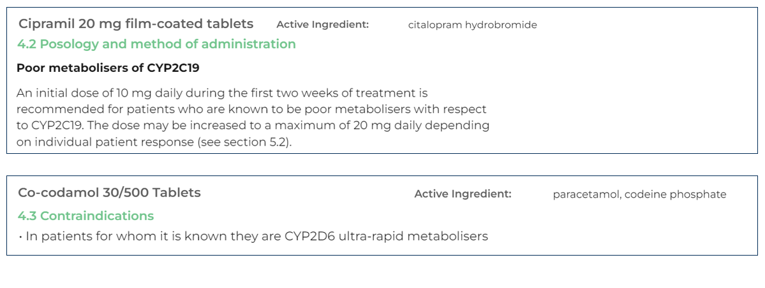
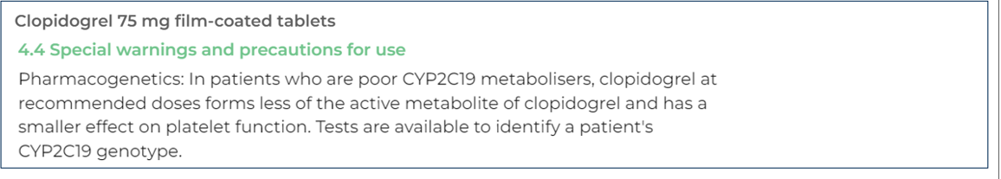
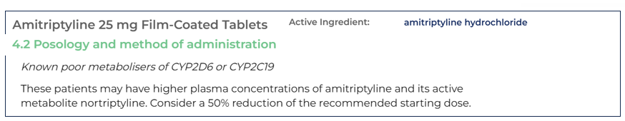
SmPCs and pharmacogenomics

Slide 28
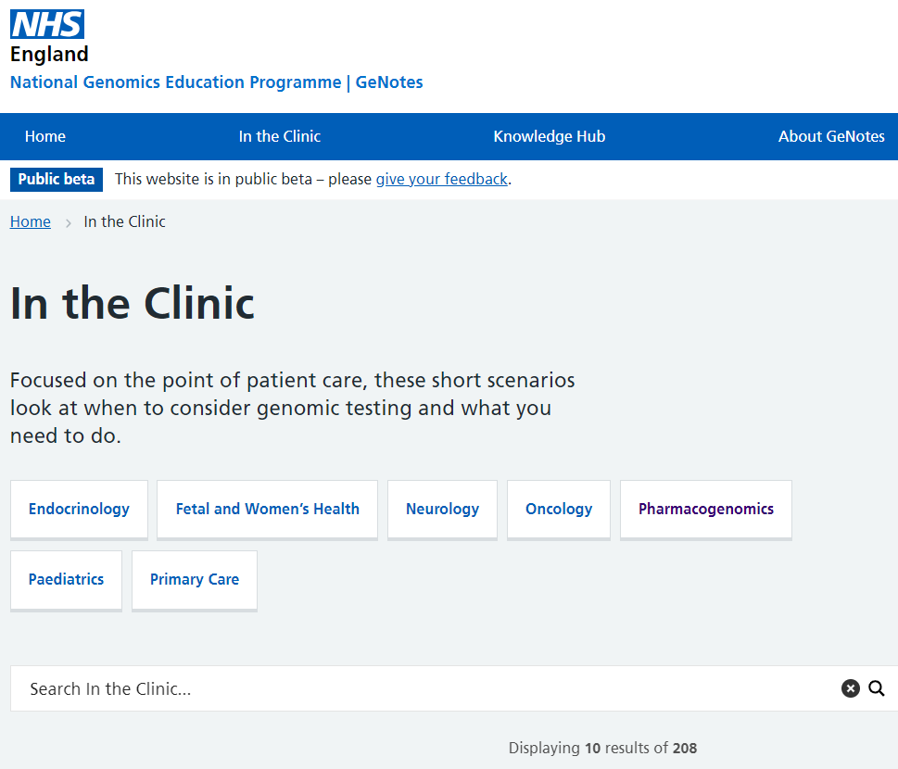

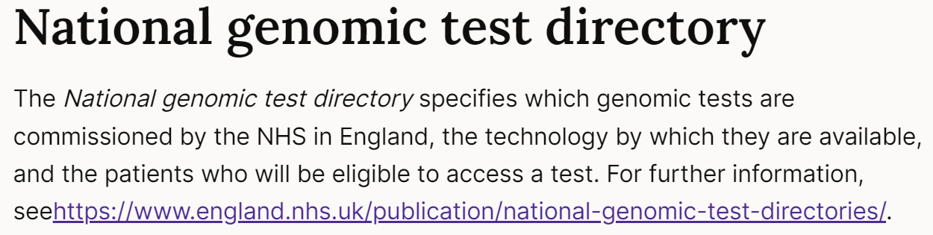
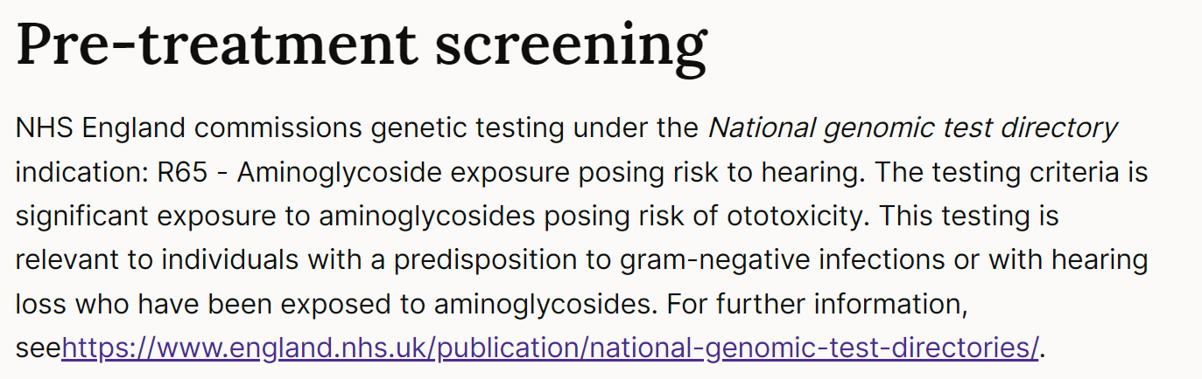

GeNotes
British National Formulary

Slide 29
Integrating Pharmacogenomics into routine clinical practice
Pharmacogenomics (PGx) in the UK is currently used predominantly in secondary care for a small group of high-risk medicines.
However, most prescribing takes place in primary care, with a large group of medicines influenced by commonly occurring genetic variations.
Pharmacogenomic information at the point of prescribing can help improve safety and efficiency of prescribing.

Slide 30
Integrating Pharmacogenomics into routine clinical practice
Testing a panel of pharmacogenes in one test
  Four pharmacogenes CYP2C19, CYP2D6, SLCO1B1, HLA-B are responsible for >95% of all drug–gene interactions observed in primary care (Youssef et al 2021 https://doi.org/10.1111/bcp.14704)
  More cost-effective than single gene testing
  Pre-emptive genotyping with actionable genotypes embedded in the medical record has the potential to be a reality (PROGRESS trial).
  Embedded in a clinical decision support tool, used to guide decisions in the same way as renal function or body mass index.

Slide 31
PROGRESS Study
The PROGRESS study is at the forefront of exploring how pharmacogenomic testing can be implemented in primary care and expanded across the NHS.
The PROGRESS project is an NHS England-funded initiative led by Manchester University NHS Foundation Trust and the NHS North West Genomic Medicine Service..
Following the success of Phase I and the launch of Phase II, the study is delivering valuable insights and making significant progress towards adopting personalised medicine within the NHS.
Aims:
To develop and validate a pharmacogenomic test for NHS use
To develop a system to translate the laboratory findings into prescribing advice for use in primary care
To work with a small number of GP Practices across England (21) to investigate the healthcare economics and implementation strategy to ensure the test is affordable for the NHS and the way it can be adopted
To work with patient groups across England to understand how patients feel about this type of testing
Notes:
Important to have pharmacogenomic information fully integrated into the electronic health records. Needs to be presented in an easy to use and understandable format.

Slide 32
Patient Cohort
Patients who are being seen for a new prescription of one of the following classes of medicines are invited to participate in the study:
  selective serotonin reuptake inhibitors (SSRIs)
  tricyclic antidepressants (TCAs)
  proton pump inhibitors (PPIs)
  Opioids
  Statins
Patients provide a blood or saliva sample which is sent to the North West Genomic Laboratory Hub (NWGLH) for panel testing and the results are returned to the primary care team in 7 to 10 working days.
The patient’s own primary care team uses the results to inform the patient’s prescription according to guidance on the Clinical System.
Notes:
Statins: (Some individuals have genetic variants in the SLCO1B1 gene that can increase the risk of statin-induced myopathy)
The risk is highest with simvastatin, which is associated with myopathy even at low doses. The risk is lower with atorvastatin and rosuvastatin, though they remain associated with myopathy when prescribed at high doses.
Pharmacogenomic dosing guidance for statins is complex and considers three variables: the statin of choice, the dose and the genetic results. The latest CPIC and/or DPWG guidelines should be reviewed prior to adjusting any prescription.
Up to 50% of patients do not respond to the first antidepressant and 30% patients discontinue within the first 6 weeks
Evidence that multiple genes and genetic variants play a role in determining response to antidepressants and development of adverse effects

Slide 33
PROGRESS Trial - Results to date
  1325 patients recruited
  Most started on SSRI or statin
  91% had clinically relevant variation in key study genes
  Change in prescription for 1 in 4

Slide 34

Genomics and the NHS 10-year plan – Universal implementation of cancer genomics
Cancerous tumours often release pieces of DNA into the bloodstream (known as circulating tumour DNA - ctDNA) and these can be sampled using a ctDNA blood test (liquid biopsy).
ctDNA blood tests enable early detection and guide and monitor treatment.
Every cancer patient will have the choice to receive comprehensive genomic analysis to guide precision treatment decisions.

Slide 35
Circulating Tumour DNA testing for lung and breast cancer
ctDNA testing is now available on the NHS to guide precision treatment for non-small cell lung cancer and breast cancer
There are multiple targeted treatments for lung cancer patients, that often increase quality of life of patients.
Patients with advanced breast cancer whose cancer has not responded to previous treatment can also have a ctDNA test to determine if they are eligible for targeted treatments
Previously this testing was done through tissue biopsy, results taking on average 3-4 weeks to be returned.
ctDNA testing provides faster results, meaning patients can start targeted treatment up to 2 weeks earlier.
Notes:
Following the success of a pilot commissioned by NHSE in 2022, the South East Genomic Medicine Service is the third centre to provide for the NHS. Testing was made freely available in 2025 to all patients that meet the clinical eligibility criteria as set out in the National Genomics Test Directory.

Slide 36
NHS Galleri Trial
Galleri® is a blood test that looks for small pieces of tumour DNA in the blood (ctDNA) and looks for a signal shared by many different types of cancer in a sample of a person’s blood.
If the test detects a cancer signal, the signal is examined to predict where in the body the cancer signal is coming from.
The test could speed up the diagnosis of more than 50 types of cancer including many of the cancers for which there are no national screening programmes, such as lung, pancreas or stomach cancers.
The NHS Galleri trial is a research trial to see how well the Galleri blood test works in the NHS. The aim of the trial is to see if using the Galleri test alongside existing cancer screening can help to find cancer early.
Over 140,000 volunteers aged 50–77 have registered to take part in the trial after receiving an invitation letter from the NHS.
The trial is now complete, and data is being collected to help with the research.
Final trial results are expected to be available from 2026.

Slide 37
Genomics and the NHS 10-year plan
Expansion of The Generation Study - Universal newborn genomic testing
The Generation study was launched in 2024 at several maternity units across England (local hospitals: Princess Royal Hospital Haywards Heath, Royal Sussex County Hospital in Brighton, Worthing Hospital in Worthing, St Georges Hospital in SWL)
Tests for over 200 rare genetic conditions by collecting an umbilical blood sample at birth.
The test looks for conditions that usually occur in the first few years of life for which there is effective treatment available on the NHS if started early in life.
There are approx. 9 babies born in the UK each year with a rare, treatable disease.
Freddie’s story:
Through this study, just four weeks after he was born at The Jessop Wing in Sheffield in April, Freddie was diagnosed with hereditary retinoblastoma, caused by a change in his RB1 gene. Left untreated, Freddie would have lost his sight.
Freddie was given a combination of laser treatment and chemotherapy, and his doctors are hopeful they can save his vision.
The government is aiming to make this newborn testing available to all
.
Notes:
There is also an ambition to expand Whole Genome sequencing. Evidence will be generated through the Generation Study and Adult Population Study.
Generation study: due to be completed in 2027 and is expected to sequence 100,000 genomes
Results are received in approx. 6 weeks – via email if no conditions suspected (99%), by phone if condition suspected (1%)
650,000 babies born in England each year screened for more treatable rare conditions
Aim: to replace current heel prick test which detects nine specific conditions – sickle cell, phenylketonuria

Slide 38
Genomics and the NHS 10-year plan – Expansion of Whole Genome Sequencing in Adults
Adult Population Study:
A new large-scale study commissioned by Genomics England due to launch in 2027- sequencing the genomes of 150,000 adults to inform how pre-emptive genomic testing is best adopted to improve health outcomes for the adult population
Seeking to gain an understanding of how people feel about genomic data being used to tailor prescribing or predict future health risks, with a focus on cardiovascular, mental health, renal and diabetes
.

Slide 39
Direct to Consumer Genomic Testing (DTC-GP)
Private DTC-GP Services available
There is often a lack of standardisation for these tests, with limited if any evidence for clinical validity or utility.
A number of pharmacogenomic tests including those of relevance to psychiatry are also available commercially.
The Royal College of General Practitioners (RCGP) in collaboration with partners and stakeholders has updated the guidance on Direct to Consumer (DTC) genomic or genetic testing (Sep 2025)
The Royal College of Psychiatrists has issued a report to provide clinically relevant summaries of the current evidence base for genetic testing across a range of mental health conditions The role of genetic testing in mental health settings (CR237).
Notes:
Thinking of using a private (non-NHS) provider of pharmacogenomics testing? Some things to consider….
What is being tested?
Which genes?
Which variants?
What is the evidence for any therapeutic recommendations made by the provider?
Does this align with peer-reviewed best practice guidelines? e.g. CPIC, PharmGKB, DPWG, CERSI-PGx, RCPsych, AMP.
Quality assurance of the laboratory?
Do they meet the UK quality standards expected for genetic testing? E.g. ISO15189, OECD Guidelines for Quality Assurance in Molecular Genetic testing (2007) and the European In Vitro Diagnostic Medical Devices Directive.
Consent and information governance
Do they meet expected data standards?
Who owns the data? Where is it stored?
Ensure appropriate processes are followed eg GDPR, DPIA, consult Trust information governance.

Slide 40
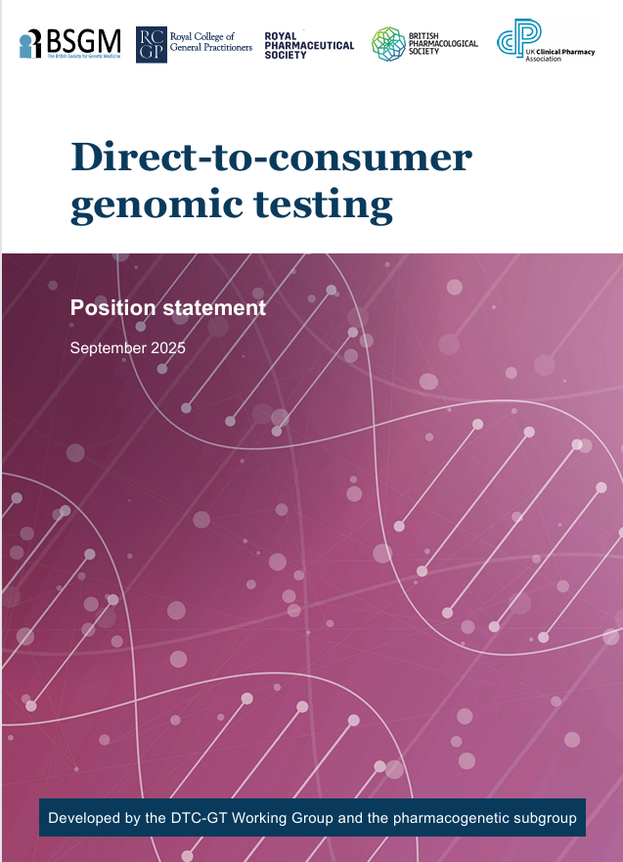
Key Recommendations from The Royal College of General Practitioners (RCGP) Direct to Consumer (DTC) genomic or genetic testing
There is considerable variation in the quality and validity of DTC-GT and healthcare professionals should exercise caution if asked to interpret such results or to use them as part of clinical decision making.
Where a DTC-GT has been performed in an accredited laboratory with robust external quality assurance, advice should be sought from regional genetics services to enable robust clinical interpretation of findings.
Patients presenting with DTC-GT results should be offered standard NHS care, including family history and risk assessment, with onward referral and testing along standard NHS pathways and protocols. Genomic services are generally able to provide advice when it is unclear if a particular patient meets existing referral criteria.
There are significant NHS costs in confirming (or refuting) DTC-GT results; these are not warranted unless there are clinical indications for testing.
Notes:
Advice and Guidance
Clinical genetics at Guy’s and St Thomas’ NHS Foundation Trust gstt.geneticscorrespondence@nhs.net
Clinical genetics at St Georges University Hospitals NHS Foundation Trust genetic.secretaries@stgeorges.nhs.uk
South East GLH based at Guys and St Thomas gst-tr.viapathgeneticsadmin@nhs.net

Slide 41
Key Recommendations from The Royal College of General Practitioners (RCGP) – Pharmacogenomic Testing
Where a DTC-GT has been performed in an accredited laboratory with robust external quality assurance, pharmacogenetic results may be used to support a decision regarding choice of medicine for an individual patient.
Caution about pharmacogenetic results should be exercised in the absence of clinical guidance concerning the relevant gene-drug pair.
Consensus pharmacogenetic prescribing guidance should be agreed upon for the UK.
Information may be available from trusted sources such as MHRA Drug Safety alerts, Summaries of Product Characteristics (SmPCs), British National Formulary (BNF) and CERSI-PGx.
The Clinical Pharmacogenetics Implementation Consortium (CPIC) and Dutch Pharmacogenetic Working Group (DPWG) both provide peer-reviewed prescribing guidelines, which are used internationally.

Slide 42

Key recommendations from The Royal College of Psychiatrists October
2023 College-report-CR237---Genetic-testing-in-mental-health-settings.pdf
Psychotropic medication:
There is currently insufficient evidence of clinical benefit to recommend pharmacogenomic testing for CYP2D6 and CYP2C19 (or other genes) in routine prescription of psychotropic medication. Projects examining the use of pharmacogenetic testing in clinical practice are currently taking place and their outcomes may impact on future recommendations regarding clinical benefit.
Mood stabilisers:
Screening for HLA-A and HLA-B alleles before prescribing certain mood stabilisers (e.g., carbamazepine) is indicated for particular ethnic groups (e.g., East Asian ancestry) but may have limited clinical utility within the wider UK population (recommended for inclusion in the National Genomics Test Directory).
Clozapine:
Testing to identify the Duffy-null genotype in individuals of African and Middle Eastern ancestry should be considered in those starting or already taking clozapine, particularly where neutropenia may otherwise limit access to clozapine treatment. (recommended for inclusion in the national genomics test directory)

Slide 43
Summary
The NHS 10-year plan provides a commitment to the expansion of Genomic Medicine with a focus on population health and pre-emptive pharmacogenomic profiles.
Vision for the future is to provide a healthcare system where everyone can benefit from genomic healthcare across our lifetime
Many trials are currently underway to inform how this can be achieved.
CERSI-PGx are developing UK Based Consensus guidelines to support the expansion of pharmacogenomic testing
By 2035, genomics could play a role in up to half of all health encounters

Slide 44
Further Resources
Genomics Education Programme
Genomics Education Programme - Genomics Education Programme (hee.nhs.uk)
  Articles, Factsheets, videos, Podcasts
  Teaching and clinical resources
  Taught Courses PGCert, PGDip, MSc
  GeNotes (Quick, concise information to help healthcare professionals make the right genomic decisions at each stage of a clinical pathway)

Slide 45
Contact Details
Sarah Flack
Medicines Optimisation Pharmacist and Lead Pharmacist Genomic Medicine
NHS Surrey Heartlands
sarahflack@nhs.net
Amy Herbert
Head of Medicines Governance & Value
NHS Sussex
amy.herbert6@nhs.net

