Slide 1

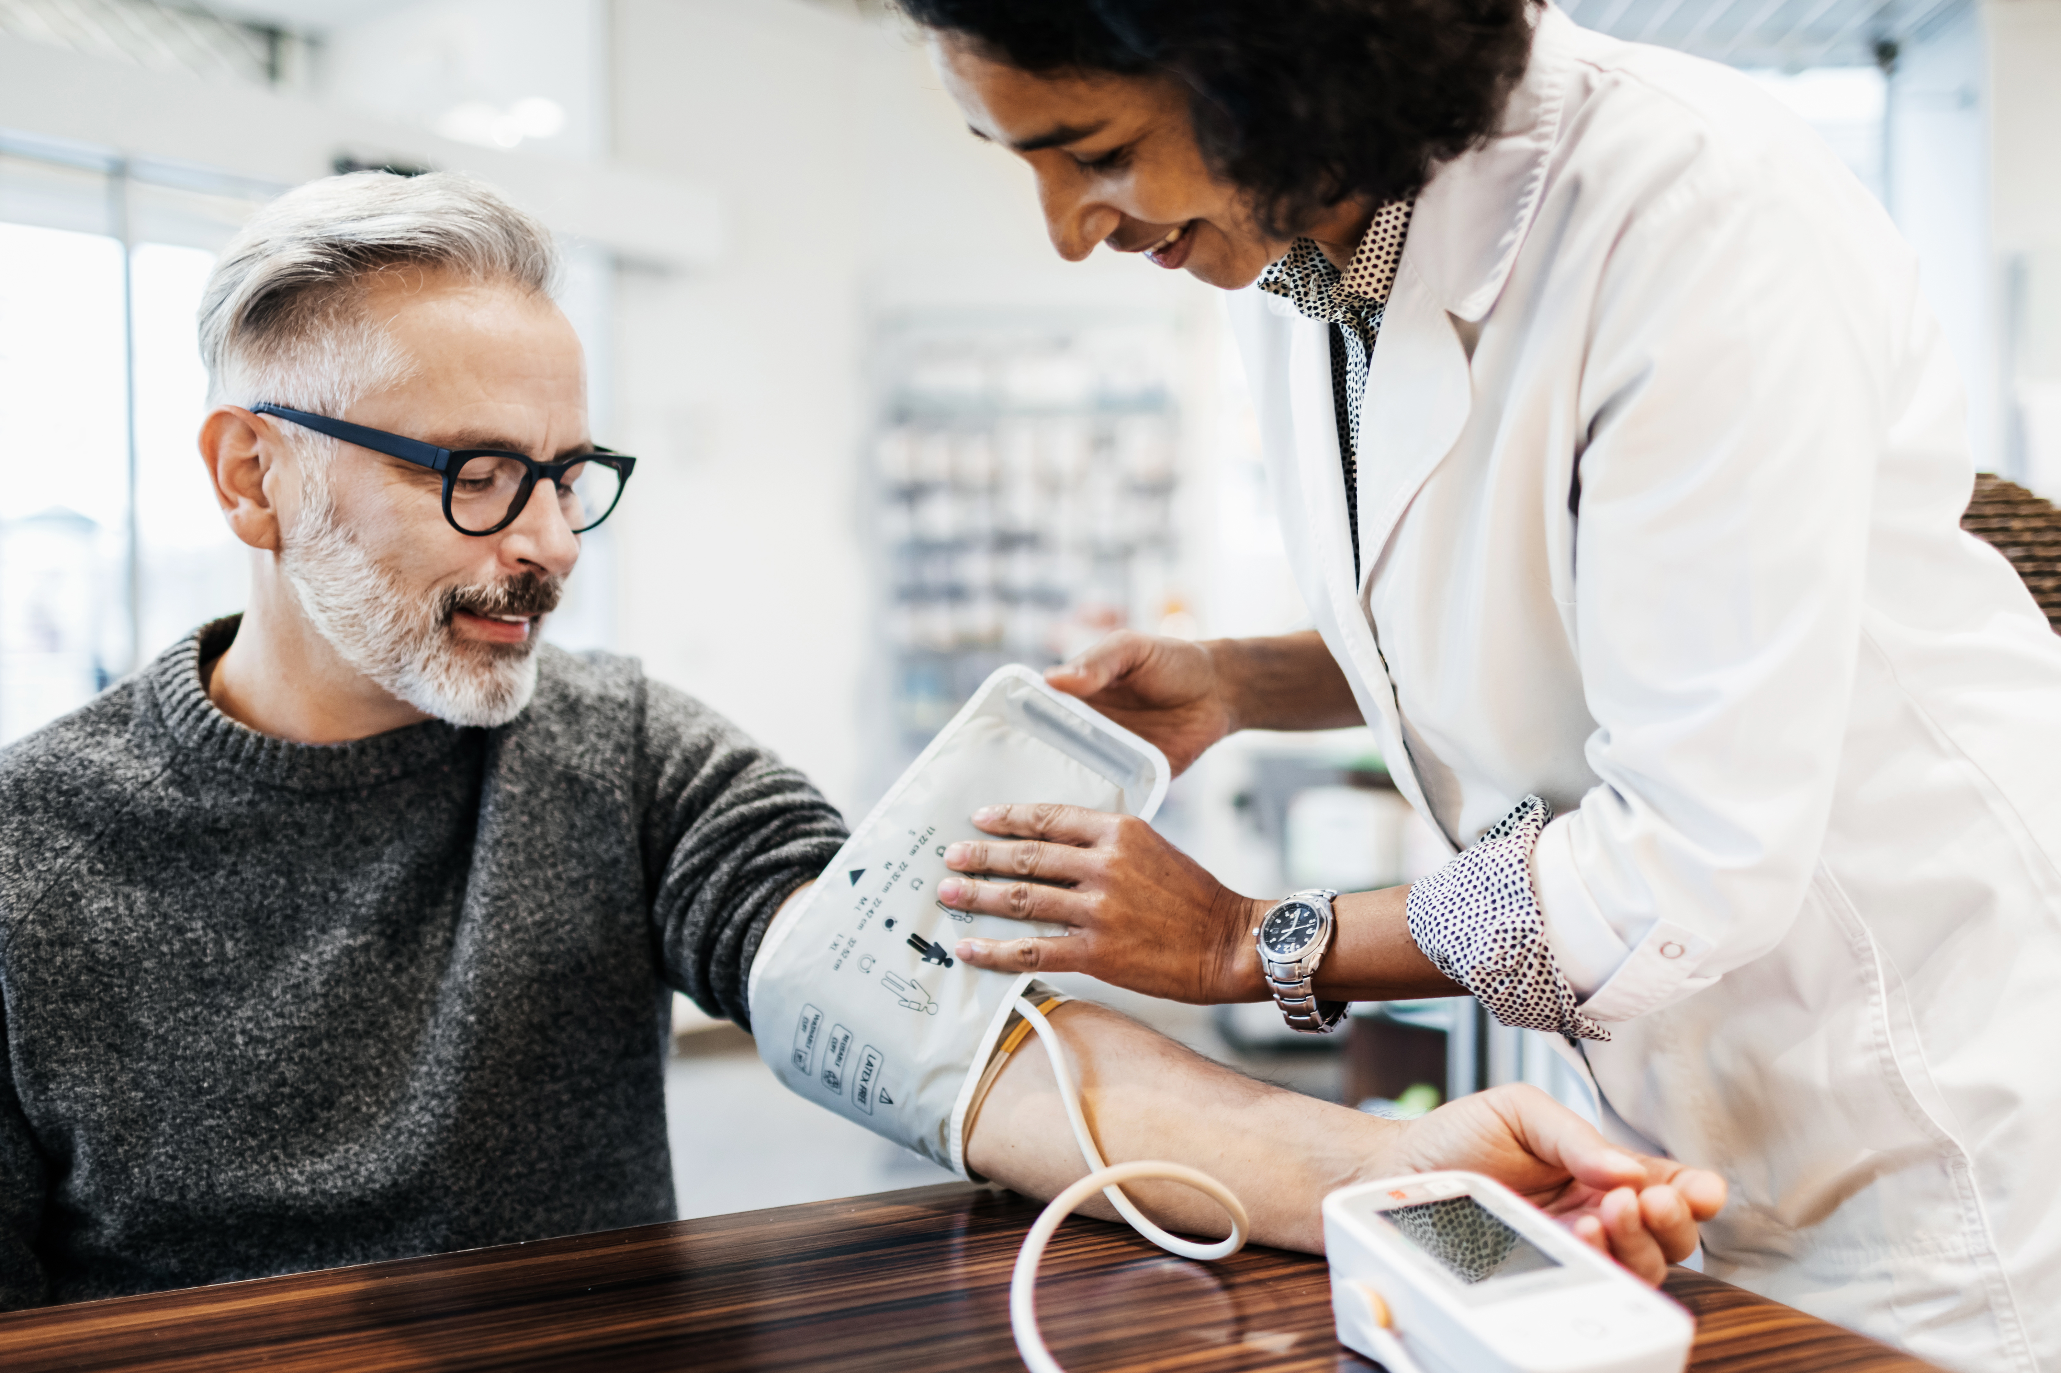
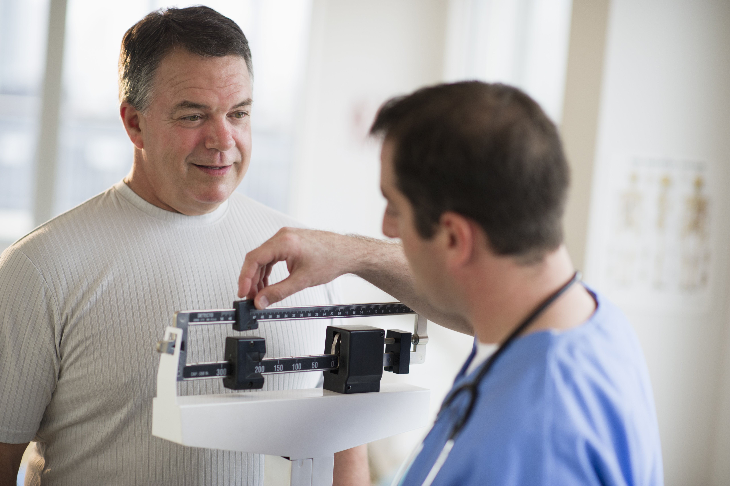
PCN SASSE1
Funding Boost of £6,500 from the PCN Board to top up the CPD funding already allocated to enhance educational activity further.
Regular CPD PCN Educational lunchtime seminars by local consultants. This is open to call PCN clinical staff to attend.
CPD Courses (Highlights) -Understanding blood test results- paramedics x2 -Clinical skills- paramedics -Royal college of Nurses Womens Health Conference-Nurse -Dermatology Annual surgery workshop- GP -Introduction to Dermoscopy Cardiff –GP -Cervical Screening course – nurse -Menopause diagnosis and Management – Nurse -Ripley Training Customer service skills training course onsite training – staff -Hypertension Master Class- Nurse -Essentials of COPD- Nurse -Ear Microsuction course-Nurse -How to manage common dermatological problems in children RCPH- ANP -Paediatric and Adolescent MSK disorders – ANP -Joint injection NB Medical – Paramedics and ANPs -Ultrasound guided injections – GP -Asthma Network conference - nurse -Red Whale update -NB Medical update
Oliver McGowan Training – A member practice has collaboratively worked with the education hub to be a host site.
Hosting student nurse placement in member practices.
2 Paramedics are practice paramedic assessors
2 new GP clinical supervisors in a member practice- expanding GP trainee numbers .
Increase in student placements- Paramedics students are allocated to the PCN and now looking to host pharmacists.
Employed a nurse who was a previous nursing student with us.
Supporting Nurse Associate trainee in a member practice.
2 Pharmacists have completed the independent prescribers course.
Sister Lisa Cook Nurse educAtor
Dr Dave Gill GP Educator
Pharmacy Technician has commenced her CPPE course.
PCN gained approval as a clinical learning environment in March 2025.
PCN Educator workforce planning workshop June 2025 attended by both Dr Gill and Sister Cook

