Slide 1


Career Development Pathways in Primary Care
Surrey Training Hub
Team email: syheartlandsicb.surreytraininghub@nhs.net
Website: https://www.surreytraininghub.co.uk/
This Career Pathway document will be reviewed annually for version updates
Thursday, 15 October 2025

Slide 2

What the Career Pathway is and is not
What a Career Pathway Is
A structured guide to help you understand your role, plan your development, and explore future career options. A tool to support career conversations during appraisals or supervision. A map of potential roles you can move into, either by progressing, changing focus, or gaining new qualifications. A way to identify training or learning opportunities that match your goals and the needs of your team or practice. Designed for everyone, clinical and non-clinical staff at any stage of their career.
What a Career Pathway Is Not
It’s not a guarantee of promotion, progress depends on readiness, opportunity, and funding. It’s not a one-size-fits-all checklist, your journey should be tailored to your strengths and goals. It does not replace HR processes or professional standards; you still need to follow your role’s specific requirements. It’s not just for clinical staff; administrative and non-clinical staff also have clear routes for development. It’s not a static document; it evolves with changing NHS roles and priorities.
Helpful Articles and Guides 🌐Visit Surrey Training Hub Website for more information on career pathways: www.surreytraininghub.co.uk 📩 Or email: syheartlandsicb.surreytraininghub@nhs.net Developing Your Career in the NHS – NHS Employers NHS Talent Academy Inspiring Futures and Informing Careers Primary Care Career Support – NHS Primary Care Careers Inclusion, equality and diversity Inclusion, equality and diversity – Leadership Academy
Statement
This document has been designed to provide an overview of career development opportunities across the primary care workforce. While it may not capture every individual role or job title, it serves as a practical guide to support you in exploring potential career progression, role development, and the training or qualifications that may be associated with these pathways.
It has been developed collaboratively with professionals and experts across education, training, and clinical practice to ensure it reflects current workforce priorities, emerging roles, and real-world progression routes within primary care.

Slide 3






Multi-professional Roles
Four Pillars of Professional Practice
Find out more about the
Clinical
Education
Research
Leadership & Management
The Four Pillars of practice— Clinical Practice, Leadership and Management, Education and Learning, and Research provide a multi-dimensional framework for any professional developing a progressive and fulfilling career within primary care.
By embracing all four pillars practitioners contribute not only as clinicians, but also as leaders, educators, and researchers, driving sustainable change and strengthening the capacity of the primary care workforce.
Advanced Practice Roles enhances career progression through structured pathways and recognition of advanced-level (Level 7) capabilities across the 4 pillars for greater autonomy and influence, allowing clinicians to shape service delivery and lead transformation. Improved patient care outcomes through high-level decision-making and evidence-based interventions which contributes to system-wide improvement via quality improvement, innovation, and policy development. An opportunity to support for future workforce development, acting as mentors, supervisors, and educators for the next generation and increase job satisfaction and retention, as practitioners are empowered to work at the top of their licence, utilising their full skillsets.Advanced Practice (AP) : Surrey Training Hub
Entry / Trainee
Beginning to develop advanced clinical reasoning and assessment skills under supervision. Shadowing, supervised practice, reflective learning.
Entry / Trainee
Participates in own learning, begins to support peers and students. May attend "train the trainer" or preceptorship sessions.
Entry / Trainee
Engages with evidence-based practice. Critically appraises literature. Participates in audit or quality improvement.
Entry / Trainee
Aware of service pressures and starting to engage with change initiatives. May support QI projects.
Experienced Practitioner
Applies advanced clinical decision-making independently. Manages undifferentiated and complex cases with increased autonomy.
Experienced Practitioner
Facilitates structured teaching and informal learning. Acts as mentor or supervisor to others. Supports induction and development plans.
Experienced Practitioner
Leads audits, implements evidence into practice, may co-author publications or service evaluations.
Experienced Practitioner
Leads small teams or projects. Influences local policy and supports organisational priorities.
Established / Expert
Leads clinical innovation, sets standards, and acts as an expert consultant in clinical decision-making. Guides others in clinical excellence.
Established / Expert
Designs education programmes, shapes curricula, and mentors multiple professionals. Leads interprofessional learning and promotes lifelong learning culture.
Established / Expert
Designs, leads, and disseminates original research. Promotes research culture. Influences policy through evidence. May supervise academic research.
Established / Expert
Strategic leader driving innovation, transformation, and cross-boundary collaboration. Contributes to policy and workforce planning.
Welcome –
Advanced Practice
Developing within the 4 Pillars of practice
Developing at level 2
Developing at level 3
Developing at level 4
https://www.hee.nhs.uk/sites/default/files/documents/Multi-professional%20framework%20for%20advanced%20clinical%20practice%20in%20England.pdf

Slide 4
Leadership & Management
How Leadership & Management Supports Career Retention and Development
Investing in leadership and management skills enables individuals to grow with purpose, take on greater responsibility, and influence positive change within their teams and systems. By offering structured pathways and accessible development opportunities, staff feel valued, supported, and empowered to progress.
This not only strengthens individual confidence and capability, but also improves job satisfaction, retention, and workforce stability. Embedding leadership at every level—from aspiring team leads to system leaders—ensures a continuous pipeline of confident, competent professionals ready to shape the future of care.
To support this, there’s a wide range of resources and programmes available, including:
Advanced Practice Leadership Management
AP Framework – Leadership Pillar
Coaching & Mentoring – Leadership Academy
Leadership and Management Framework Development – Information Pack 2025 NHS England
Leadership development opportunities – ICS surreyheartlands.org
Leading for Wellbeing Compassionate Leadership
NHS Leadership Academy
NHS Learning Hub Modules:
Protected Learning Time (PLT): Leadership-focused sessions via your practice or PCN CPD-funded courses via PCNs
Training Hub Leadership Development Programme

Slide 5




Knowledge & Development
Surrey Heartlands Resources for Knowledge and Development
In addition to the role-specific training outlined in this document, the Training Hub also provides access to a wide range of additional development opportunities and resources. These are designed to support both individual career progression and wider workforce development, and include:
Continuing Professional Development (CPD) – funded courses and learning opportunities to enhance skills and knowledge.
Protected Learning Time (PLT) – dedicated time for practices and PCNs to engage in collaborative learning and service development.
Library and Knowledge Services – access to evidence-based resources, journals, and research support.
Apprenticeships – structured work-based learning pathways across clinical and non-clinical roles.
CPD Funding
The process for CPD funding has now changed. The ICB has provided
funding for CPD via the PCN Educator project. Please contact your
PCN Educator directly to discuss your CPD requirements.
Continued Professional Development (CPD) : Surrey Training Hub
Annual allocation via PCNs for all CPD needs
Access through PCN Educators PCN Educator contact details
Information about other nationally recognised or locally run courses can be found here:
Surrey Training Hub Courses​
Protected Learning Time (PLT)
In recognition of the need for general practices to have protected time to access and
carry out essential training to support the great work that they do.
Protected Learning Time (PLT) : Surrey Training Hub
Themed sessions organised by Practice Managers and PCNs to address local, regional and nation requirements to support the workforce.
Access through Surrey Training Hub/PCNs
Surrey Training Hub Apprenticeships
Apprenticeships : Surrey Training Hub
Apprenticeship Programmes
Clinical Apprenticeships
An Apprenticeship is an opportunity to work and study at the same time, enabling
individuals to gain experience whilst taking nationally recognised qualifications, completing on programme learning and earning a salary.
For guidance on career pathways and programme access contact:
https://www.surreytraininghub.co.uk
Library Services
Access to knowledge and library services is available to all working in primary care
(GPs, nurses, pharmacists, allied health professionals, ophthalmologists, dentists,
managers and administrative staff) working across Surrey Heartlands.
Library and Knowledge Service : Surrey Training Hub
Key services
Evidence searches and summaries: to inform your decision making, quality
improvement projects and patient care
NHS Knowledge & Library Hub : support in using the hub which connects NHS staff to centrally funded e-resources
Munch & Learns : bite-size online training on how and where to look for evidence-based resources and tips to support academic studies and CPD
Knowledge Share : updates on the latest research evidence and tailored to your own clinical and professional interests
Surrey Heartlands authored papers Contact: Kerry.seelhoff@nhs.net

Slide 6




Health & Wellbeing
Workplace Health and Wellbeing in Surrey Heartlands Primary Care
Surrey Training Hub is committed to creating a healthy, supportive working environment across primary care. We aim to protect, promote, and improve the physical, mental, and social wellbeing of all staff through practical resources, inclusive policies, and a culture of care. By supporting our workforce, we strengthen resilience, improve retention, and enhance patient outcomes ensuring sustainable, high-quality care by our healthcare professionals.
Your Health and Wellbeing : Surrey Training Hub
NHS England » NHS health and wellbeing framework
Clinical Strategy - ICS
https://www.surreyheartlands.org/our-vision?utm_source
Our NHS People Promise
Insights and recommendations from a pan-London evaluation of initiatives to address educator burnout in primary care
https://www.nhsemployers.org/publications/nhs-health-and-wellbeing-framework?utm_source
NHS England » Looking after your team’s health and wellbeing guide
NHS Staff Survey 2024 Benchmark Report
Click on the video to find out more about the 10 Year Plan
“Health and wellbeing in the workplace means creating a safe, supportive environment where NHS staff in Surrey Heartlands feel physically well, mentally resilient, valued, and connected—supported through clear leadership, community engagement, targeted programmes, and data-driven improvement.”
With reference to the NHS Framework:
“Staff to feel well, healthy and happy at work…clear actionable steps…guidance on what good health and wellbeing looks like…."
The NHS Health & Wellbeing Framework describes this as:
“Staff to feel well, healthy and happy at work”“…an interactive document that makes the case for staff health and wellbeing, sets out clear actionable steps, and provides guidance on how organisations can understand what good health and wellbeing looks like…”
10 Year Health Plan for England: fit for the future

Slide 7
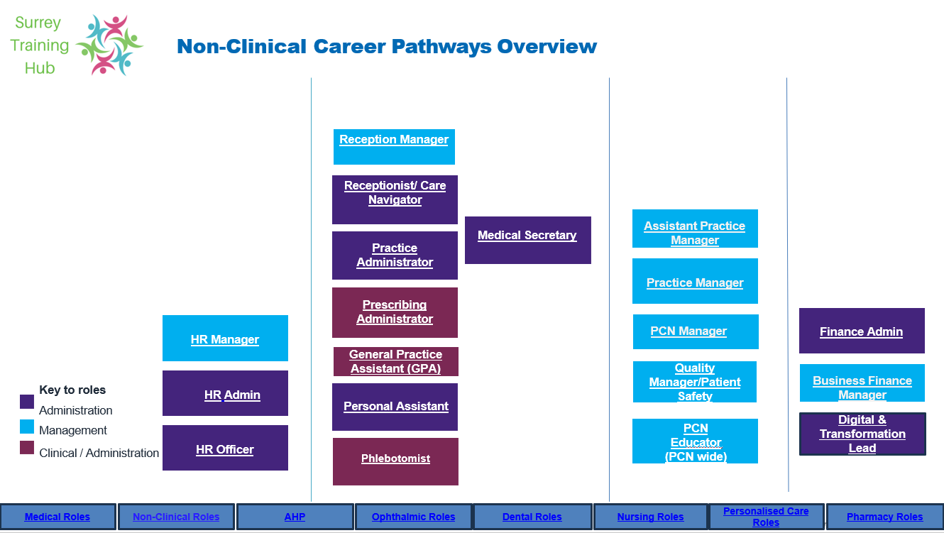
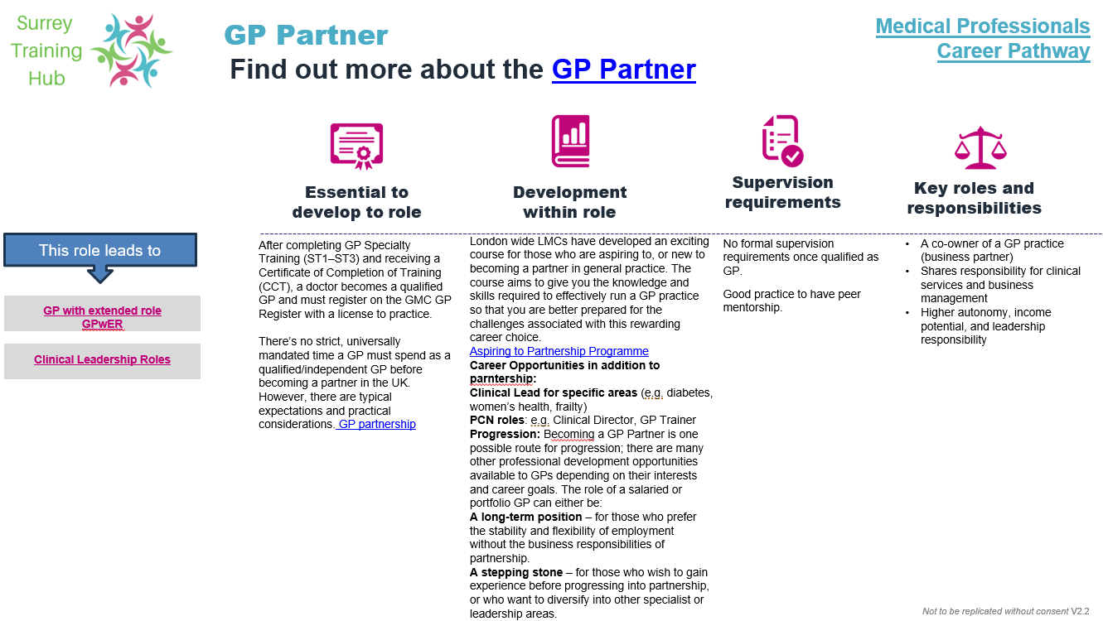





How to use this interactive document
Career Pathway Overview Role Requirements Overview
Click the home icon to view the career pathway overview
Click to switch between pathways
Click on a role to view the role requirements
Click these boxes to switch between roles.......
Click links for further information
If you have any comments, questions or feedback on this tool, please contact Alexandria.dyer4@nhs.net

Slide 8
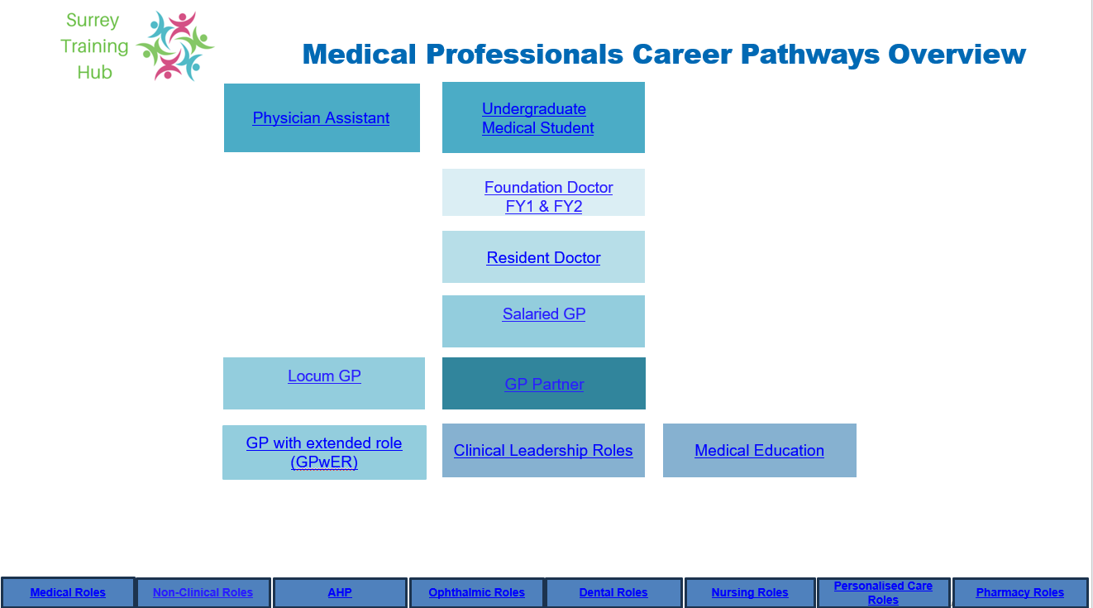
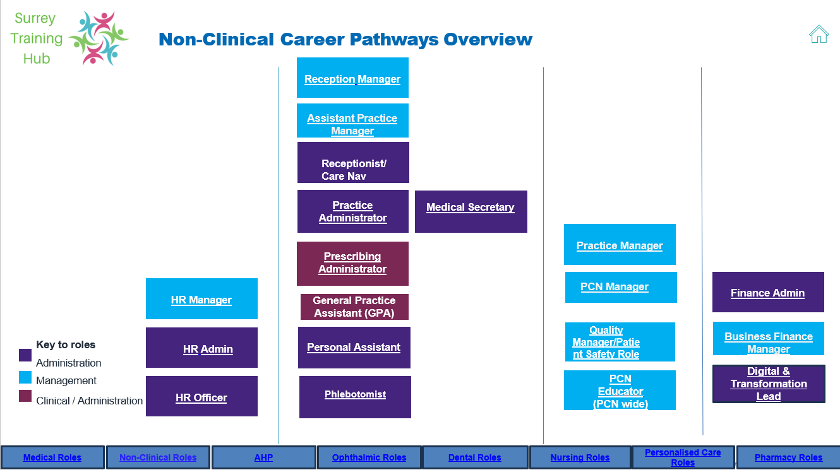


Choose your pathway
Medical
Professionals Career Pathways
Non-Clinical
Professional Career Pathways
Ophthalmic
Professional Career Pathway
Dental
Professional Career Pathway
Coming soon
Coming soon
Not to be replicated without consent V2.2
Notes:
Change hese when updated 16/07

Slide 9
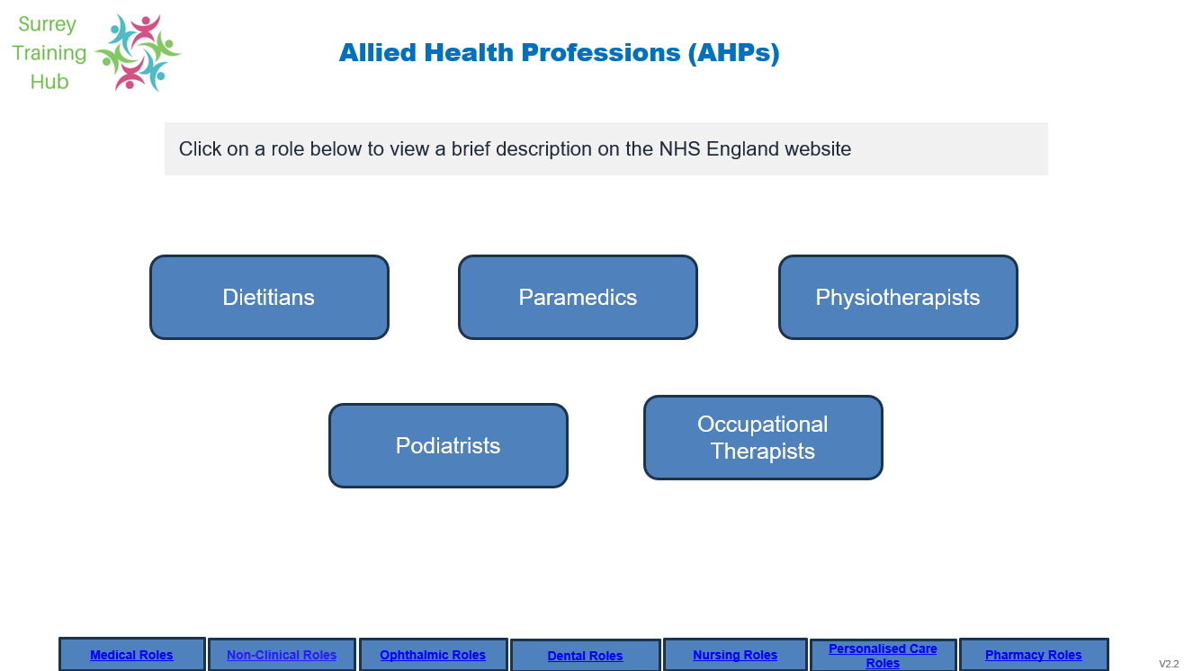
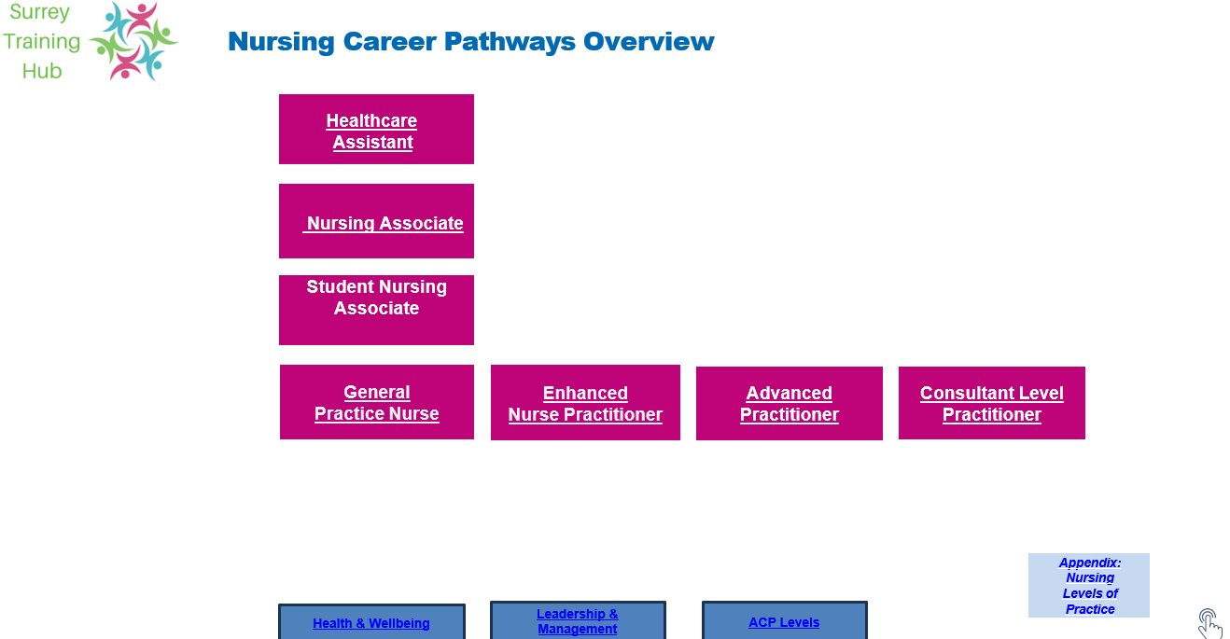
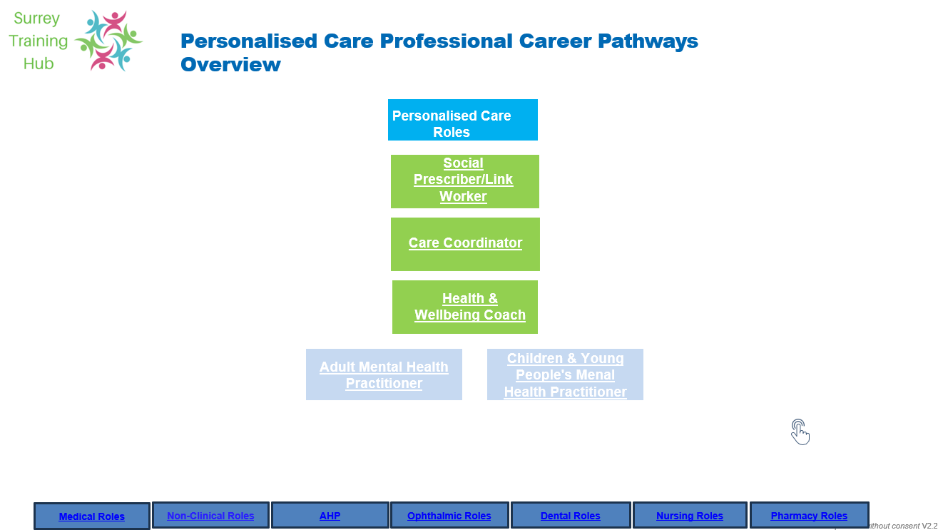
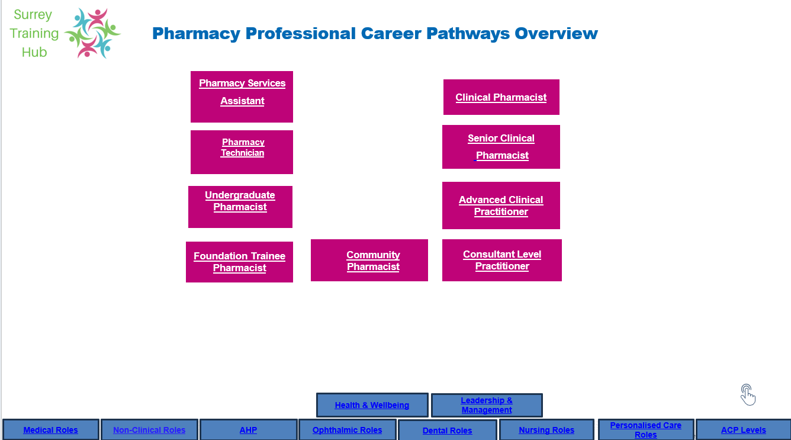
Choose your pathway
Allied Healthcare Professional (AHP) Career Pathways
Nurse Professionals
Career Pathways
Personalised Care Professionals Career Pathways
Pharmacy Professionals
Career Pathways
Not to be replicated without consent V2.2

Slide 10
Medical Professionals Career Pathways Overview
Physician Assistant
Undergraduate Medical Student
Foundation Doctor FY1 & FY2
Healthcare
Assistant
Resident Doctor
Salaried GP
Locum GP
GP Partner
GP with extended role (GPwER)
Clinical Leadership Roles
Medical Education
Medical Roles
Non-Clinical Roles
AHP
Nursing Roles
Personalised Care Roles
Pharmacy Roles
Health & Wellbeing
Notes:
Change tabs at the end when all agreed

Slide 11
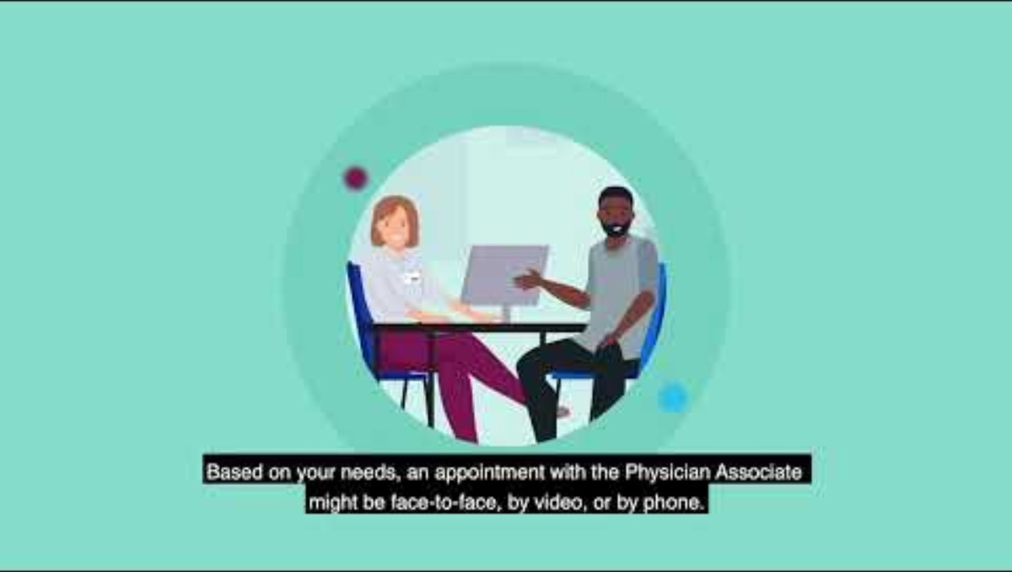
Medical Professionals Career Pathway
Physician Assistant
Find out more about the Physician Assistant
Essential to develop in role
Development
within role
Supervision requirements
Key roles & responsibilities
Primary care entry requirements:
All new PAs entering primary care must have completed a minimum of 2 years' employment in secondary care settings prior to their employment.
Complete Accredited PA Course
2-year PGDip or MSc (apprenticeship route available).
Pass PARA Exam
200-question test + 14-station OSCE
Up to 4 attempts per part
Register with GMC
Mandatory from Dec 2024
Optional PGCerts in education, leadership, or advanced practice (not required for registration).
Post-Qualification for UK Physician Assistants (PA)
Must register with GMC to practice legally (from Dec 2024).
Can work in clinical settings under supervision of a doctor.
Optional career development via PGCerts in:
  Medical Education Leadership
  Advanced Physician Assistants (APAs) — senior PAs with proven competence, leadership, and education responsibilities.
PAs should have the opportunity for ongoing training and development in the context of a formal certification and credentialling programme. This should include the ability to take on added responsibilities that are commensurate with that training.
PAs can teach, mentor, and support learners, particularly other PAs, nurses, or AHPs.
Recommendations and immediate actions from the Leng Review
PAs must always work under the supervision of a named senior doctor. The degree of supervision should be proportionate to the PA’s competence, experience and the clinical. Supervision must be formalised with defined responsibilities and adequate time. Newly qualified (0–2 yrs)-Direct supervision — all decisions discussed / reviewed. Experienced (>2 yrs)Indirect supervision — regular case discussion, available for escalation. Advanced / credentialled PA-Indirect, structured, working to defined scope, still under named doctor. Supervision of Physician Assistants Response to the recommendations of the Independent Review of Physician Associates and Anaesthesia Associates (the Leng Review)
To provide care to patients within the medical model as part of a multidisciplinary team, under supervision of a senior doctor, contributing to diagnosis, management and continuity of care.
Notes:
Add to website Physician associates | NHS Employers
Add video link or video to website
About the RCP | RCP
As the demands on the healthcare system evolve, clinical professionals are supported to recognise and embrace opportunities to transition into leadership and management roles, broadening their contribution beyond direct patient care. The four pillars of advanced clinical practice- Clinical Practice, Leadership and Management, Education and Learning, and Research, offer a framework for developing a well-rounded, progressive career in primary care.

Slide 12
Undergraduate Medical Student
Find out more about the Undergraduate Medical Student
Medical Professionals Career Pathway
Essential to
develop to role
Development
within role
Supervision requirements
Key roles and responsibilities
This role leads to
The first step for anyone wanting to pursue a career as a doctor is to study medicine at undergraduate level or via a graduate medical course. Normally this will take four to six years of study.
Clinical placements are integral to medical education, providing students with hands-on experience in various healthcare settings. Key aspects include:GMC UK-Introduction to our guidance on undergraduate clinical placements
Assessment strategies must be robust and aligned with the "Outcomes for Graduates":
Diverse Assessment Methods: Utilisation of various tools such as Objective Structured Clinical Examinations (OSCEs), written exams, and workplace-based assessments to evaluate competencies.
Blueprinting: Assessments should be systematically mapped to curriculum outcomes to ensure comprehensive coverage.
Feedback Mechanisms: Regular, constructive feedback is essential to guide student development.
Reasonable Adjustments: Accommodations must be made to support students with disabilities, ensuring equitable assessment conditions. GMC UK-Assessment in undergraduate medical education
​Each student is assigned a Named Educational Supervisor and a Named Clinical Supervisor to oversee their educational progress and clinical work, respectively. ​
Student Assistantships: In the final year, students undertake assistantships designed to prepare them for the responsibilities of a Foundation Year 1 (F1) doctor. GMC Clinical Placement
For comprehensive guidance, refer to the GMC's resources on Standards, Guidance and Curricula. These documents provide detailed information to support medical schools, educators, and students in delivering and engaging with high-quality medical education.GMC UK-Standards, guidance and curricula
Foundation Doctor
FY1 & FY2
Notes:
Add to website Search | RCP

Slide 13
Foundation Doctor
Find out more about the Foundation Doctor
Medical Professionals Career Pathway
Essential to
develop to role
Development
within role
Supervision requirements
Key roles and responsibilities
This role leads to
The Foundation Programme is a two-year, structured, workplace-based training programme bridging medical school and specialty/general practice training. It consists of six rotations across various specialties and settings, providing broad clinical exposure and experience.
Progression through the Foundation Programme is assessed through various methods:
Supervised Learning Events (SLEs): Including Mini-Clinical Evaluation Exercises (Mini-CEX), Direct Observation of Procedural Skills (DOPS), and Case-Based Discussions (CBDs).
E-Portfolio: A digital record documenting learning experiences, assessments, and reflections.
Annual Review of Competence Progression (ARCP): A formal review determining readiness to progress to the next training stage.
Progression through the Foundation Programme is assessed through various methods:
Supervised Learning Events (SLEs): Including Mini-Clinical Evaluation Exercises (Mini-CEX), Direct Observation of Procedural Skills (DOPS), and Case-Based Discussions (CBDs).
E-Portfolio: A digital record documenting learning experiences, assessments, and reflections.
Annual Review of Competence Progression (ARCP): A formal review determining readiness to progress to the next training stage.
​Supervision is a cornerstone of foundation training, ensuring patient safety and supporting doctor development:
Named Supervisors: Each foundation doctor is assigned a Named Educational Supervisor and a Named Clinical Supervisor responsible for overseeing educational progress and clinical work, respectively.
Level-Appropriate Supervision: Supervision levels are tailored to the doctor's competence, confidence, and experience.
On-Site Senior Support: Foundation doctors must have on-site access to senior colleagues for guidance and assistance.
Foundation doctors are expected to achieve specific competencies outlined in the Foundation Programme Curriculum. Key areas include:
Professionalism and Trust: Demonstrating integrity, compassion, and respect for patients.
Communication and Teamwork: Effectively interacting with patients, families, and healthcare teams.
Clinical Care: Assessing, diagnosing, and managing patient care safely.
Safety and Quality Improvement: Engaging in practices that enhance patient safety and care quality.
Teaching and Learning: Participating in educational activities and reflective practice.
These outcomes are detailed in the UK Foundation Programme Curriculum.
UK Foundation Programme - UK Foundation Programme
GP Speciality Training ST1-ST3
Notes:
Add to website Foundation Doctor 2025 Specialised foundation programme (SFP) recruitment and allocation | NHS England | Workforce, training and education
Search | RCP

Slide 14
Resident Doctor (GP Training)
Find out more about the Resident Doctor
Medical Professionals Career Pathway
Essential to
develop to role
Development
within role
Supervision requirements
Key roles and responsibilities
This role leads to
There are several routes to GP Training, and there is a pathfinder available here: Pathfinder for doctors who wish to gain entry to the GP Register (OLD)
The standard UK pathway is application through the National Recruitment Office on successful completion of the Foundation Programme: GP Specialty Training recruitment | Medical Hub
GP Resident Doctors complete a 3-year programme including 24 months of GP specific posts, and 12 months of hospital posts in a variety of clinical settings.
On successful completion of Workplace Based Assessments, and 2 exams (Applied Knowledge Test and Simulated Consultation Assessment, then the Certificate of Completed Training is awarded by the GMC
Progression through the GP Training Programme is regularly assessed:
Workplace Based Assessments:
All 3 years WPBA assessments
Records are maintained on the
RCGP e-portfolio.
Applied Knowledge Test (From Year 2) Applied Knowledge Test
Simulated Consultation Assessment (From Year 3) Simulated Consultation Assessment (SCA)
Annual Review of Competence Progression (ARCP): A formal review each 12 months of training determining readiness to progress to the next training stage.
​Supervision is a cornerstone of medical training, ensuring patient safety and supporting doctor development:
Clinical Supervisor (GP or Consultant):
Provides overall responsibility for the resident doctor through their individual training post (4-6 months). At the end of the post will provide a Clinical Supervisor Report (CSR) which provides evidence in the portfolio of progression.
Educational Supervisor (GP): Named GP who has accredited as an ES with the GMC quality processes. The ES provides educational overview of the Resident Doctor's entire 3-year programme. Provides twice yearly Educational Supervisor Reports, and the final "competent for licensing grading" on satisfactory completion of WPBA, AKT and SCA.
GP Resident doctors are key members of medical teams across hospital and community settings, providing care under a level of supervision that is appropriate to their experience and capabilities.
They are expected to engage fully in their WPBA requirements to demonstrate progression on the curriculum: GP curriculum
The Resident Doctor contract details the time allocated to clinical duties and the time designated as structured education in the working week.
Qualified GP/Salaried GP
Locum GP
Notes:
Add to website Foundation Doctor 2025 Specialised foundation programme (SFP) recruitment and allocation | NHS England | Workforce, training and education
Search | RCP

Slide 15
Salaried GP
Find out more about the General Practitioners (GP)
Medical Professionals Career Pathway
Essential to
develop to role
Development
within role
Supervision requirements
Key roles and responsibilities
This role leads to
Employed by a GP practice or Primary Care Network (PCN)
Career Opportunities:
Clinical Lead for specific areas (e.g. diabetes, women’s health, frailty)
PCN roles: e.g. Clinical Director, GP Trainer
Progression: Can stay long-term or use it as a stepping stone to partnership, portfolio roles, or specialist interests.
No formal supervision requirements once qualified as GP.
Good practice to have peer mentorship.
Encouragement of continued professional development is maintained to be kept up to date such as Early career GPs (First5)
Webinars : Surrey Training Hub
Core Responsibilities include:
Providing high-quality, patient-centred clinical care in line with NHS and GMC standards.
Managing acute and chronic conditions through consultations, home visits, and multidisciplinary collaboration.
Supporting preventative care, health promotion, and long-term condition management.
Participating in clinical governance, audits, and quality improvement activities.
Contributing to the training and supervision of other staff (e.g. GP registrars, students, nurses, and administrative teams).
Working closely with colleagues to ensure continuity and safety of patient care. BMA Salaried GP Hhandbook Update 2025.pdf
After completing GP Specialty Training (ST1–ST3) and receiving a Certificate of Completion of Training (CCT), a doctor becomes a qualified GP and must register on the GMC GP Register with a license to practice.
In order to practice in the UK, doctors who obtain their CCT in General Practice must also join the National Performers List.
​
GP Partner
GP with extended role
GPwER
Clinical Leadership Roles
Doctors who are the subject of undertakings or conditions imposed by NHS England (under the Performers Lists Regulations) and/or the General Medical Council (GMC)/the Medical Practitioners Tribunal (MPT) may require clinical supervision. The level of clinical supervision required will be prescribed by NHS England and/or the GMC and/or the MPT (in the case of the GMC and MPT, further information about supervision can be found here at pages 3-6
Notes:
Add to website Search | RCP

Slide 16
Locum GP
Find out more about the General Practitioners (GP)
Medical Professionals Career Pathway
Essential to
develop to role
Development
within role
Supervision requirements
Key roles and responsibilities
This role leads to
After completing GP Specialty Training (ST1–ST3) and receiving a Certificate of Completion of Training (CCT), a doctor becomes a qualified GP and must register on the GMC GP Register with a license to practice.
In order to practice in the UK, doctors who obtain their CCT in General Practice must also join the National Performers List.
Locum GPs can be hired by practices directly or via agencies or locum platforms. Locum GP's receive payments for short- or medium-term work, so need to complete their own tax returns and pension forms.
There is a requirement for good organisational skills, communication, and time-management skills to balance multiple roles, maintain accurate records, and meet both clinical and administrative responsibilities effectively.
The locum role allows for maximum flexibility in working patterns and therefore development opportunities are wide ranging. Many qualified GPs who have "portfolio" careers choose the locum GP pathway to allow them to work across different settings.
No formal supervision requirements once qualified as GP.
Good practice to have peer mentorship.
Encouragement of continued professional development is maintained to be kept up to date such as Early career GPs (First5)
Webinars : Surrey Training Hub
A Locum GP provides short-term or sessional clinical cover within GP practices, Primary Care Networks (PCNs), or other NHS primary care settings. The role ensures continuity of patient care during periods of leave, vacancy, or increased service demand. Locum GPs are typically self-employed and work under agreed terms that define the duties, hours, and scope of practice for each engagement. BMA GP Locum Handbook-2021.pdf
​
Qualified GP/Salaried GP
GP Partner
Clinical Leadership Roles
Doctors who are the subject of undertakings or conditions imposed by NHS England (under the Performers Lists Regulations) and/or the General Medical Council (GMC)/the Medical Practitioners Tribunal (MPT) may require clinical supervision. The level of clinical supervision required will be prescribed by NHS England and/or the GMC and/or the MPT (in the case of the GMC and MPT, further information about supervision can be found here at pages 3-6
Notes:
Add to website Search | RCP

Slide 17
GP Partner
Find out more about the GP Partner
Medical Professionals Career Pathway
Essential to
develop to role
Development
within role
Supervision requirements
Key roles and responsibilities
This role leads to
After completing GP Specialty Training (ST1–ST3) and receiving a Certificate of Completion of Training (CCT), a doctor becomes a qualified GP and must register on the GMC GP Register with a license to practice.
There’s no strict, universally mandated time a GP must spend as a qualified/independent GP before becoming a partner in the UK. However, there are typical expectations and practical considerations. GP partnership
London wide LMCs have developed an exciting course for those who are aspiring to, or new to becoming a partner in general practice. The course aims to give you the knowledge and skills required to effectively run a GP practice so that you are better prepared for the challenges associated with this rewarding career choice.
Aspiring to Partnership Programme
Career Opportunities in addition to partnership:
Clinical Lead for specific areas (e.g. diabetes, women’s health, frailty)
PCN roles: e.g. Clinical Director, GP Trainer
Progression: Becoming a GP Partner is one possible route for progression; there are many other professional development opportunities available to GPs depending on their interests and career goals. The role of a salaried or portfolio GP can either be:
A long-term position – for those who prefer the stability and flexibility of employment without the business responsibilities of partnership.
A stepping stone – for those who wish to gain experience before progressing into partnership, or who want to diversify into other specialist or leadership areas.
No formal supervision requirements once qualified as GP.
Good practice to have peer mentorship.
A co-owner of a GP practice (business partner)
Shares responsibility for clinical services and business management
Higher autonomy, income potential, and leadership responsibility
​
GP with extended role
GPwER
Clinical Leadership Roles
Notes:
Update GPA with New information from BNU received 15/04/2025 Make generic EOI and Flyer

Slide 18
GP with extended role GPwER
Find out more about the GPwER
Medical Professionals Career Pathway
Essential to
develop to role
Development
within role
Supervision requirements
Key roles and responsibilities
This role leads to
A GP with an extended role (GPwER) is a GP who undertakes a role that is beyond the scope of GP training and the MRCGP and requires further training.
A GP should be able to demonstrate:
evidence of a CCT or equivalent in
general practice
evidence of being currently registered and licensed and in good standing with the GMC
evidence of continued practice in a primary care role on a performers list (or equivalent) and active engagement in an annual medical (whole scope of practice) appraisal
RCGP-Guide-to-GP-clinical-extended-roles-June-21-v21.pdf
GPwER key distinction is that a GPwER’s management of the patient extends beyond the medical model, and as a GP they bring important additional skills in practicing holistically and dealing with complexity and uncertainty to these roles
There are many GP clinical extended roles and often local variation in roles to meet specific population needs. Some examples include:
Dermatology
Mental Health
Emergency Medicine
Women’s Health
Cardiology
Sports Medicine
General Practitioners with Extended Roles
Mentoring is a rewarding experience for both participants, so let's get started.
Mentoring journey overview
The GMC’s requirements for supporting information for appraisal and revalidation must be met for the GPwER scope of practice. This means that the annual appraisal portfolio should include the supporting information included below:
CPD
quality improvement activity (QIA)
significant events
patient feedback
colleague feedback
complaints and compliments.
Extended role accreditation
The RCGP’s position on extended role accreditation, and reaccreditation, is outlined in the RCGP guide to clinical extended roles.
The RCGP does not accredit GPs with extended roles but currently supports the British Association of Dermatologists to provide an accreditation programme for dermatology GPwERs.
Mentoring at RCGP
For some extended roles, GPs will be able to demonstrate competence through an accreditation process. The RCGP’s position is that:
Accreditation will only add value in a limited number of extended roles, where there are potential benefits in terms of patient safety and quality of care, and a desire by GPs for a route to demonstrate competence in these areas.
If an accreditation process is provided, it should be delivered as a primary/secondary care collaboration, involving jointly agreed assessment standards and both GP and consultant input into assessment and quality assurance processes.
Demonstration of continued competence through the annual medical appraisal and revalidation process replaces the former need for periodic reaccreditation.
​
Clinical Leadership Roles
Notes:
Update GPA with New information from BNU received 15/04/2025 Make generic EOI and Flyer

Slide 19
Clinical Leadership Roles
Find out more about Clinical Leadership
Medical Professionals Career Pathway
Essential to
develop to role
Development
within role
Supervision requirements
Key roles and responsibilities
RCGP Leadership Capabilities Framework support GPs to develop their leadership skills. It outlines the capabilities needed for leadership in different GP contexts. There are several GP leadership contexts, but we've focused on the most common:
GPs in postgraduate training – for doctors training to become a GP (trainees should refer to the relevant sections of the RCGP curriculum)
Practice level leadership – for leading immediate team or practice
locality level leadership – for leading services, groups or multiple practices or PCNs.
System level leadership - for leading whole organisations or healthcare systems, possibly at a national level
Medical Leadership Competency Framework
The framework aims to help GPs with personal development and career progression. Multidisciplinary teams can also use it as a training and development tool.
Using the framework
The framework consists of five key areas, taken from the NHS Medical Leadership Competency Framework.
Each area is broken down into smaller elements, showing the capability outcome expected at each career stage.
The RCGP's Mentoringplatform connects you with GPs who support one another in their personal and career development, locally and further afield, who can share a wealth of experience and knowledge. Connect with colleagues with leadership experience and skills on our mentoring platform.
Join their leadership forum to participate in open discussion to share ideas and network with members.
Self-awareness
Building self-belief
Understanding and developing your strengths
Developing a set of skills
Time management
Personal qualities and behaviours to influence outcomes
An Overview of GP Leadership - OLE module 1 - helps you to understand what leadership is, how it compares with management, and how you can understand yourself as a leader.
Importance of learning leadership skills at the start of a GP career.
​
Notes:
Create webpage
Add to webpage Leadership pillar | Turas | Learn
Tookit Advanced practice toolkit | Turas | Learn
Introduction to Advanced Practice
Professional Development and Advanced Practice
Pillars of practice
Clinical practice pillar
Facilitation of Learning pillar
Leadership pillar
Evidence, research and development pillar
Leadership Pllar Leadership pillar | Turas | Learn
Clinical Pillar Clinical practice pillar | Turas | Learn
Education Pillar Facilitation of Learning pillar | Turas | Learn
Research Pillar Evidence, research and development pillar | Turas | Learn
Developing leadership knowledge and skills Evidence, research and development pillar | Turas | Learn
Working with others Beginning Managing people and resources | Turas | Learn (nhs.scot)
Developing Managing people and resources | Turas | Learn (nhs.scot)
Extending Managing people and resources | Turas | Learn (nhs.scot)
Myers Briggs Type Preferences Perception Judgment
Myrersbriggs

Slide 20
Medical Education Leadership Roles
Find out more about Education Leadership
Medical Professionals Career Pathway
Essential to develop to roles
Development
within role
Supervision requirements
Key roles and responsibilities
Clinical Supervisor:
An appropriately trained educator who is responsible for overseeing a specified learner’s clinical work throughout a placement in a clinical environment.
Educational Supervisor: A trained educator who has personal responsibility for the development of an aspiring GP Resident Doctor in their 3-year training.
Requirements for each step in the educator pathway has clearly defined GMC standards:
Becoming a GP Educational Supervisor - Working across Kent, Surrey and Sussex
Doctors who take on the additional medical training roles and responsibilities have a general enthusiasm for their job and a desire to instill this in a new generation.
Each of the roles has specific development including the requirement for annual appraisal and CPD.
Clinical and educational supervisors will join a local faculty group and will be invited to regular CPD events from the affiliated training scheme Training Programme Directors.
CPD includes "hot topics" around the training requirements and Deanery updates, as well as more generic skills such as coaching, giving feedback, equality and diversity, quality improvement.
Educational supervisors are offered a funded place on PGCert (Medical Education and Strategic Leadership) course at the time of training for the role.
There are also opportunities to take on wider educational leadership roles, such as PCN Education Lead, coordinating multi-professional learning, mentoring new supervisors, or contributing to Training Hub or regional education initiatives that support collaborative workforce development across Surrey Heartlands.
Clinical and educational supervisors are maintained on a register and must reaccredit on a regular basis.
Annual peer appraisal is conducted as part of reaccreditation as well as a minimum attendance to local faculty training events.
Other quality markers are monitored including resident doctor feedback.
Clinical Supervisors:
Induction and orientation for new learners
Completing regular placement touch points and reviews of progress towards PDP.
Completion of workplace-based assessments
Completion of final evaluations of progress and performance in the post
Educational Supervisors:
Oversight of the entire 3-year training programme of a GP Resident Doctor
Remain an active member fo local faculty and Deanery representation
Maintain knowledge and performance of RCGP standards
Responsibility for completion of regular workplace-based assessment, regular developmental feedback, and final assessments of capability.
​
Notes:
Create webpage
Add to webpage Leadership pillar | Turas | Learn
Tookit Advanced practice toolkit | Turas | Learn
Introduction to Advanced Practice
Professional Development and Advanced Practice
Pillars of practice
Clinical practice pillar
Facilitation of Learning pillar
Leadership pillar
Evidence, research and development pillar
Leadership Pllar Leadership pillar | Turas | Learn
Clinical Pillar Clinical practice pillar | Turas | Learn
Education Pillar Facilitation of Learning pillar | Turas | Learn
Research Pillar Evidence, research and development pillar | Turas | Learn
Developing leadership knowledge and skills Evidence, research and development pillar | Turas | Learn
Working with others Beginning Managing people and resources | Turas | Learn (nhs.scot)
Developing Managing people and resources | Turas | Learn (nhs.scot)
Extending Managing people and resources | Turas | Learn (nhs.scot)
Myers Briggs Type Preferences Perception Judgment
Myrersbriggs

Slide 21
Non-Clinical Career Pathways Overview
Reception Manager
Receptionist/ Care Navigator
Assistant Practice Manager
Practice Administrator
Medical Secretary
Practice Manager
Prescribing
Administrator
HR Manager
PCN Manager
Finance Admin
General Practice Assistant (GPA)
HR Admin
Quality Manager/Patient Safety
Business Finance
Manager
Key to roles Administration Management
Clinical / Administration
Personal Assistant
PCN Educator (PCN wide)
Digital & Transformation Lead
HR Officer
Phlebotomist
Medical Roles
Non-Clinical Roles
AHP
Nursing Roles
Personalised Care Roles
Pharmacy Roles
Health & Wellbeing
Not to be replicated without consent V2.2
Notes:
Update this slide on slide 3
Correct the arrow
Tabs need rearranging

Slide 22
Non-Clinical Professionals Career Pathway
HR Manager
Find out more about primary care roles
Essential to
develop to role
Development
within role
Supervision requirements
Key roles and responsibilities
These are the core requirements and attributes needed to function effectively as an HR Manager:
Strong understanding of employment law, NHS terms and conditions, and HR policies
Experience managing employee relations cases (e.g. disciplinaries, grievances)
Knowledge of HR systems (e.g. ESR, Trac, HealthRoster)
CIPD Level 5 (minimum) or equivalent qualification
Excellent communication, negotiation, and conflict-resolution skills
Ability to maintain confidentiality and professional judgement
Strong analytical and problem-solving ability
Employment Law & ERCIPD Level 5 or Level 7 / ACAS Training | Acas CIPD | The Professional Body for HR & People Development
NHS Terms & Conditions
NHS Agenda for Change / Workforce Policy Training
NHS Employers People Analytics
Excel/Power BI / ESR Reporting / Workforce Planning
FutureLearn: Online Courses and Degrees from Top Universities
Leadership & HR Strategy
Mary Seacole or Elizabeth Garrett Anderson Programme
Leadership Academy – Better Leaders, Better Care, Brighter Future
Equality, Diversity & Inclusion
Inclusive Leadership / WRES training
NHS England » Equality, diversity and health inequalities
Talent Management & OD
OD Practitioner CPD / Coaching and Mentoring Qualifications
[CIPD / ILM / NHS Leadership Academy]
Health & Wellbeing
Staff Support Programmes / HR role in Occupational Health
NHS England » Supporting our NHS people
There are no mandatory supervision requirements for the role however ongoing training and development needs must be identified and discussed as relevant with their line manager.
Should have access to monthly supervision from a line manager. Should also have an appropriate named individual in the PCN to provide general advice and support on a day-to-day basis.
Workforce Planning & People Management
Employee Relations & Employment Law
Leadership & Staff Engagement
Policy & Compliance
Data, Reporting & Systems
Organisational Development & Change
This role leads to
PCN Manager
Useful Links
CIPD Qualifications and Career Support
NHS Employers – Workforce & HR Guidance
One NHS Workforce Planning
NHS Leadership Academy
www.bpp.com/courses/leaders hip-and- management/apprenticeships/s enior-people-professional
For more information https://haso.skillsforhealth.org. uk/pathways
Mid-Level Band 6–7
HR Manager / Employee Relations Specialist
Band 8a–8b
Senior Leadership
CIPD Level 7 -apprenticeship

Slide 23
Non-Clinical Professionals Career Pathway
HR Administrator
Find out more about primary care roles
Essential to
develop to role
Development
within role
Supervision requirements
Key Roles & Responsibilities
This role leads to
To succeed in the HR Administrator role, it’s essential to have:
Good organisational and communication skills
Attention to detail and accuracy in data entry
A basic understanding of employment processes and confidentiality
Confidence using Microsoft Office and HR systems (e.g. ESR, TRAC, NHS Jobs)
A helpful, approachable manner and a strong commitment to confidentiality and equality
As an HR Administrator, you can progress by:
Gaining experience in recruitment, payroll, and employee relations processes
Learning how to interpret HR policies and support casework administration
Building confidence with ESR and reporting tools (e.g. Excel)
Completing CIPD Level 3 in HR Practice or relevant HR modules
Working towards roles such as HR Officer, Recruitment Advisor, or ESR Specialist
Should have access to monthly supervision from a line manager. Should also have an appropriate named individual in the PCN to provide general advice and support on a day-to-day basis.
Maintain accurate employee records (paper/electronic).
Process contract changes
Manage starters/leavers documentation
Recruitment Support
Payroll Coordination
HR Correspondence
Data Entry & Reporting
General Office Support
HR Officer
HR Manager
HR Fundamentals (CIPD Level 3)
CIPD | The Professional Body for HR & People Development
NHS HR Systems (ESR, TRAC)
Home - elearning for healthcare
Payroll & Absence Management
Payroll Courses by IPPE | Online Training Options | CIPP
Communication & Organisation
The home of free learning from the Open University | OpenLearn - Open University
CIPD level 3 – example provider Level 3 HR Apprenticeship | Courses | BPP
Employment Law Introduction
Training | Acas
Employment standards and regulation | NHS Employers

Slide 24


Senior People Professional Level 7 Apprenticeship
The Role - Senior People Professional | Senior People Professionals are the in-house experts in people, work and change. They champion the people agenda to create working environments and cultures that help get the best out of people and as a result build employee engagement and high performance. Senior People Professionals may specialise in either Human Resources (HR), Learning and Development (L&D) or Organisation Design and Development (OD).
Who is it for | This apprenticeship programme supports individuals aiming to progress into a Senior People Professional role, with backing from their employer. It is ideal for: Those who’ve completed a Level 5 HR Apprenticeship and are ready for a senior or strategic role Operational professionals seeking senior or strategic progression Managers outside HR or Learning & Development
Duration | 2-3 years
Funding | Apprenticeship levy (via government co-funding 5% option or request levy gifting ) to pay fees. Employer pays salary. From 1 January 2026, the government will implement changes to the funding of Level 7 apprenticeships in England.
Find education provider | Training Providers
Apprenticeship requirements | 20% 'off the job' protected learning - Approximately one day a week of an apprentice's contractual working time over the duration of the programme will be given over to study.
Supervision & assessment in practice | Line managers will be a key driver in learner development, importantly in agreeing the unique learning plan and kept abreast of progress at every step.
End Point Assessment (EPA) | A work-based project and presentation with a Q&A session and a professional discussion underpinned by a portfolio of evidence
Progression routes | This programme will enable apprentices to develop the professional skills and subject expertise that will help them to further and excel in their career. Apprentices will be able to improve practices in their organisation, helping to drive performance and effectiveness. Senior People Professionals are the in-house experts in people, work and change.

Slide 25
Non-Clinical Professionals Career Pathway
HR Officer
Find out more about primary care roles
Essential to
develop to role
Development
within role
Supervision requirements
Key roles and responsibilities
This role leads to
Typical Band:
Band 5–6 Team: People Services / Workforce / HR Business Partnering
To perform successfully as an HR Officer, the following are essential:
Understanding of NHS HR policies (e.g. Agenda for Change, employment law basics)
Strong interpersonal skills – able to build trust with staff and managers
HR system proficiency – e.g., Electronic Staff Record (ESR), TRAC, NHS Jobs
Data handling and reporting – basic Excel, analytics, and confidentiality awareness
Attention to detail – particularly in contractual paperwork, HR letters, and policy interpretation
Emotional resilience and discretion – due to the sensitive nature of ER cases
Start or complete CIPD Level 5 (Associate Diploma in People Management) ICS Learn CIPD
Employment Law Knowledge Take ACAS courses in disciplinary/grievance Training | Acas
HR procedures System Mastery Attend ESR and TRAC training workshops; NHS Digital webinars Home - NHS England Digital
Move Towards HR Advisor Role take on ER casework, policy drafting, or project work under guidance of HRBPs
Should have access to monthly supervision from a line manager. Should also have an appropriate named individual in the PCN to provide general advice and support on a day-to-day basis.
Employee Relations Support
Recruitment & Onboarding
Policy and Advisory Support
HR Data and Records Management
Attendance and Sickness Monitoring
Learning and Development Coordination
Staff Engagement and Support
HR Manager
Quality Manager/Patient Safety Role
Progress to:
Band 6 HR Advisor / Senior HR Officer
Band 7 HR Business Partner
Band 7–8a HR Manager
www.bpp.com/courses/leaders hip-and-management/ apprenticeships/hr-consultant- partner
Employment standards and regulation | NHS Employers
For more information https://haso.skillsforhealth.org. uk/pathways

Slide 26


HR Support Level 3 Apprenticeship
The Role - HR Support | Human Resource professionals support managers and employees in organisations of all sizes. They provide frontline HR guidance based on company policy and current law, helping to minimize legal risks and avoid employment tribunals.
Who is it for | This Apprenticeship is ideal for existing employees who are looking to begin their professional journey in the Human Resources (HR) space. Throughout this apprenticeship, they will gain practical skills and insight into how the HR function supports an organisation and its culture – as well as developing a deep understanding of how your role supports colleagues as well as overall businesses goals.
Duration | 15-18 months
Funding | Apprenticeship levy (via government co-funding 5% option or request levy gifting ) to pay fees. Employer pays salary.
Find education provider | Training Providers
Apprenticeship requirements | 20% 'off the job' protected learning, which includes attending college sessions
Supervision & assessment in practice | Employers are expected to provide opportunities for apprentices to participate in work and projects that contribute to a portfolio of evidence required for assessment.
End Point Assessment (EPA) | The End Point Assessment consists of two parts : A Professional discussion and Q&A, supported by the summary of portfolio evidence and a Knowledge assessment.
Progression routes | Upon completion, apprentices will be eligible for Associate membership of the Chartered Institute of Personnel and Development. They may also choose to progress to the Level 5 People Professional Apprenticeship, which is suitable for those moving into advisory or more strategic roles.

Slide 27
Non-Clinical Professionals Career Pathway
Reception Manager
Find out more about the Reception roles
Essential to
develop to role
Development
within role
Supervision requirements
Key roles and responsibilities
This role leads to
There are no formal entry requirements for the receptionist role, making it an excellent starting point for individuals seeking to begin or develop a career in healthcare. Previous experience in customer service, administration, or reception work particularly within a medical or care setting is beneficial but not essential. Strong communication, organisation, and IT skills are advantageous, and comprehensive training and ongoing support are provided to help new team members succeed and progress within the role.
For training opportunities access can be gained through;
Practice Index GP Solutions/Receptionists in General Practice
Practice Index Summer Boucher
LMC New to Practice Management
Training - Surrey and Sussex LMCS
Coaching and Mentoring Teams - Practice Index Training
Further training will support upskilling & development to progress into other Primary Care roles:
Association of Medical Secretaries, Practice Managers, Administrators and Receptionists (AMSPAR)
British Society of Medical Secretaries and Administrators (BSMSA)
Care Certificate - eLearning for healthcare
Undertaking additional training to support your career pathway through L3/L5 training or apprenticeships
AMSPAR - Level 5 Courses
PMA Innovative Leader– Incorporating the Team Leader/Supervisor Level 3 Apprenticeship Standard - PMA
Level 3 Apprenticeship Standard PMA (pma-uk.org)
For apprenticeship opportunities contact Surrey Training Hub Apprenticeships
Example Apprenticeship route see link below:
Evolved Leader level 5
Operations Manager standard
Find providers who offer this training: HERE
Should have access to monthly supervision from a line manager. Should also have an appropriate named individual in the PCN to provide general advice and support on a day-to-day basis.
Induction and training of all new staff
Ensure adequate staffing levels and arrange reception team rotas
Manage the various appointments
Deal with more complex enquiries from patients and deputise for practice management Deal with general telephone enquiries from patients and general public
Record requests for repeat prescriptions
Make appointments for patient to see doctor, nurse and other clinical staff associated with the practice
The above list of duties is not exhaustive and may be subject to change as deemed necessary.
To become an effective front office supervisor, you can start by improving your listening, focus on working towards customer delight by providing exceptional service. It is also important to ensure that you and your staff have a thorough understanding of the property and its services.
  Practice Manager
Notes:
Create on ebpabe block links for each receptionist/Administration role

Slide 28
Receptionist
Find out more about the Care Navigator
Non-Clinical Professionals Career Pathway
Essential to
develop to role
Development
within role
Supervision requirements
Key roles and
responsibilities
This role leads to
Recommended 1-year minimum (reception experience or equivalent experience)
Receptionists in Primary Care - Practice Index Training include specific training courses in:
Reception Master Classes
Taking Control of the
Customer Conversation
Conflict Resolution
Resolving telephone conflict
Telephone Signposting
and Triage for Receptionists
and HCSWs
QOF training for receptionists / medical secretaries
Training can also be accessed through the LMC
You can advance to an apprenticeship Level 3 or similar focusing on health and wellbeing e.g.
Click for PMA training info
Care Certificate - eLearning for healthcare
Apprenticeships
Leadership and Management to support Wellbeing, Resilience and Leadership
A named first point of contact in the PCN (including GP). Monthly supervision can be provided by an appropriate member of the MDT including an advanced practitioner
Further guidance on supervision, education and training can be found in the workforce development framework for care navigators
Access to local and regional networks / local integrated action learning sets and The National Academy for Social Prescribing | NASP
FutureNHS Collaboration Platform - Get in touch to express your interest
Helen.rotonen@surreycc.gov.uk
Coaching and Mentoring support Expressions of interest to Coaching and Mentoring Hub : NHS Leadership Academy
Provides co-ordination and navigation through the health and care systems
Facilitates joint working across
organisations and MDTs
Makes referrals to services and other health and care professionals
Helps patients prepare for / follow-up and supports patients to book appointments
Signposts patients to information
Works in partnership with MDT colleagues including social prescribing link worker(s) and health and wellbeing coach(es)
See competency framework
as there is continuous development
in role to work through Bronze,
Silver and Gold levels
Reception Manager
General Practice Assistant (GPA)
Student Nursing Associate
Enrolled in, undertaking, or qualified from appropriate two-day care co-ordination training as accredited by the Personalised Care Institute Accredited eLearning completed in personalised care and support planning and shared decision making
Accredited Training Menu - Personalised Care Institute
Or access our STH A-Z
Training & Webinars
Surrey Training Hub Courses
Notes:
Add Care navigator to receptionist/Administration webpage
How to improve care navigation in general practice NHS England » How to improve care navigation in general practice

Slide 29
Non-Clinical Professionals Career Pathway
Practice Administrator
Find out more about the Practice Administrator role
Essential to
develop to role
Development
within role
Supervision requirements
Key roles and responsibilities
This role leads to
Confident in communication through a wide range of channels and competent in use of relevant IT databases
Current Adult and Child Safeguarding training level 1-3
Basic life support training
Example Apprenticeship route
Business Admin with embedded Clinical Coding | Incorporating the Level 3 Apprenticeship Standard PMA (pma-uk.org)
Apprenticeships | Surrey Training Hub Primary Care Training Hub
Undertaking additional training to support your career pathway
Once you have gained relevant skills you may be able to progress to:
Medical Secretary
Care Navigator or explore other clinical roles such as a Care Coordinator or general practice assistant (GPA) General Practice Assistant - eLearning for healthcare a HCA role, by taking your first steps into the clinical fields First Steps | Professional services | Royal College of Nursing which involves more duties and responsibilities. After further qualifications you may be able to train as a Nursing Associate and later on train to be a registered Nurse.
Should have access to monthly supervision from a line manager. Should also have an appropriate named individual in the PCN to provide general advice and support on a day-to-day basis.
Support the Practice Manager (PM)/ Quality Assurance Manager (QAM)
Work with the PM/QAM on any actions necessary
Ensures that all relevant DES/ LES policies / protocols are regularly updated and accessible
Supports the partners and PM/Admin Supervisor in the extraction of data for recalls and administrative duties
Liaise with the Nurse/partners to resolve any clinical issues / concerns when required
General Practice Assistant (GPA)
Receptionists in Primary Care - Practice Index Training include specific training courses in:
Reception Master Classes
Taking Control of the
Customer Conversation
Conflict Resolution
Resolving telephone conflict
Telephone Signposting and Triage for Receptionists and HCSWs
QOF training for receptionists / medical secretaries
Care Certificate - eLearning for healthcare​
Training can also be accessed through the LMC
Adheres to the NHS Values
The NHS values | Health Careers

Slide 30
Business Administrator Level 3 Apprenticeship
The Role - Business Administrator | Business Administrators support and engage with different parts of the organisation and interact with internal and external customers. They not only ensure the smooth running of processes and procedures, but also deliver robust record keeping, data management, and communication to stakeholders.
Who is it for | This apprenticeship covers all things administration such as communication, organisation, decision-making, interpretation of information and IT skills. The business administration apprenticeship can be contextualised to include specific areas within the primary care environment. Typical roles that this apprenticeship will support are Administration Assistant, Personal Assistant, Office Assistant, Medical Secretary, Administration Supervisor and Receptionist or Reception Supervisor.
Duration | 12-18 months at workplace
Funding | Apprenticeship levy (via government co-funding 5% option or request levy gifting ) to pay fees. Employer pays salary.
Find education provider | Training providers
Apprenticeship requirements | 20% 'off the job' protected learning. This will include a wide range of teaching and learning techniques and styles including one-to-one coaching, discussions and teaching, observations, practical assessments, mentoring, independent research and e-learning.
Supervision & assessment in practice | Line managers will be key drivers in learner development, particularly in agreeing to the unique learning plan and staying informed of progress at every step.
End Point Assessment (EPA) | The End Point Assessment consists of 2 methods: Observation with Questions and Professional Discussion.
Progression routes | The administration role may be a gateway to further career opportunities, such as management or senior support roles and undertake apprenticeships such as: Team Leader Level 3, Associate Project Manger level 4 or HR Support Level 3.

Slide 31
Non-Clinical Professionals Career Pathway
Medical Secretary
Find out more about the Medical Secretary roles
Essential to
develop to role
Development
within role
Supervision requirements
Key roles and responsibilities
This role leads to
There are no set requirements for the medical secretary role. Employers will generally ask for administrative experience as well knowledge of medical terminology.
Medical Secretarial training
e.g. Medical Secretary Diploma -
Level 2 | Pitman Training (pitman- training.com)
Association of Medical Secretaries, Practice Managers, Administrators and Receptionists (AMSPAR) ​
British Society of Medical Secretaries and Administrators (BSMSA)
Should have access to monthly supervision from a line manager. Should also have an appropriate named individual in the PCN to provide general advice and support on a day-to-day basis.
Arranging appointments and meetings and diary management
taking minutes
Dealing with enquiries and providing information by email and telephone
managing records, creating and up
dating spreadsheets and databases
Once you have gained relevant skill and experience as a Medical Secretary you may want to explore other roles such as a general practice assistant (GPA) General Practice Assistant - eLearning for healthcare may be able to progress to a clinical role What is a Healthcare Assistant (HCA)? Responsibilities & Career Path which involves more duties and responsibilities. After a further period of time, you may be able to train as a Nursing Associate and later on train to be a registered Nurse.
General Practice Assistant (GPA)
Personal Assistant
Example Apprenticeship route
Business Admin with embedded Clinical Coding | Incorporating the Level 3 Apprenticeship Standard PMA (pma-uk.org)
Undertaking additional training to support your career pathway;
Care Certificate - eLearning for healthcare
An Introduction to Medical Terminology - Practice Index Training
CQC Essentials for Administrative Staff - Practice Index Training
Care Navigation Training Course - Practice Index Training
In addition, there will be in house training to learn to work to practice/PCN medicines policies and protocols.​
Surrey Training Hub Courses​​
​
Relevant e-Learning for Healthcare (e-LfH) modules: ​
Catalogue​
Receptionists in Primary Care - Practice Index Training include specific training courses in:
Reception Master Classes
Taking Control of the
Customer Conversation
Conflict Resolution
Resolving telephone conflict
Telephone Signposting
and Triage for Receptionists
and HCSWs
QOF training for receptionists / medical secretaries
Training can also be accessed through the LMC
Apprenticeships | Surrey Training Hub Primary Care Training Hub

Slide 32


Prescribing Administrator
Find out more primary care roles
Non-Clinical Professionals Career Pathway
Essential to
develop to role
Development
within role
Supervision requirements
Key roles and responsibilities
This role leads to
Recommended 1-year minimum (reception experience or equivalent experience)
In addition, there will be in house training to learn to work to practice/PCN medicines policies and protocols.
Surrey Training Hub Courses​
Relevant e-Learning for Healthcare (e-LfH) modules:
Catalogue
Once you have gained relevant skills and experience in your role, you may want to explore other roles such as a general practice assistant (GPA) General Practice Assistant - eLearning for healthcare may be able to progress to a clinical role What is a Healthcare Assistant (HCA)? Responsibilities & Career Path which involves more duties and responsibilities. After a further period of time, you may be able to train as a Nursing Associate and later on train to be a registered Nurse.
Works and trains under the supervision of a suitably qualified person. This could be a pharmacy registrant or another appropriately qualified or experienced individual. See the
Pharmacy Inspections | GPhC | Standards
Follows specified practice/PCN
Guidelines and protocols
Has access to daily supervision from an appropriately trained supervisor.
Oversee prescribing activity and ensure accurate information is entered onto the prescribing system and prescriptions generated efficiently and effectively.
Processing of clinical data related to prescriptions as appropriate according to clinical instructions.
To print and distribute prescriptions as appropriate according to clinical instructions.
To ensure safe storage of controlled drug prescriptions and pads (in accordance with Misuse of Drugs regulations).
Liaise with pharmacies and GPs and respond to prescribing queries.
Undertake administrative duties e.g., office diary co-ordination, dealing with routine correspondence and to develop and effective maintain record keeping system.
Receptionists in Primary Care - Practice Index Training include specific training courses in admin:
The ‘Medicines Management Guide to Prescribing’ on the Surrey Prescribing Advisory Database (PAD) contains useful information including:
Signposting (section 1)
Guidance on general prescribing
situations and issues (section 3) -
Guidelines:MedicinesManagement
Prescribing Guides
Prescribing situations and issues around processes (section 5)
Section 5 - Prescribing situations and issues (Processes) Oct 2023.pdf
The ‘Repeat Prescription Management Guidelines’ on the Surrey PAD includes guidance for writing a practice prescribing policy and guidance on repeat prescribing: Guidelines : Repeat Prescription Management
General Practice Assistant (GPA)
Pharmacy Technician
For apprenticeship opportunities contact Surrey Training Hub Apprenticeships ​​
Find providers who offer this training: HERE
Notes:
The ‘Medicines Management Guide to Prescribing’ on the Surrey Prescribing Advisory Database (PAD) contains useful information including:
Signposting (section 1)
Guidance on general prescribing situations and issues (section 3) - Guidelines : Medicines Management Prescribing Guides
Prescribing situations and issues around processes (section 5) - Section 5 - Prescribing situations and issues (Processes) Oct 2023.pdf
The ‘Repeat Prescription Management Guidelines’ on the Surrey PAD includes guidance for writing a practice prescribing policy and guidance on repeat prescribing: Guidelines : Repeat Prescription Management

Slide 33
General Practice Assistant
Find out more about the GPA Role
Non-Clinical Professionals Career Pathway
Essential to
develop to role
Development
within role
Supervision requirements
Key roles and responsibilities
Undergraduate Pharmacist
This role leads to
Recommended 1-year minimum (reception experience or equivalent experience)
GPA FAQs
GPA Job Description
Receptionists in Primary Care - Practice Index Training include specific training courses in:
Reception Master Classes
Taking Control of the
Customer Conversation
Conflict Resolution
Resolving telephone conflict
Telephone Signposting and Triage for Receptionists and HCSWs
Understanding Investigations
Vitamin B12 Injection technique training
Training can also be accessed through the LMC
You can also see the Phlebotomist page
On-the-job GPA accredited training programme in line with the DES role outline and NHS National competency framework for GPAs
If interested in enrolling on the GPA programme please click GP-Assistant-Flyer.docx
For advice and guidance on the GPA accredited course contact
Alexandria Dyer syheartlandsicb.surreytraininghub@nhs.net
Care Certificate (strongly recommended to build foundation learning for the duration of the programme)
PMA Business Administration - GP Assistant Contextualised | Incorporating the Level 3 Apprenticeship Standard - PMA
On-the-job training and development should be led by a GP mentor, in line with the DES role outline and NHS National competency framework for GPAs
The GPA learner should receive half a day per week of mentoring, in addition to monthly reviews. Whilst the GP mentor is overseeing the learner’s development and has responsibility to sign off the competencies, this may include support from other members of the multi-disciplinary team.
Arranges clinical support: referrals, tests and follow-ups
Conducts simple clinical observations
Provides administrative support:
letters, completing forms for GPs
to sign
Explains procedures to patients
Once you have gained relevant skill and experience you can work towards a HCA role, you may be able to progress to taking your First Steps | Professional services | Royal College of Nursing which involves more duties and responsibilities. After a further period of time, you may be able to train as a Nursing Associate and later on train to be a registered Nurse.
EEA qualified international pharmacist
Receptionist
Healthcare Assistant
EEA qualified international pharmacist
Nursing Careers
Nursing Associate
Healthcare Assistant
Additional support with Wellbeing and Leadership or visit the Surrey Training Hub Health & Wellbeing resources Your Health and Wellbeing : Surrey Training Hub​
Nursing Associate
For apprenticeship opportunities contact Surrey Training Hub for Apprenticeships ​
Registered Nurse
Registered Nurse
General
Practice Nurse
General
Practice Nurse
Notes:
Update GPA with New information from BNU received 15/04/2025 Make generic EOI and Flyer

Slide 34
Non-Clinical Professionals Career Pathway
Personal Assistant
Find out more about primary care roles
Essential to
develop to role
Development
within role
Supervision requirements
Key Role & Responsibilities
This role leads to
To be effective in the role of a Personal Assistant (PA) within the NHS, it is essential to develop strong organisational, communication, and digital skills. This includes managing complex diaries, handling sensitive information with discretion, and using systems like Microsoft Office, Outlook, and ESR confidently.
As responsibilities grow, PAs can progress into senior administrative or executive support roles by enhancing their project support skills, understanding NHS governance structures, and completing relevant training in areas such as time management, digital systems, and professional communication.
Should have access to monthly supervision from a line manager. Should also have an appropriate named individual in the PCN to provide general advice and support on a day-to-day basis.
Diary & Calendar Management
Meeting Coordination
Communication Handling
Document Management
Confidential Correspondence
Stakeholder Liaison
Office Administration
Medical Secretary
General Practice Assistant (GPA)
Better skills, better jobs and better health - Skills for Health Sector Council
Medical Secretary Diploma – Level 2 | Pitman Training (pitman-training.com)
Receptionists in Primary Care - Practice Index Training include specific training courses in:
Reception Master Classes
Taking Control of the
Customer Conversation
Conflict Resolution
Resolving telephone conflict
Telephone Signposting
and Triage for Receptionists
and HCSWs
QOF training for receptionists / medical secretaries
Training can also be accessed through the LMC
Microsoft 365 Training
FutureLearn: Online Courses and Degrees from Top Universities
Leadership Academy – Better Leaders, Better Care, Brighter Future
Home - elearning for healthcare
Leadership Academy – Better Leaders, Better Care, Brighter Future
Progress to:
Band 4–5
Personal Assistant (PA)
Band 5–6
Executive Assistant / Senior PA
Band 6–7
Business Support Manager
Band 6–7
Project / Programme Officer

Slide 35
Phlebotomist
Find out more about primary care roles
Non-Clinical Professionals Career Pathway
Essential to
develop to role
Development
within role
Supervision requirements
Key roles and
responsibilities
This role leads to
Recommended 1-year minimum (reception experience or equivalent experience)
Berkshire and Surrey Pathology Services (BSPS) offers structured training pathways for phlebotomists, including advanced competency development.
Advance Phlebotomy Competency Training - CPD Certified
BSPS
Phlebotomists within BSPS complete advanced Phlebotomy training including Paediatrics and receive in-depth pre post analytical training to maximise sample quality. The portfolio completed by Phlebotomy is an initial 3 months at a Band 2 working under supervision, completion of competencies which elevate you to a Band 3.
You will work under the supervision or a more experienced colleague (e.g. senior nurse). This is referred to as a workplace competency assessment.
During this time, your performance is measured against agreed competency frameworks. That means the standards that have been agreed for phlebotomy in your health field.
Your mentor will use this time to help perfect your skills. For you, the workplace competency assessment is a chance to ask questions and benefit from constructive feedback.
The role of a phlebotomist includes:
Drawing blood from patients for various purposes, such as diagnostic testing, medical procedures, or blood donation.
Using techniques to locate veins, sanitise the puncture site, and efficiently draw blood with minimal discomfort to the patient.
Preparing the testing room with the proper tools.
Keeping patients calm while drawing blood.
Labeling samples for further analysis in medical laboratories.
Care Certificate - eLearning for healthcare (must complete) for building foundation learning in healthcare and proceeding to General Assistant Programme (GPA)
Please see for reference National Occupational Standard CH132 (obtain venous blood samples) which is the current and most widely adopted standard for phlebotomy and venepuncture practice.
https://tools.skillsforhealth.org.uk/competence-details/html/4381/
General Practice Assistant (GPA)
Student Nursing Associate
You can undertake Infection Prevention and Control (IPC)​​
Skills for Health modules 1&2.
Once you have gained relevant skills and experience as a phlebotomist you may want to explore other roles such as a general practice assistant (GPA) General Practice Assistant - eLearning for healthcare may be able to progress to a clinical role What is a Healthcare Assistant (HCA)? Responsibilities & Career Path which involves more duties and responsibilities. After a further period of time, you may be able to train as a Nursing Associate and later on train to be a registered Nurse.
Venepuncture (Phlebotomy) Training - Theory & Practical . After successful completion of the course and competence sign-off mentored practice will be required within a clinical setting
Access the The Ultimate Guide to Phlebotomy Training | Skills for Health
Notes:
to change icon on key roles/responsibility

Slide 36
Non-Clinical Professionals Career Pathway
Assistant Practice Manager
Find out more about the other non-clinical roles
Essential to
develop to role
Development
within role
Supervision requirements
Key roles and responsibilities
This role leads to
No pre-set entry requirements
Candidates recruited with a variety of academic qualifications or relevant experience
Level 3 Business Administrator Apprenticeship | Dynamic Training
AMSPAR - Level 5 Courses
The AMSPAR qualifications are designed for medical administration and management professionals. They include:
Level 5 Diploma in Primary Care and Health Management
Level 5 Certificate in Primary Care and Health Management
Level 3 Diploma in Medical Administration
AMSPAR - Qualification Costs
To progress to a practice manager it is usually required to hold a relevant qualification such as the Certificate/Diploma in Primary Care and Health Management (DPCHM) awarded by the Association of Medical Secretaries, Practice Managers, Administrators and Receptionists (AMSPAR).
​These qualifications are recognised in the UK and are aimed at enhancing the skills and competencies of medical secretaries, receptionists, and practice managers.
Additional training bundles:
Practice Manager Bundle - Practice Index Training
EMIS Awareness - Practice Index Training
Leadership & Management Bundle - Practice Index Training
GP Training Bundle - Practice Index Training​
Training - Surrey and Sussex LMCS
Should have access to monthly supervision from a line manager. Should also have an appropriate named individual in the PCN to provide general advice and support on a day-to-day basis.
Key duties and responsibilities include:
Overseeing the daily operations of the practice to ensure its smooth functioning
Developing and implementing office policies and procedures
Managing patient scheduling, registration, and billing processes
Handling the financial aspects of the practice, including budgeting, payroll, and accounting
Recruiting, hiring, training, and supervising office staff
Ensuring compliance with all healthcare regulations and safety standards
Negotiating contracts with vendors and service providers
Maintaining a safe and comfortable environment for patients and staff
Responding to patients’ complaints and concerns in a timely and professional manner
Overseeing the maintenance and procurement of office equipment and supplies
Practice Manager
Telephone Triage for Receptionists - Practice Index Training
EMIS Awareness - Practice Index Training
For Apprenticeship opportunities contact surrey Training Hub via Apprenticeships​​
​Example Apprenticeship route see link below:​
Evolved Leader level 5​
​Operations Manager standard ​
​Find providers who offer this training: HERE​

Slide 37
Non-Clinical Professionals Career Pathway
Practice Manager
Find out more about primary care roles
Essential to
develop to role
Development
within role
Supervision requirements
Key roles & responsibilities
This role leads to
No pre-set entry requirements
Candidates recruited with a variety of academic qualifications or relevant experience
The AMSPAR qualifications are designed for medical administration and management professionals. They include:
Level 5 Diploma in Primary Care and Health Management
Level 5 Certificate in Primary Care and Health Management
Level 3 Diploma in Medical Administration
To become a practice manager, it is usually required to hold a relevant qualification such as the Certificate/Diploma in Primary Care and Health Management (DPCHM) awarded by the Association of Medical Secretaries, Practice Managers, Administrators and Receptionists (AMSPAR).
​IGPM offer status accreditation. These qualifications are recognised in the UK and are aimed at enhancing the skills and competencies of medical secretaries, receptionists, and practice managers.
Additional training bundles:
Practice Manager Bundle - Practice Index Training
Should have access to monthly supervision from a line manager. Should also have an appropriate named individual in the PCN to provide general advice and support on a day-to-day basis.
A Practice Manager include:
Overseeing the daily operations of the practice to ensure its smooth functioning
Developing and implementing office policies and procedures
Managing patient scheduling, registration, and billing processes
Handling the financial aspects of the practice, including budgeting, payroll, and accounting
Recruiting, hiring, training, and supervising office staff
Ensuring compliance with all healthcare regulations and safety standards
Negotiating contracts with vendors and service providers
Maintaining a safe and comfortable environment for patients and staff
Responding to patients’ complaints and concerns in a timely and professional manner
PCN Manager
For Apprenticeship opportunities contact Surrey Training Hub Apprenticeships​​
​Example Apprenticeship route see link below:​
Evolved Leader level 5​
​Operations Manager standard ​
Training can also be accessed through the LMC
​
​
AMSPAR - Level 5 Courses
PMA Innovative Leader
Telephone Triage for Receptionists - Practice Index Training
Coaching and Mentoring Teams - Practice Index Training

Slide 38
Non-Clinical Professionals Career Pathway
PCN Manager
Find out more about primary care roles
Essential to
develop to role
Development
within role
Supervision requirements
Key Roles & Responsibilities
This lead at PCN Level, you would typically be an experienced manager, bringing both day-to-day management skills and a strategic perspective. Qualifications and experience required will vary, but a management qualification is desirable, and a proven history of motivating and managing people.
The IGPM has been created to support the development and career progression of the General Practice Management community and to provide a governing body through which managers can become accredited and fully recognised as a distinct profession.
Associate members of the IGPM can apply, if the Associate is appropriately experienced, to be accredited as a full Member of the IGPM.
ifgterpm.oearrgithin.uk/ accreditation
Should have access to monthly supervision from a line manager. Should also have an appropriate named individual in the PCN to provide general advice and support on a day-to-day basis.
Developing and implementing a management plan for their Primary Care Network
leading, managing, and
coordinating a team of primary
care professionals
Objectively evaluating the performance of the Primary Care Network
Developing strategies for optimising and improving the Primary Care Network
Building relationships with key stakeholders, such as local commissioners
Operational Management Course – CMI Level 5 - INPD INPD
Designed for aspiring and new Practice Managers, this programme covers key areas such as practice finances, HR, CQC compliance, and leadership.
​Primary Care Management Programme - PMA
PMA Senior Leader – Incorporating the Senior Leader Level 7 Apprenticeship Standard – PMA (pma-uk.org)
Leadership Academy – Better Leaders, Better Care, Brighter Future
Offers a range of online modules relevant to primary care management and leadership.
Advanced Level in leadership:
Mary Seacole
NHS Leadership Academy,
Surrey training hub leadership resources
A postgraduate-level diploma aimed at developing skills and competencies needed for managing primary care at scale. Diploma in advanced primary care management | HFMA

Slide 39
Operations Manager Level 5 Apprenticeship
The Role - Operations Manager | Operations managers lead teams and collaborate with senior managers to achieve organisational goals. They play a vital role in overseeing operational areas, ensuring teams are guided, supported, and aligned with company policies and legislation. Their responsibilities include setting and managing objectives, providing clear leadership, and ensuring smooth departmental functioning. In smaller organisations, they may also help execute strategic goals.
Who is it for | This level 5 management apprenticeship has been created for middle managers from any area in a business who run departments, other teams, or projects. This programme is ideal for: Operations Managers, Practice Managers, Regional Managers, Divisional Managers, Department Managers or Specialist Managers
Duration | 18-24 months
Funding | Apprenticeship levy (via government co-funding 5% option or request levy gifting ) to pay fees. Employer pays salary.
Find education provider | Training Providers
Apprenticeship requirements | 20% 'off the job' protected learning - Approximately one day a week of an apprentice's contractual working time over the duration of the programme will be given over to study.
Supervision & assessment in practice | Throughout the programme learners will develop a portfolio of evidence which will include academic assessments and work-based product evidence. They will be allocated a mentor by their workplace, who will support them throughout their journey and with the creation of their portfolio and completion of modular assessments. Their mentors will have the opportunity to contribute to their development and set meaningful targets via attendance at regular tripartite progress reviews.
End Point Assessment (EPA) | A professional discussion on the portfolio, a work-based project proposal, and a presentation with Q&A
Progression routes | This apprenticeship will give learners the skills, knowledge and behaviours to take on new opportunities to progress onto a senior management position. Upon completion of this apprenticeship learners can register as a full member with the Chartered Management Institute and/or the Institute of Leadership & Management. Apprentices with 3 years' of management experience can apply for Chartered Manager status through the CMI.

Slide 40
Non-Clinical Professionals Career Pathway
Quality Manager/Patient Safety Role
Find out more about primary care roles
Essential to
develop to role
Development
within role
Supervision requirements
Key roles and responsibilities
The role is essential in supporting and advancing high-quality care delivery across NHS services. It focuses on ensuring the achievement of safe, effective, and patient-centred outcomes through systematic evaluation, service improvement, and staff development.
Training can be accessed through Policy Manager - Practice Index HUB
Certified Professional in Patient Safety (CPPS) TM | Institute for Healthcare Improvement
Training can also be accessed through the LMC
Band 7:
Quality Manager
Undertake PGCerts, become QI project lead, engage with ICS-wide work
Band 8a+:
Head of Quality / Governance Lead
Strategic oversight roles, policy development, system-wide influence
Should have access to monthly supervision from a line manager. Should also have an appropriate named individual in the PCN to provide general advice and support on a day-to-day basis.
Key responsibilities and essential elements of the role include but not limited to:
Promoting Quality Standards
Monitoring and Improving Patient Outcomes
Develop and implement quality assurance frameworks
Ensure compliance with CQC, NHS England, and other regulator
Championing Patient Safety and Experience
Enabling Career Progression and Workforce Capability
Develop and implement quality assurance frameworks
Facilitate shared learning across departments
Support delivery of NHS Patient Safety Strategy and National Safety Standards
Oversee serious incident investigations
Ensure timely reporting on systems like Datix
Promote a just culture and psychological safety within teams
Professional Networks & Memberships
Community (The Health Foundation) – Join here
Institute of Healthcare Management (IHM) – Membership
NHS Clinical Governance Support Team (via ICBs)
Resources and Links
NHS Leadership Academy
NHS England Quality Improvement
Patient Safety Training - NHS
Q Community (Health Foundation)
HQIP Audit Training
Quality, Service Improvement and Redesign (QSIR) Practitioner - Courses The CPD Certification Service
CQC Essentials for Managers - Practice Index Training

Slide 41
PCN Educator
Find out more about STH Learning Environments
Non-Clinical Professionals Career Pathway
Essential to
develop to role
Development
within role
Supervision requirements
Key roles and responsibilities
Current or prior clinical registration (e.g. nurse, AHP, Pharmacist, GP, or educationalist background) or working in a leadership role across a PCN e.g. PCN Ops Manager
Knowledge of primary care structures and workforce challenges
Experience in education, supervision, and/or mentoring
Ability to coordinate multiple practices and stakeholders
Familiarity with national frameworks (NHSE 10-year Health Plan, CQC, GPN 10-point plan, Core Capabilities frameworks)
A desire grow and retain the right multiprofessional workforce with their PCN/Neighbourhood
Development focuses on expanding leadership skills in education, building interprofessional networks, and embedding inclusive, high-quality workforce development and learning environments within PCNs.
Enhance supervision confidence
Supervision for Multi-Professional Teams - eLearning for healthcare
Leadership Development Opportunities/ Programmes specifically the NHSE Interprofessional Education Leadership Fellowship (IELF) Leadership and Management : Surrey Training Hub
Develop the skills and confidence to lead on educational quality, governance, communication, and influence, while actively engaging with communities of practice and education forums—both locally and across wider system networks (e.g. via NHS Futures or system-wide collaborations).
Attend monthly PCN Educator Training Hub meetings Learning Environment : Surrey Training Hub
Should have access to monthly supervision from a line manager. Should also have an appropriate named individual in the PCN to provide general advice and support on a day-to-day basis.
A PCN Educator is responsible for supporting education, workforce planning and learner expansion across a Primary Care Network. The role ensures staff across clinical and non-clinical roles have access to high-quality learning, supervision, and career progression, aligned with local priorities and national standards.
This is a strategic and facilitative role, not usually a teaching post, but one that works alongside practices, Training Hubs, ICBs, and NHSE.
Acting as the Education point of contact within the PCN, signposting and skills development tracking
Equitable allocation of CPD funding
Lead on CLE approval/ annual review

Slide 42
Finance Administrator
Find out more about primary care roles
Non-Clinical Professionals Career Pathway
Essential to
develop to role
Development
within role
Supervision requirements
Key roles and responsibilities
This role leads to
A Finance Administrator is essential in supporting accurate financial processes and ensuring the smooth operation of NHS financial systems. This includes processing transactions, supporting budget monitoring, and ensuring adherence to financial governance and audit requirements.
Introduction to NHS Finance
NHS Finance Skills Development (FSD)
AAT Accounting Qualifications (Level 2–4)
L2 Accounts / Finance Assistant
L3 Assistant Accountant
L4 Professional Accounting or Taxation Technician
NHS Finance Academy Programmes (Aspiring Finance Leaders)
Public Sector Finance CPD (NHS-focused)
Should have access to monthly supervision from a line manager. Should also have an appropriate named individual in the PCN to provide general advice and support on a day-to-day basis.
Financial Transactions
Payroll & ESR Support
Budgetary Support
Data Entry & Analysis
Reporting & Compliance
Procurement Support
Stakeholder Liaison
Digital & Transformation Lead
Entry (Band 3)-Finance Administrator → Finance Assistant (Band 4)
Mid (Band 4–5) Finance Officer → Payroll Officer / Procurement Officer
Advanced (Band 6–7) Assistant Finance Manager → Finance Business Partner / Procurement Manager
Senior (Band 8+) Head of Finance / Head of Financial Services / Deputy Director of Finance
Notes:
Edit the link for T from Bus finance manager

Slide 43
Accounts or Finance Assistant Level 2 Apprenticeship
The Role - Accounts or Finance Assistant | The broad purpose of the occupation is to carry out accounting and finance tasks. These tasks support the creation of items such as financial statements and other data. Their work is carried out under supervision following set procedures for most tasks. Such tasks may include financial data entry, reconciling figures, trial balances, double-entry bookkeeping, handling accounts payable and receivable.
Who is it for | This Apprenticeship is ideal for existing employees with limited experience who are looking to build their skills in this essential role. This apprenticeship will benefit individuals already working at a junior role within an Accountancy department or finance function.
Duration | 15 months
Funding | Apprenticeship levy (via government co-funding 5% option or request levy gifting ) to pay fees. Employer pays salary.
Find education provider | Training Providers
Apprenticeship requirements | 20% 'off the job' protected learning, which includes attending college sessions
Supervision & assessment in practice | Employers are expected to provide opportunities for apprentices to participate in work and projects that contribute to a portfolio of evidence required for assessment.
End Point Assessment (EPA) | The End Point Assessment consists of two parts : A structured interview, supported by the summary of portfolio evidence and an in-tray test overview.
Progression routes | With an appropriate role that can demonstrate significant new learning, the next steps could be to progress onto our Level 3 Assistant Accountant Apprenticeship, Payroll Administrator level 3 or Level 4 Professional Accounting Apprenticeships.

Slide 44
Non-Clinical Professionals Career Pathway
Business Finance Manager
Find out more about primary care roles
Essential to
develop to role
Development
within role
Supervision requirements
Key roles and responsibilities
Typical Band: Band 6–8b Settings: NHS Trusts, Integrated Care Boards (ICBs), Commissioning Support Units (CSUs), Primary Care Networks (PCNs)
Core Requirements:
Professional finance qualification (e.g. AAT, CIMA, ACCA, CIPFA)In-depth knowledge of NHS finance, contracting, and performance monitoring
Strong Excel and financial modelling skills
Understanding of NHS business planning cycles, budget setting, and national policy
Excellent communication skills to engage both finance and clinical/non-finance colleagues
Entry (Band 6–7) Senior Management Accountant / Assistant Finance Manager
Mid-Level (Band 8a–b)
Business Finance Manager / Head of Finance
Advanced (Band 8c+)
Deputy Director / Director of Finance
Finance Apprenticeships – Leadership Academy
Should have access to monthly supervision from a line manager. Should also have an appropriate named individual in the PCN to provide general advice and support on a day-to-day basis.
Financial Planning
Business Partnering
Reporting
Contract Management
Workforce & Pay Monitoring
Capital & Projects
Audit & Governance
Example Senior Finance Apprenticeships see below.
L6 Accounting Finance Manager
L7 Accountancy or Taxation Professional

Slide 45
Non-Clinical Professionals Career Pathway
Digital and Transformation Lead
Find out more about Digital and Transformation Lead
Key roles and
responsibilities
Development
within role
Supervision requirements
Key roles & responsibilities
This role leads to
Background in project management, clinical systems, or business change
Often combined with PRINCE2 / Agile
or Lean Six Sigma qualifications.
Digital Academy Courses, NHS Transformation Directorate resources
Home | NHS Digital Academy
Postgraduate Certificate / Diploma in Digital Health, Data Science or Health Informatics
Universities offer NHS-funded or blended learning options:
Should have access to monthly supervision from a line manager. Should also have an appropriate named individual in the PCN to provide general advice and support on a day-to-day basis.
Undertakes transformation and improvement projects in PCNs, including the adoption and optimisation of digital tools
Improves population health, workforce, management, and estate planning, and care quality.
Quality Manager/Patient Safety Role
Project Officer / Change Facilitator (Band 5–6)​
Digital Transformation Lead / Programme Manager (Band 7–8a)​
Head of Digital / PCN Digital Lead / ICS Programme Lead (Band 8b–8c)​
Chief Information Officer / Director of Digital Transformation (Band 8d–9)

Slide 46
Pharmacy Professional Career Pathways Overview
Pharmacy Services
Assistant
Clinical Pharmacist
Pharmacy Technician
Senior Clinical
Pharmacist
Care Navigator /
Coordinator
Healthcare
Assistant
Undergraduate
Pharmacist
Advanced Clinical
Practitioner
Foundation Trainee Pharmacist
Community Pharmacist
Consultant Level
Practitioner
Health & Wellbeing
AHP ROLES
MULTI-PROFESSIONAL ROLES
Leadership & Management
ACP Levels
Medical Roles
Non-Clinical Roles
AHP
Nursing Roles
Personalised Care Roles
Not to be replicated without consent V2.2

Slide 47


Pharmacy Services Assistant
Find out more about becoming a Pharmacy Assistant
Pharmacy Professionals
Career Pathway
Key roles and responsibilities
General Practice Assistant (GPA)
Essential to
develop to role
Development
within role
Supervision requirements
Care Navigator/
Coordinator
This role leads to
Health and Science Level 2 Apprenticeship – 12-15 months You’ll receive training whilst working and be enrolled in a training course working towards a nationally recognised pharmacy services qualification at minimum RQF level 2
Pharmacy services assistant (level 2) - apprenticeship training course
Nationally recognised, credit-bearing qualifications are available
https://www.healthcareers.nhs.uk/explore-roles/pharmacy/roles-pharmacy
Pharmacy support staff education and training | General Pharmaceutical Council
Watch this video a day in the life of a pharmacy assistant Bing Videos
Home - Pharmacy Careers
Certificates in the Principles and Practice for Pharmacy Support Staff
opportunities as a pharmacy assistant which will upskill you in knowledge:
BTEC Level 2: Unit 2 – Principles of Health and Safety for Pharmacy Support Staff – PWDS
BTEC Level 2: Unit 3- Effective Teamwork within Pharmacy Services – PWDS
BTEC Level 2: Unit 5 – Dispensing and Supply of Prescribed Medicines and Medicinal Products – PWDS
After gaining experience as a pharmacy assistant, you can pursue further training to become a pharmacy technician, which involves completing a two-year accredited course combining practical work and study.
Working under the supervision of another person while they are training. This could be a registrant or another appropriately qualified or experienced individual.
NHSE Supervision guidance for primary care network multidisciplinary teams
Guide to Supervision in Primary care: A-guide-to-supervision-in-KSS-primary-care-V2.1-Oct-24.pdf
Local training and development opportunities are available by attending your local PLTs :Protected Learning Time (PLT) : Surrey Training
Pharmacy support staff have an important role in:
the dispensing and supply of medicines or medical devices
advising on the use of medicines and medical devices
assisting pharmacy professionals to provide pharmacy services
Please click here to read about different roles in pharmacy
Phlebotomist
Prescribing
Administrator
Pharmacy Technician
Pharmacy Services
Assistant
Useful Resources
Health Careers – Pharmacy Assistant
PWDS – Pharmacy Support Staff Programs
Not to be replicated without consent V2.2

Slide 48

Pharmacy Services Assistant Level 2 Apprenticeship
The Role - Pharmacy Services Assistant | The Pharmacy Services Assistant (PSA) works under the supervision of a Pharmacist, Pharmacy Technician, or other accountable healthcare professional. The PSA provides a variety of pharmacy and medicines services to patients, the public and other professional healthcare teams. The PSA supports the delivery of pharmacy services in a variety of pharmacy environments.
Who is it for | This Apprenticeship is a great way for individuals to gain the skills and qualifications needed to work in a pharmacy settings.
Duration | 12 months + EPA
Funding | Apprenticeship levy (via government co-funding 5% option or request levy gifting ) to pay fees. Employer pays salary.
Find education provider | Training Providers
Apprenticeship requirements | 20% 'off the job' protected learning, which includes attending college sessions
Supervision & assessment in practice | Apprentices receive work-based pastoral support and learning opportunities from employer (pharmacy assistants or pharmacy technician) and are assigned a college assessor.
End Point Assessment (EPA) | The End Point Assessment consists of a knowledge test, simulated observation and question/answer session and professional discussion.
Progression routes | Upon completion of the Apprenticeship, the apprentice will gain a Level 2 Qualification/Standard in Pharmacy Services. Apprentices could also choose to undertake further study to become a Pharmacy Technician.

Slide 49
Pharmacy Technician
Find out more about the Pharmacy Technician role
Pharmacy Professionals
Career Pathway
Essential to
develop to role
Development
within role
Supervision requirements
Key roles and
responsibilities
GENERAL PRACTICE PHARMACY TECHNICIAN PATHWAY
BTEC/NVQ 3 Pharmacy Services or equivalent in pharmaceutical sciences and registered with General Pharmaceutical Council GPhC) Pharmacy technician education and training | General Pharmaceutical Council
A Pre-Registration Trainee Pharmacy Technician (PTPT) requires community pharmacy or hospital experience/ placement.
Approved apprenticeship course providers and pathways can be found on the GPhC site here
Training in primary care for qualified pharmacy technicians is through the CPPE Primary Care Pharmacy Education Pathway (15 months)
Applicants must be in an ARRS role unless self-funding – Please refer to the guidance here
Enrolled in or qualified from an approved training programme that meets the
National Competency Framework for Primary Care Pharmacy Technicians
Identifying learning gaps and providing a structured career progression from pre-registration trainee, to foundation level practitioner to advanced practitioner using
Association of Pharmacy Technicians UK (APTUK) Foundation Pharmacy Framework:
Training for pharmacy technicians:
https://www.hee.nhs.uk/our-work/medicines-optimisation/training-pharmacy-technicians
Leadership Programmes
Supervision must be carried out monthly by a pharmacist or GP
Mentor and coaching training
Education and supervision training
Guide to Supervision in Primary care: A-guide-to-supervision-in-KSS-primary-care-V2.1-Oct-24.pdf
NHSE Supervision guidance for primary care network multidisciplinary teams
Local training and development opportunities are available by attending your local PLTs :Protected Learning Time (PLT) : Surrey Training
Useful Resources: Pharmacy Page: Surrey Training Hub
Supports Structured Medication Reviews (SMRs)
Counsels' patients on medicines
Manages prescriptions Conducts medicines reconciliation
Conducts medicines audits
Practice supervisor (PS) or Education supervisor (ES) or student placements, PTPTs and trainee pharmacist
Please click here to read about different roles in pharmacy
Statutory / regulator requirements General Pharmaceutical Council (GPhC)

Slide 50
Pharmacy Technician Level 3 Apprenticeship
The Role - Pharmacy Technician | Pharmacy Technicians work in a wide range of settings, including (but not exclusively): registered pharmacies, community services, justice (the Prison Service), GP Practices, dispensing doctors’ practices, care homes and integrated care boards, hospitals, mental health, defence (HM Armed Services) and within the pharmaceutical industry Pharmacy technicians manage the supply of medicines and devices in a pharmacy and assist pharmacists with advisory services. The actual work setting will determine the specific areas of activity that the Pharmacy Technician undertakes.
Who is it for | Those who work in a pharmacy environment and want to progress their pharmacy career and register with the GPhC.
Duration | 24 months
Funding | Apprenticeship levy (via government co-funding 5% option or request levy gifting ) to pay fees. Employer pays salary.
Find education provider | Accredited Training Providers
Apprenticeship requirements | 20% 'off the job' protected learning, which includes attending college sessions
Supervision & assessment in practice | Apprentices receive work-based pastoral support and learning opportunities from employer (pharmacist or pharmacy technician) and are assigned a college assessor.
End Point Assessment (EPA) | Professional Discussion based on a Portfolio of Evidence and observation with question-and-answer session
Progression routes | Upon successful completion of the programme Pre-Registration Trainee Pharmacy Technician (PTPT) apprentices will be registered Pharmacy Technicians, equipped to work in various pharmacy settings.

Slide 51
Undergraduate Pharmacy Student
Find out more about studying Pharmacy
Pharmacy Professionals
Career Pathway
Essential to
develop to role
Development
within role
Supervision requirements
Key roles and
responsibilities
This role leads to
Applying to become a pharmacist:
The first step to becoming a pharmacist is to take a Master’s degree (MPharm) course in pharmacy that is accredited by the General Pharmaceutical Council (GPhC).
Accredited pharmacy degree courses last for four years although there are five-year sandwich courses which include a year in the workplace. The course combines learning theory with gaining practical skills.
Undertake clinical placements in various settings as determined by the HEI. Surrey Heartlands clinical placements support email: syheartlandsicb.primarycareplacements@nhs.net
You can search for GPhC-accredited courses using our course finder.
After passing your MPharm degree, to register with the GPhC and practice as a pharmacist, you must:
Undertake a 12-month foundation training programme in community pharmacy, hospital pharmacy, general practice or other settings, or a combination of these (sandwich degrees include this).
In England, you apply for this programme through Oriel.
Pass the GPhC registration assessment.
You can then apply for Job vacancies for qualified pharmacists advertised on the NHS Jobs website and elsewhere.
Accredited courses must meet the GPhC’s standards but programmes vary in their content, the way they are structured, and how they are taught and assessed. The facilities available and amount of support and supervision may also differ from course to course.
Guide to Supervision in Primary care: A-guide-to-supervision-in-KSS-primary-care-V2.1-Oct-24.pdf
NHSE Supervision guidance for primary care network multidisciplinary teams
Assisting with medication reviews, identifying potential drug interactions, and ensuring proper medication adherence, leading to im-proved patient outcomes.
Participate in and promote preventive care measures such as vaccination programmes, health screenings, and patient education, contributing to better long-term health outcomes.
Updating and documenting outcomes for example from AccuRx messages from patients.
Holistic assessments: Including vital signs, BMI measurements, BP measurements, peak flow assessments.
Can alleviate some of the workload from GPs, nurses, and other clinicians by assisting in routine tasks such as patient consultations,
medication queries, and
administrative duties.
Audits or health promotion projects
Supporting the surgeries with QOF, Prescribing Quality/Incentives Schemes
Chronic Disease Management.
Foundation Trainee Pharmacist
GENERAL PRACTICE PHARMACIST PATHWAY
Careers in Pharmacy

Slide 52
Foundation Trainee Pharmacist
Find out more about studying Pharmacy
Pharmacy Professionals
Career Pathway
Essential to
develop to role
Development
within role
Supervision requirements
Key roles and
responsibilities
This role leads to
After passing the MPharm degree trainee pharmacists must then successfully complete all of the requirements of a GPhC accredited foundation trainee pharmacist programme in order to join the register as a pharmacist.
NHS England Foundation Trainee Pharmacist Programe Website
Trainee pharmacists spend 52 weeks in supervised training at an approved training site(s) e.g. in community pharmacy, hospital pharmacy, general practice or other settings, or a combination of these (sandwich degrees include this).
In England, you apply for this programme through Oriel
The 2021 standards for the initial education and training of pharmacists (IETP) introduced a new set of learning outcomes that cover the full five years of education and training.
Once you've successfully:
Passed your Foundation Training Year
Passed the Registration Assessment
You can apply for registration with the General Pharmaceutical Council (GPhC) and officially become a UK-registered pharmacist.
If you have completed an MPharm course which meets the 2021 standards, you will be assessed at prescribing as part of your foundation training.
Provided you are signed off by your designated prescribing practitioner, you will be eligible to apply to register as an independent prescriber(IP).
If you have completed an MPharm which meets the previous (2011) standards for education and training or are studying on an OSPAP course, you will not be eligible to register as an IP when you first register, regardless of when you complete your training, or sit the registration assessment.
You must take an accredited IP course once you have registered to become an IP.
Foundation training | General Pharmaceutical Council
Designated Supervisor (DS) - Registered pharmacist with 3+ years experience.
Designated Prescribing Practitioner (DPP) - Any healthcare professional with legal independent prescribing rights.
Guide to Supervision in Primary care: A-guide-to-supervision-in-KSS-primary-care-V2.1-Oct-24.pdf
NHSE Supervision guidance for primary care network multidisciplinary teams
Local training and development opportunities are available by attending your local PLTs :Protected Learning Time (PLT): Surrey Training
Useful Resources:
NHS England Trainee Pharmacist Foundation Year Programme/2025-2026
Trainee Pharmacists:CPPE
​Suggested activities for Foundation Trainee Pharmacists in general practice can be found in Appendix 1. How could a trainee support my practice?
Please click here to read about different roles in pharmacy.
Key responsibilities for Trainee Pharmacists Pharmacy Careers.
Clinical Pharmacist
GENERAL PRACTICE PHARMACIST PATHWAY
Notes:
Add to page 2 and associated linked pages

Slide 53

Community Pharmacist
Find out more about the Pharmacy roles
Pharmacy Professionals
Career Pathway
Essential to
develop to role
Development
within role
Supervision requirements
Key roles and
responsibilities
Registered with the General
Pharmaceutical Council (GPhC)
Register as a pharmacist.
Local training and development opportunities are available by attending your local Community Pharmacy Surrey & Sussex – Representing, supporting, developing and promoting NHS Community Pharmacy in Surrey and Sussex
Pharmacist Development | Student, Pre-Reg & Practice | RPS
Newly Qualified Pharmacist Pathway – CPPE
Designed specifically for pharmacists in their first year of practice CPPE NQP Pathway
If you are changing your area of practice, then please see our early careers pharmacists page for resources to support you to move into community pharmacy, hospital pharmacy or primary care.
RPS Core Advanced Pharmacist Curriculum
(Expert Professional Practice Curriculum)
​
Collaborating with general practice practitioners as these currently only apply for general practice staff only:
Guide to Supervision in Primary care: A-guide-to-supervision-in-KSS-primary-care-V2.1-Oct-24.pdf
NHSE Supervision guidance for primary care network multidisciplinary teams
Local training and development opportunities are available by attending your local PLTs :Protected Learning Time (PLT): Surrey Training We remain committed to inclusivity across all service providers. In recognition of the important role of Community Pharmacists, and the local arrangements that exist between PCNs and pharmacy providers, we encourage PCN leaders to include Community Pharmacists in relevant development activities, such as Protected Learning Time sessions, to strengthen integrated working across the wider system.
Accurately dispense prescriptions, ensuring the right medicine, dose, and instructions
Check for allergies, interactions, and contraindications
Ensure the safe storage, supply, and disposal of medicines
Provide clear advice on medication use, side effects, and adherence
Help relieve pressure on GPs and urgent care
Refer patients when red flags or complex issues arise
Support Primary Care Networks (PCNs) with clinical pathways and service delivery
Work with other professionals to improve integrated care and health
outcomes.
Whilst the core remains as dispensing prescriptions, majority of this can be delegated to support staff whilst the pharmacist focuses on national and locally commissioned services i.e Pharmacy First. Community pharmacies | Healthy Surrey
Other roles relating to Community Pharmacy are:
Clinical Director Pharmacist
Locum pharmacist
Superintendent Pharmacist
Pharmacist Development - Pharmacy Careers
Pharmacy Manager
Area Manager
Regional Manager
Professional Services Manager
GENERAL PRACTICE PHARMACIST PATHWAY
Statutory / regulatory requirements General Pharmaceutical Council (GPhC)

Slide 54

Pharmacy Professionals
Career Pathway
Clinical Pharmacist
Find out more about the Levels of Practice
Essential to
develop to role
Development
within role
Supervision requirements
Key roles & responsibilities
This role leads to
Registered with the General
Pharmaceutical Council (GPhC)
Register as a pharmacist.
Enrolled in or qualified from an approved training programme,
e.g. Primary care pharmacy education pathway (PCPEP) or equivalent. RPS Post-Registration Foundation Curriculum | RPS
Please see the following brochure for more information: pcpep-brochure.pdf (cppe.ac.uk). 18 month pathway.
The ability to independently prescribe is crucial for pharmacists delivering care across the NHS. Working with our partners and stakeholders, we are developing funded training offers for pharmacists aiming to become independent prescribers.
Independent Prescribing | NHS England | Workforce, training and education
-
Further development in mentoring and coaching training as well as education and supervision training
Chief Pharmaceutical Officer's Pharmacy leaders’ development programme
Clinical pharmacists must be supervised by a senior or advanced practice pharmacist at least once a month, with access to a GP for support / development.
CPPE pathway support:
CPPE Educational Supervisor
Clinical Mentor by CPPE
Local clinical supervisor
Local peer support in PCN
HEI support for supervision roles
Prescribing Development Programme | RPS
Designated Prescribing Practitioner (DPP) support
A Competency Framework for all Prescribers | RPS
DPP guidance and DPP competency framework Dec 2019.pdf Framework
Clinical Pharmacist responsibilities may include;
Practice supervisor (PS)
Independent Prescriber (IP)
Designated Supervisor (DS)
Designated Prescribing Practitioner (DPP)
Senior or Advanced Practitioner
As the demands on the healthcare system evolve, clinical professionals are supported to recognise and embrace opportunities to transition into leadership and management roles, broadening their contribution beyond direct patient care. The four pillars of advanced clinical practice- Clinical Practice, Leadership and Management, Education and Learning, and Research, offer a framework for developing a well-rounded, progressive career in primary care.
GENERAL PRACTICE PHARMACIST PATHWAY

Slide 55
Pharmacy Professionals
Career Pathway
Senior Pharmacist
Find out more about the Levels of Practice
Development
within role
Supervision requirements
Key roles & responsibilities
Essential to
develop to role
This role leads to
As a qualified Senior Pharmacist you will enhance as an Advanced Clinical Pharmacist/Specialist Pharmacist/Leadership Roles/PCN Lead Pharmacist.
Registered with the General
Pharmaceutical Council (GPhC)
Register as a pharmacist.
Completed and qualified from an approved training programme,
e.g. Primary care pharmacy education pathway (PCPEP) or equivalent. RPS Post-Registration Foundation Curriculum | RPS
Please see the following brochure for more information: pcpep-brochure.pdf (cppe.ac.uk). 18-month pathway.
Independent Prescribing | NHS England | Workforce, training and education
-
RPS Core Advanced Pharmacist Curriculum
(+/-Expert Professional Practice Curriculum)
ACP MSc qualification at Higher Education Institution
Advanced Level in leadership:
Chief Pharmaceutical Officer's Pharmacy leaders’ development programme
Further studies to progress to consultant by undertaking a RPS Consultant Pharmacist Curriculum
RPS Guidance
Advanced practice will require meeting GPhC outcomes.
Senior clinical pharmacists must be supervised by a GP or advanced practice pharmacist at least once every 3 months
If progressing to become an Advanced Pharmacy Practitioner please see Advanced practice page as well as
RPS Advanced Pharmacy Framework and Professional Knowledge Guides.
Local Pharmacy Networks
Advanced Clinical Pharmacist/ Specialist Pharmacist/ Leadership Role/ PCN Lead Pharmacist)
Conducts structured medication reviews (SMRs)​
Independent prescribing / deprescribing​
Provides medication advice to healthcare professionals and patients​
Optimises medication (e.g. antibiotic stewardship)​
Translates medicines national policies into local implementation​
Adopts a whole system approach to medicines management
Managing undifferentiated undiagnosed conditions
Assessing and triaging patients, including same day triage
Advanced Practitioner
Consultant Level
As the demands on the healthcare system evolve, clinical professionals are supported to recognise and embrace opportunities to transition into leadership and management roles, broadening their contribution beyond direct patient care. The four pillars of advanced clinical practice- Clinical Practice, Leadership and Management, Education and Learning, and Research, offer a framework for developing a well-rounded, progressive career in primary care.
GENERAL PRACTICE PHARMACIST PATHWAY

Slide 56
Nursing Career Pathways Overview
Healthcare
Assistant
Student Nursing Associate
Care Navigator /
Coordinator
Nursing Associate
General
Practice Nurse
Enhanced
Nurse Practitioner
Advanced
Practitioner
Consultant Level
Practitioner
Appendix: Nursing Levels of Practice
Medical Roles
Non-Clinical Roles
AHP
Health & Wellbeing
Personalised Care Roles
Leadership & Management
ACP Levels
Not to be replicated without consent V2.2

Slide 57

Healthcare Assistant (HCA)
Find out more about the HCA role
Nursing Professionals
Career Pathway
Essential to
develop to role
Development
within role
Supervision requirements
Key roles and responsibilities
This role leads to
Recommended 1-year minimum (reception experience or equivalent experience)
Available HCSWD Programmes | NHS Professionals
Care Certificate - elearning for (strongly recommended to build foundation learning for healthcare roles)
These are examples of clinical skills HCAs might develop within their roles;
ECG Training
Venepuncture Training
Immunisation updates
Vitamin B12 and Injection Techniques (Dependent on local practice requirements and scope of practice)
Health Care Support Worker: Senior Healthcare Support Worker Level 3
This role can lead into further career pathways to Student Nursing Associate (SNA) : Surrey Training Hub
Once you have gained relevant skills and experience as a HCSW/HCA, you may be able to progress to a Senior Healthcare Support Worker which involves more duties and responsibilities.
After a further period of time, you may be able to train as a Student Nursing Associate and later on train to be a registered Nurse.
Apprenticeships
Click for PMA training details
To work appropriately delegated and clinically supervised by a registered healthcare professional until competence is demonstrated by the HCA. Day to day clinical supervision should be available as required.
Administrative Tasks
Patient Comfort and Wellbeing
Collecting Vital Signs
Health Checks
Blood Pressure Monitoring:
Supporting Chronic Disease Clinics
Administering Vaccines:
Wound Care
Student Nursing Associate
Senior Health Care Support Worker Apprenticeship (Please seek guidance from your PCN for advice)
Healthcare Assistant | Primary Care Careers
Health Care Assistant Champions – supporting each other to do the best for patients - YouTube
Notes:
Add video links to nursing webpage
Let’s talk aboutperson centred care Let's talk about person-centred care | Caring with Confidence: The Code in Action | NMC
Delegation Let's talk about delegation | Caring with Confidence: The Code in Action | NMC
Caring with confidence Let's talk about delegation | Caring with Confidence: The Code in Action | NMC
Professional judgement ‘Let's talk about professional judgement | Caring with Confidence: The Code in Action | NMC
Judgement ‘Let's talk about professional judgement | Caring with Confidence: The Code in Action | NMC
Accountability Let's talk about accountability | Caring with Confidence: The Code in Action | NMC
Discrimination Let's talk about challenging discrimination | Caring with Confidence: The Code in Action | NMC
Enabling professionalism - rectifying medicines management issues
Enabling professionalism-Challenging poor practice Enabling professionalism - challenging poor practice
What makes you a registered professional What makes you a registered professional
Nursing and Midwifery – Practice assessors Nursing and Midwifery – Practice assessors
About the Nursing and Midwifery Council Just Used Confused | Dad 20s Car AD
NMC Revalidation NMC Revalidation
Reflection in Nursing (660) Reflection in Nursing – YouTube
Reflective Practice Reflective Practice

Slide 58
Senior Healthcare Support Worker Level 3 Apprenticeship
The Role - SHSW | The broad purpose of the occupation is support registered healthcare professionals in the delivery of high quality and compassionate health and care services. A senior healthcare support worker will provide clinical, therapeutic or diagnostic care under the direct or indirect supervision of a registered healthcare professional.
Who is it for | Junior or new HCSWs, orthose transitioning into the role from healthcare admin or phlebotomy roles, as it covers skills and knowledge needed and is flexible to suit abroad range of health and social care settings.
Duration | 18 months + EPA
Funding | Apprenticeship levy (via government co-funding 5% option or request levy gifting ) to pay fees. Employer pays salary.
Find education provider | Training providers
Apprenticeship requirements | 20% 'off the job' protected learning, which includes attending college sessions
Supervision & assessment in practice | Apprentices receive work-based pastoral support and learning opportunities from employer (nursing and senior HCSW team) and are assigned a college assessor.
End Point Assessment (EPA) | Assessed via written assignments and project work, discussions, presentation and a test. Completion of Functional Skills Level 2 and Care Certificate, as required.
Progression routes | Upon completion, learners can pursue a L5 Trainee Nursing Associate or Registered Nurse Degree apprenticeships.

Slide 59

Student Nursing Associate
Find out more about the SNA role
Nursing Professionals
Career Pathway
Essential to develop to role
Development
within role
Supervision requirements
Key roles & responsibilities
This role leads to
Obtained GCSE Maths and English at grade 9 to 4 (A to C) or Functional Skills Level 2 in Maths and English
Working towards completion of the Nursing Associate Apprenticeship or enrolled on an NMC approved provider 2-year foundation degree
Care Certificate (strongly recommended to build foundation learning for the duration of the programme)
Engage in Continuing Professional Development (CPD) courses in areas like diabetes, learning disabilities, or mental health.
Student Nursing Associate (SNA) : Surrey Training Hub
Level 5 NMC approved Nursing Associate qualification
NHS England GPN
National Careers
NHS England During training, those wishing to become nursing associates will develop the skills and knowledge, over the course of a two-year programme (such as an apprenticeship) to deliver care in a primary care setting. They deliver specific clinical tasks and direct care under the direction of a registered nursing associate (or other registered care professional). ​
Standards for pre-registration nursing associate programmes - The Nursing and Midwifery Council​
2-year foundation degree delivered by a Nursing and Midwifery Council (NMC) approved provider​
Register as a nursing associate - The Nursing and Midwifery Council
NHSE GPN Fundamentals
Should have access to monthly supervision from an experienced nursing associate, practice nurse or advanced nurse practitioner.
Should also have an appropriate named individual in the PCN to provide general advice and support on a day-to-day basis
Delivers care while under supervision of a nursing associate or registered nurse​
Develops own clinical competence​
Develops scope of practice in line with NHS England’s Primary Care and General Practice Nursing Career and Core Capability Framework​
Performs and records clinical observations
Nursing Associate
General
Practice Nurse

Slide 60
Nursing Associate
Find out more about the Nursing Associate
Nursing Professionals
Career Pathway
Essential to
develop to role
Development
within role
Supervision requirements
Key roles and
responsibilities
This role leads to
GCSE English and Maths A-C or equivalent / Functional Skills Level 2
During training, those wishing to become nursing associates will develop the skills and knowledge, over the course of a two-year programme (such as an apprenticeship) to deliver care in a primary care setting. They deliver specific clinical tasks and direct care under the direction of a registered nursing associate (or other registered care professional).
Standards for pre-registration nursing associate programmes - The Nursing and Midwifery Council
2-year foundation degree delivered by a Nursing and Midwifery Council (NMC) approved provider
Care Certificate (strongly recommended to build foundation learning for the duration of the programme)
Register as a nursing associate - The Nursing and Midwifery Council
NAs may wish to progress to registered nurse via the registered nurse degree apprenticeship RDNA pathway.
1-year minimum supervision
Should have access to monthly supervision from a practice nurse or other healthcare professional, e.g. advanced practitioner. Should also have an appropriate named individual in the PCN to provide general advice and support on a day-to-day basis
Standards for education and training standards for student supervision and assessment
Nursing Associates Working in Primary Care
Enables registered nurses to provide care
Supports and supervises student nursing associates (SNAs)
Performs and records clinical observations
Supports wound care management
Promotes health and wellbeing to patients
Advises and signposts patients
Maintains health records
Responsibilities may include:
Undertaking and recording clinical observations (e.g., blood pressure, temperature, pulse).
Taking blood samples.
Administering injections and medications.
Supporting patients and families with emotional and practical needs.
Identifying potential safeguarding concerns.
Ensuring privacy, dignity, and safety of patients.
General
Practice Nurse
Surrey Training Hub-Apprenticeships
standards for pre-registration nursing associate programmes.
Surrey Training Hub Courses
For apprenticeship opportunities contact Apprenticeship lead via Apprenticeships ​​
Find providers who offer this training: HERE
Notes:
Let’s talk aboutperson centred care Let's talk about person-centred care | Caring with Confidence: The Code in Action | NMC
Delegation Let's talk about delegation | Caring with Confidence: The Code in Action | NMC
Caring with confidence Let's talk about delegation | Caring with Confidence: The Code in Action | NMC
Professional judgement ‘Let's talk about professional judgement | Caring with Confidence: The Code in Action | NMC
Judgement ‘Let's talk about professional judgement | Caring with Confidence: The Code in Action | NMC
Accountability Let's talk about accountability | Caring with Confidence: The Code in Action | NMC
Discrimination Let's talk about challenging discrimination | Caring with Confidence: The Code in Action | NMC
Enabling professionalism - rectifying medicines management issues
Enabling professionalism-Challenging poor practice Enabling professionalism - challenging poor practice
What makes you a registered professional What makes you a registered professional
Nursing and Midwifery – Practice assessors Nursing and Midwifery – Practice assessors
About the Nursing and Midwifery Council Just Used Confused | Dad 20s Car AD
NMC Revalidation NMC Revalidation

Slide 61
Nursing Associate Level 5 Apprenticeship
The Role - Nursing Associate | Nursing Associates are regulated by the NMC and bridge the gap between HCSWs and Registered Nurses, allowing nurses to focus on more complex patient care. The Nursing Associate role is generic, meaning they work with people of all ages, in a variety of settings in health and social care.
Who is it for | The Nursing Associate Apprenticeship suitable is for healthcare workers currently employed in a healthcare setting, usually working as a healthcare assistant. The programme can also be used to support external recruitment of new Nursing Associate apprentices to your organisation.
Duration | 24 months
Funding | Apprenticeship levy (via government co-funding 5% option or request levy gifting ) to pay fees. Employer pays salary.
Find education provider | Training Providers
Apprenticeship requirements | Minimum 6 hours per week ‘off the job’ protected learning plus 2300 hours of protected learning time as required by the NMC – 50% theory time and 50% practice learning time (including 460 hours of external placement) Delivery models vary but typically include one day a week attendance at the Higher Education Institution
Supervision & assessment in practice | Supervision and assessment follows the NMC Standards for student supervision and assessment (nmc.org.uk), with a named Academic Assessor within the University, and named Practice Assessor & Practice Supervisor/s within the learning environment
End Point Assessment (EPA) | The end-point assessment comprises of an observation including question and answer session as necessary and a professional discussion.
Progression routes | Completing GP NA Fundamentals course. Development of scope of practice to include additional clinical skills (cytology/imms), with potential to focus within a specific area. Take on Practice Supervisor role for other learners and develop assessor skills. Progress to become a registered Nurse by continuing RNDA programme.

Slide 62
General Practice Nurse (GPN)
Find out more about the GPN role
Nursing Professionals
Career Pathway
Essential to
develop to role
Development
within role
Supervision requirements
Key roles and responsibilities
This role leads to
General Practice Nurses (GPNs) play a key part in delivering care within their communities, alongside other members of a multidisciplinary general practice team. They assess, plan, develop, implement, and evaluate treatment options for patients.
Managing your registration What is a general practice nurse? | Primary Care Careers
What is a general practice nurse? | Primary Care Careers
Enhanced clinical practitioner (level 6) - apprenticeship training course
Enhanced practice NHSE landing page
Could you be a nurse prescriber?
Under the new NMC standards, entry onto a programme is determined by whether you can provide evidence that you have the necessary skills, knowledge and experience to sign up.
It is essential to have workplace support, specifically an experienced member of staff to act as your clinical mentor. This role is called the designated prescribing practitioner.
All GPNs must have regular access to clinical supervision within their practice or PCN.
To develop the future nursing workforce the NMC requires GPNs to be practice assessors and practice supervisors.
NMC Standards for Education and Training Standards for Student Supervision and Assessment
A Competency Framework for all Prescribers
DPP guidance and Designated Prescribing Practitioner Competency Framework
A General Practice Nurse (GPN) is a registered nurse who works autonomously within a Multidisciplinary Team (MDT) within General Practice (GP) surgeries as part of a Primary Healthcare Team and is usually employed by the General Practitioners.
Working as part of a team, the role of the GPN is to assess, screen, and treat patients of all ages, including babies, children, and adults. GPNs also offer health promotion advice in areas such as contraception, weight loss and smoking cessation in addition to emphasis on promoting Women’s and Men’s health and providing national health prevention services like cervical screening and baby immunisations.
GPNs are usually directly employed by the GP practice on an individual employment contract.
Enhanced
Nurse Practitioner
As the demands on the healthcare system evolve, clinical professionals are supported to recognise and embrace opportunities to transition into leadership and management roles, broadening their contribution beyond direct patient care. The four pillars Clinical Practice, Leadership and Management, Education and Learning, and Research.
Graduate Certificate-General Practice Nursing 2025-26 | medtribe.com
Nurse prescriber: Course explained by qualified non-medical prescriber | RCN Magazine | Royal College of Nursing
Independent Prescribing/Supplementary Prescribing: | medtribe.com
The Levels of Nursing
Notes:
Let’s talk aboutperson centred care Let's talk about person-centred care | Caring with Confidence: The Code in Action | NMC
Delegation Let's talk about delegation | Caring with Confidence: The Code in Action | NMC
Caring with confidence Let's talk about delegation | Caring with Confidence: The Code in Action | NMC
Professional judgement ‘Let's talk about professional judgement | Caring with Confidence: The Code in Action | NMC
Judgement ‘Let's talk about professional judgement | Caring with Confidence: The Code in Action | NMC
Accountability Let's talk about accountability | Caring with Confidence: The Code in Action | NMC
Discrimination Let's talk about challenging discrimination | Caring with Confidence: The Code in Action | NMC
Enabling professionalism - rectifying medicines management issues
Enabling professionalism-Challenging poor practice Enabling professionalism - challenging poor practice
What makes you a registered professional What makes you a registered professional
Nursing and Midwifery – Practice assessors Nursing and Midwifery – Practice assessors
About the Nursing and Midwifery Council Just Used Confused | Dad 20s Car AD
NMC Revalidation NMC Revalidation

Slide 63

Enhanced Nurse Practitioner
Find out more about the Advance Practice
Nursing Professionals
Career Pathway
Essential to
develop to role
Development
within role
Supervision requirements
Key roles and responsibilities
This role leads to
Has completed a nursing degree or Registered Nursing Degree Apprenticeship (RNDA)
Registered with the NMC
Has a post graduate qualification at level 7 or above RELEVANT to the area of enhanced practice, for example in wound care, diabetes, respiratory, CVD, Dementia, Women’s Health, Public health, and Population Health Management.
Is working at an enhanced level of practice as described in the primary care and General Practice nursing Career and Core Capabilities Framework: HERE
The Principles of Enhanced Level Practice.pdf
Enhanced practice NHSE landing page
​
NHSE accredited MSc advanced practice programme or the NHS England e- Portfolio (supported) process
Clinic/practice supervision: day-to- day support provided by a named/duty senior/more experienced clinician for issues arising in the practice.
Clinical/professional supervision: regular support from a named senior/ experienced clinician/practitioner to promote high clinical standards and develop professional expertise.
Educational supervision: supports learning and enables learners to achieve proficiency.
Supervision Guidance for primary care network multidisciplinary teams (NHSE,2023); HERE
Report template
Registered nurses working at an enhanced level are expected to be able to manage discrete activities in complex, challenging and changing situations and environments.
You should also be confident to seek further guidance when they reach the boundaries of their competence.​
​
An enhanced practice nurse has the following key responsibilities in relation to delivering health services.
Advanced Clinical Practitioner
As the demands on the healthcare system evolve, clinical professionals are supported to recognise and embrace opportunities to transition into leadership and management roles, broadening their contribution beyond direct patient care. The four pillars practice- Clinical Practice, Leadership and Management, Education and Learning, and Research.
Advanced Level in leadership:
Mary Seacole
NHS Leadership Academy,
Surrey training hub leadership resources
DPP guidance and Designated Prescribing Practitioner Competency Framework
The Principles of Enhanced Level Practice.pdf
A Competency Framework for all Prescribers
standards-for-prescribing-programmes.pdf
Enhanced level nurses added to ARRS
The Levels of Nursing
Notes:
The Vision for Advanced and Consultant Practice

Slide 64
Enhanced Clinical Practitioner Level 6 Apprenticeship
The Role - Enhanced Clinical Practitioner | Enhanced Clinical Practitioners are qualified health and social care professionals who are working at an enhanced level of practice with specific knowledge and skills in a field of expertise. They plan, deliver, and evaluate care for patients, often managing specific aspects of their care in a more holistic manner.
Who is it for | This Apprenticeship course is ideal for established, motivated nurses and Allied Health Professionals that want to develop their career and work at an enhanced level, expanding clinical expertise within their given field. Prospective apprentices should currently be employed in a healthcare role and have the support of their employer.
Duration | 18 months
Funding | Apprenticeship levy (via government co-funding 5% option or request levy gifting ) to pay fees. Employer pays salary.
Find education provider | Training Providers
Apprenticeship requirements | 20% 'off the job' protected learning, which includes attending face-to-face and online learning
Supervision & assessment in practice | Clinical supervision, ongoing support, reflection opportunities, and feedback.
End Point Assessment (EPA) | The End Point Assessment consists of two parts : Professional Discussion Underpinned by a Portfolio of Evidence and professional discussion
Progression routes | A natural progression for those who want to deepen their clinical expertise and take on more advanced roles is Enhanced Clinical Practitioner Level 7 apprenticeship

Slide 65

Advanced Practitioner (AP)
Four Pillars of Professional Practice
Find out more about the Advance Levels of Practice
Essential to
develop to role
Development
within role
Supervision requirements
Key roles and
responsibilities
This role leads to
Registered healthcare professional for example a nurse, pharmacist, physiotherapist, occupational therapist, podiatrist, paramedic or dietitian.
Educated to master’s degree level on a CfAP accredited programme or via the Supported E-Portfolio Route so that work encompasses the four pillars of clinical practice, leadership and management, education and research at Level 7 according to the capabilities outlined in the Multi-professional framework for advanced practice in England
Please see Guidance documents and eligibility criteria for entry onto an accredited pathway on the Training Hub Website as well as here NHSE accredited MSc advanced practice programme or the NHS England e- Portfolio (supported) process
A qualified AP must ensure through annual appraisal that they continue to meet the capabilities of all 4 pillars as described in the Multi- Professional Framework and any profession specific or prescribing competency frameworks.
They can in time then progress to support other trainee APs and/ or become a Designated Prescribing practitioner for those training in Independent Prescribing. Designated Prescribing Practitioner Competency
Supervision for the trainee advanced practitioner is mandatory.
Throughout the period of training, there must be a minimum of one hour of scheduled supervision every week; of which one in four (once a month) is a scheduled hour with the coordinating education supervisor who provides a consistent relationship throughout training and must have an in-depth understanding of the advanced practitioner’s role within the specialty. Associate workplace supervisors who work collaboratively with the coordinating education supervisor to guide trainee development in one or more of the 4 pillars of advancing practice.
Once qualified there are no mandatory supervision requirements for an Advanced Practitioner however ongoing training and development needs must be identified and discussed as relevant with their line manager.
Independently manage complete clinical episodes of care for patients with undifferentiated and undiagnosed conditions, identifying red flags and underlying serious pathology taking appropriate action. Utilise complex decision making to inform diagnosis, investigation, and treatments within a broad scope of practice actively taking a personalised and population-centred approach to enable shared decision making with the patient.
They have a leadership role within their practice and/or Primary Care Networks (PCN) and possibly also within the Integrated Care System (ICS) around pathways and population health.
They play an active role in educating others within the Multidisciplinary team and lead on QI/ research initiatives.
Consultant Level
Practitioner
Receptionist
General Practice Assistant (GPA)
As the demands on the healthcare system evolve, clinical professionals are supported to recognise and embrace opportunities to develop their skills within the professional scope of practice to a higher level across all four pillars of practice- Clinical Practice, Leadership and Management, Education and Learning, and Research.
Care Navigator/
Coordinator
Phlebotomist
Prescribing Administrator
Pharmacy Services Assistant
Pharmacy Technician
Healthcare Assistant
Not to be replicated without consent V2.2
Notes:
Advanced Practice video NHSE SE Advanced Practice Leadership and Management
The vision for advances and Consultant Practice The Vision for Advanced and Consultant Practice

Slide 66
Advanced Clinical Practitioner Level 7 Apprenticeship
The Role - Advanced Clinical Practitioner | Advanced Clinical Practitioners are experienced clinicians who demonstrate expertise in their scope of practice. They are healthcare professionals, educated to Master’s level or equivalent, who demonstrate expertise in their scope of practice. Advanced Clinical Practitioners manage defined episodes of clinical care independently, from beginning to end, providing care and treatment from the time an individual first presents through to the end of the episode, which may include admission, referral or discharge, or care at home.
Who is it for | The apprenticeship is aimed at practitioners holding registration with a professional body to develop their clinical skills and knowledge to an advanced level. It encompasses the four pillars of clinical practice, leadership and management, education and research with demonstration of core capabilities, and field-specific clinical competence.
Duration | Typically 3 years
Funding | Apprenticeship levy (via government co-funding 5% option or request levy gifting ) to pay fees. Employer pays salary.
Find education provider | Training Providers
Apprenticeship requirements | A registered healthcare practitioner with a relevant professional body (NMC/HCPC) in the UK. Also need working in an appropriate role that will allow the development of advanced clinical practice and have organisational support to undertake the course.
Supervision & assessment in practice | Apprentices are supported through structured clinical supervision by experienced practitioners, starting with close oversight and progressing to more autonomous practice as confidence grows. They are assessed through observations, case discussions, reflective accounts, and feedback, all mapped to the Multi-professional Framework for Advanced Clinical Practice.
End Point Assessment (EPA) | Clinical Knowledge Test, Observation of Practice, Professional Discussion and 360-Degree Feedback. In some cases, apprentices may be required to present a clinical case they have managed, discussing the decision-making process and patient outcomes.
Progression routes | ACPs may pursue doctorates (e.g., DProf, PhD) to enhance research or academic credentials. They could also undertake Postgraduate Certificates in leadership, education, or specialist clinical skills.

Slide 67
Consultant Level Practitioner
Find out more about the Levels of Practice
Four Pillars of Professional Practice
Essential to
develop to role
Development
within role
Supervision requirements
Key roles and responsibilities
This role leads to
3-5 years minimum working
In general practice as an
Advanced Clinical Practitioner
All consultant level registered clinicians will demonstrate Level 8 doctoral level capabilities to act within highly abstract and complex contexts.
Below is a self-assessment guide for practitioners to support the developmental pathway from advanced to consultant level practice. It supports practitioners to evidence the impact of the role on practice. It recognises that pathways are unique to the learning and development needs of the individual, their practice setting and the needs and priorities of the services in which they work.
MPCP-Self-Assessment-Tool-June-2023-1.docx
NHS England Consultant Practitioner Capability and Impact Framework encompasses the career of the consultant and their expected impact, particularly across integrated systems.
Consultant-level practice capability and impact framework - Advanced Practice
As per professional registration requirements/ guidance to support Continuing Professional Development, wellbeing and Quality of Care within scope of practice.
Expertise in four pillars of practice necessary for enabling quality care from micro, to meso and macro levels of the system
The key skill set for systems leadership and systems transformation aided by clinical credibility in own professional field
This goes beyond developing expertise in professional practice and independent decision-making in complex and unpredictable situations to incorporating both expertise and evidence-based practice across pathways, services, organisations and the system, working with service users, communities and partners.
Clinical academic role as an embedded researcher
Leadership & Management
Not to be replicated without consent V2.2
Notes:
The Vision for Advanced and Consultant Practice
Consultant Level Practice - Advanced Practice

Slide 68
Personalised Care Professional Career Pathways Overview
Social Prescriber/Link Worker
Care Coordinator
Health & Wellbeing Coach
Care Navigator /
Coordinator
Adult Mental Health Practitioner
Children & Young People's Mental Health Practitioner
Medical Roles
Non-Clinical Roles
AHP
Nursing Roles
Health & Wellbeing
Leadership & Management
ACP Levels

Slide 69

Personalised Care Professionals Career Pathway
Social Prescribing Link Worker
Find out more about Social Prescribing Link Worker
Essential to
develop to role
Development
within role
Consolidated learning / supervision requirements
Key roles & responsibilities
This role leads to
Completed the eLearning for
Health online programme ‘Social Prescribing – learning for link workers’
Enrolled in or qualified from appropriate training as accredited by the Personalised Care Institute
Attends the peer support networks delivered at place or system by the integrated care system (ICS) and / or NHS England in the region.
NHS England » Social prescribing link worker welcome pack
NHSE has developed a package of learning and support for care coordinators and SPLWs including webinars, online learning programme, regional training workshops and informal peer support. To access this please email Social Prescribing - eLearning for healthcare
Care Certificate (strongly recommended to build foundation learning whilst in role)
Training can also be accessed through the LMC
NHSE advises PCI accredited 4-day health coaching. Please attend the 2-day booking via the links. For the additional 2 day top up please contact the PCWC inbox for more info.
A named first point of contact in the PCN (including a GP); including access to monthly supervision from an appropriate health professional (e.g. allied health professional, GP).
Further guidance on supervision, education and training can be found in the workforce development framework for social prescribing link workers
NHS England » Social prescribing link workers
Welcome to NHS England's Social Prescribing Network
Connects people to non-medical community-based activities, groups and services that meet practical, social and emotional needs, including specialist advice services and the arts, physical activity and nature.
Helps people identify issues that affect their health and wellbeing when co-producing a personalised care and support plan.
(NHS England » What is personalised care?)
Student Nursing Associate
Shared decision making
Personalised care and support planning
Enabling choice, including legal rights to choice
Social prescribing and community-based support
Supported self-management
Personal health budgets and integrated personal budgets
General Practice Assistant (GPA)
NASP articles and webinars really useful too : The National Academy for Social Prescribing | NASP
How to become a Social Prescribing Link Worker – latest blog from National Academy for Social Prescribing | NASP
Another key part of the role is building strong local relationships with VCSE sector organisations and community groups. I've attached the PCN reference guide that might be helpful for explaining this element?
Once you have gained enough skill and experience you may want to explore other roles such as a general practice assistant (GPA) General Practice Assistant - eLearning for healthcare may be able to progress to a clinical role What is a Healthcare Assistant (HCA)? Responsibilities & Career Path which involves more duties and responsibilities. After a further period of time, you may be able to train as a Nursing Associate and later on train to be a registered Nurse.

Slide 70

Personalised Care Professionals Career Pathway
Care Coordinator
Find out more about the Care Coordinator role
Essential to
develop to role
Development
within role
Consolidated learning / supervision requirements
Key roles and
responsibilities
This role leads to
Recommended 1-year minimum (reception experience or equivalent experience)
Receptionists in Primary Care - Practice Index Training include specific training courses in:
Reception Master Classes
Taking Control of the
Customer Conversation
Conflict Resolution
Resolving telephone conflict
Telephone Signposting and Triage for Receptionists and HCSWs
QOF training for receptionists / medical secretaries
Care Certificate (strongly recommended to build foundation learning whilst in role)
Training can also be accessed through the LMC
Apprenticeship
Level 3 or similar focusing on health and wellbeing e.g.
Click for PMA training info
Apprenticeships
Access to local and regional networks / local integrated action learning sets
The National Academy for Social Prescribing | NASP
FutureNHS Collaboration Platform
Get in touch to express your interest
Helen.rotonen@surreycc.gov.uk Coaching and Mentoring support
Expressions of interest to
Coaching and Mentoring Hub : NHS Leadership Academy
A named first point of contact in the PCN (including GP). Monthly supervision can be provided by an appropriate member of the MDT including an advanced practitioner
Further guidance on supervision, education and training can be found in the workforce development framework for care coordinators
Provides co-ordination and navigation through the health and care systems
Facilitates joint working across
organisations and MDTs
Makes referrals to services and other health and care professionals
Helps patients prepare for / follow-up
Supports patients to book appointments
Signposts patients to information
Works in partnership with MDT colleagues including social prescribing link worker(s) and health and wellbeing coach(es)
See competency framework
as there is continuous development
in role to work through Bronze,
Silver and Gold levels
General Practice Assistant (GPA)
Social Prescriber/Link Worker
Leadership and Management to support Wellbeing, Resilience and Leadership
Enrolled in, undertaking, or qualified from appropriate two-day care co-ordination training as accredited by the Personalised Care Institute
Accredited e-learning completed in personalised care and support planning and shared decision making
Accredited Training Menu - Personalised Care Institute
Student Nursing Associate
Meet our care coordinator - working alongside GPs to meet patients' healthcare needs.
Notes:
Care Navigator role required for the website
The Role
Care Navigators are members of the practice support staff such as administrators or receptionists who have been specially trained to know about all the local health and wellbeing services available for the patient both in the practice and in the local area.
Benefits for the Practice
Saving time and appointments by identifying patients’ needs and directing them to the right service or person
Providing information about the practice and external services
Making the best use of NHS resources
Benefits for the Patient
Getting information about the type of services available and how to use them
Learning about self-referral for certain services
Accessing the most appropriate place for their care
Video(s)
http://Leading Change, Adding Value - Primary Care Navigators - YouTube

Slide 71
Community Health and Wellbeing Worker Level 3 Apprenticeship
The Role - CHWW | The broad purpose of the Community Health and Wellbeing Worker (CHWW) role is to work in partnership with individuals and their communities to identify and address health and wellbeing needs, improve health, prevent ill-health and reduce inequalities. The role of CHWW is to understand local provision, develop relationships with individuals, communities and supporting organisations, and build on individual and community strengths to enable people to achieve what matters to them regarding their health and wellbeing.
Who is it for | The CHWW apprenticeship is applicable to a wide range of roles, including but not limited to: Social Prescribing link Worker, Community Connector, Care Navigator, Health Champion Health Trainers and Live Well Coaches. The course covers how to support community health by building local resilience, identifying resources, and promoting wellbeing. Apprentices learn to give informed advice on local services, use preventative approaches to tackle the root causes of ill health, and apply behavioural science to help individuals and communities make healthier choices.
Duration | 12-15 months
Funding | Apprenticeship levy (via government co-funding 5% option or request levy gifting ) to pay fees. Employer pays salary.
Find education provider | Training Providers
Apprenticeship requirements | 20% 'off the job' protected learning - Approximately one day a week of an apprentice's contractual working time over the duration of the programme will be given over to study.
Supervision & assessment in practice | Regular guidance from a workplace mentor or supervisor, reflective practice and feedback to support development and progress reviews with employer and training provider
End Point Assessment (EPA) | Multiple-choice Test, Demonstration of Practice and Professional Discussion underpinned by a Portfolio of Evidence.
Progression routes | After completing a Level 3 CHWW Apprenticeship, typical progression routes include: Nursing Associate level 5 and Assistant Practitioner Level 5

Slide 72

Personalised Care Professionals Career Pathway
Health and Wellbeing Coach
Find out more about Health & Wellbeing Coach
Consolidated learning / supervision requirements
Key roles & responsibilities
Essential to
develop to role
Development
within role
This role leads to
Requirements for health and wellbeing coaches are laid out in the workforce development framework for health and wellbeing coaches, along with details surrounding training and supervision. In the first instance there is a 4-day accredited training programme provided by the Personalised Care Institute paired with 50 hours of coaching experience.
Further opportunities to develop in your
role may include:
Motivational interviewing refresher
Cultural competence and reducing health inequalities
Trauma-informed approaches
Digital tools for coaching and remote support
Population health management training
Public health campaigns and outreach methods
A named first point of contact in the PCN (including a GP). Should have access to monthly supervision from an appropriate member of the MDT including an advanced practitioner and health coaching mentor. Group coaching supervision is also encouraged.
Further guidance on supervision, education and training can be found in the workforce development framework for health and wellbeing coaches
Uses coaching skills to support people to make conscious and informed health choices, change behaviours and encourage proactive management and prevention of illness
Works closely with MDT colleagues, including link workers, to provide access to self-management education, peer support and social prescribing
General Practice Assistant (GPA)
Care Coordinator
Children & Young People’s Mental Health Practitioner
NHS England page for health and wellbeing coaches
NHS England – Workforce development framework for health and wellbeing coaches
The Personalised Care Institute
What is a health and wellbeing coach?- NHS East of England video
Care Certificate (strongly recommended to build foundation learning whilst in role)
Training can also be accessed through the LMC
Personalised Care Institute
NHS England – Health and Wellbeing Coaches
eLearning for Healthcare (e-LfH)
Coaching Apprenticeship Level 5
Adult Mental Health Practitioner
For Apprenticeship opportunities contact Surrey Training Hub Apprenticeships​​

Slide 73

Personalised Care Professionals Career Pathway
Children and Young
People’s Mental Health Practitioner
Find out more about Mental Health Practitioner
Key roles and
responsibilities
Development
within role
Supervision requirements
Key roles & responsibilities
The mental health practitioner role can be filled by many clinical and non-clinical professionals with mental health expertise. These professionals could be community psychiatric nurses, clinical psychologists, mental health occupational therapists or peer support workers.
The scope of the role is decided at primary care network (PCN) or practice level and may vary according to the patient populations needs. Mental health practitioners can act as a bridge between primary and secondary care services to facilitate patient-centred care across services provided.
PCN Mental Health Practitioner​
Bespoke CPD for PCN-based MHPs: includes physical health, suicide prevention, care planning, and cultural competency​.
​​
​Advanced Practice (AMHP)
For social workers, nurses, OTs with experience; leads to statutory AMHP responsibilities.
Training & CPD | BASW
Advanced Practice in Mental Health - Matthew's Story
Non-Medical Prescribing (NMP)
Standards for prescribing | The HCPC
​​
NHS England » Mental health practitioners
Understanding the role of mental health practitioners in primary care | NHS Confederation
Mental health advanced practice area specific capability and curriculum framework
A PCN should ensure that the postholder is supported through the local provider of CYP community mental health teams (or by the employer) by robust clinical governance structures to maintain quality and safety, including monthly supervision.
Supports children and young people (CYP) (and their families / carers) who present to general practice with identified or suspected mental health issues (e.g. anxiety, depression, recognising risk of an eating problem, or in responding to crisis including those who may have complex needs).
Ranging from AfC Band 4 to 8a including, but not limited to, a children wellbeing practitioner, CYP community mental health nurse / practitioner, clinical psychologist, mental health occupational therapist, mental health community connector, care navigator or other role, as agreed between the PCN and provider of CYP community mental health teams.
NHS Health Careers page for mental health and wellbeing practitioner
NHS England page for mental health practitioners

Slide 74
Personalised Care Professionals Career Pathway
Adult Mental Health Practitioner
Find out more about Adult Mental Health Practitioner
Essential to develop to role
Development
within role
Supervision requirements
Key roles & responsibilities
The mental health practitioner role can be filled by many clinical and non-clinical professionals with mental health expertise. These professionals could be community psychiatric nurses, clinical psychologists, mental health occupational therapists or peer support workers.
The scope of the role is decided at primary care network (PCN) or practice level and may vary according to the patient populations needs. Mental health practitioners can act as a bridge between primary and secondary care services to facilitate patient-centred care across services provided.
PCN Mental Health Practitioner
Bespoke CPD for PCN-based MHPs: includes physical health, suicide prevention, care planning, and cultural competency.
A PCN should ensure that the postholder is supported through the local community mental health services provider (or by the employer) by robust clinical governance structures to maintain quality and safety, including monthly supervision.
Supports adults and older adults with complex mental health needs whose main need is not anxiety or depression (who would be seen in the local NHS Talking Therapies service).
Ranging from AfC Band 4 to 8a, roles can include but are not limited to: community psychiatric nurse, clinical psychologist, mental health occupational therapist, peer support worker, mental health community connector or other role, as agreed between the PCN and community mental health service provider.
Advanced Practice (AMHP)
For social workers, nurses, OTs with experience; leads to statutory AMHP responsibilities.
Advanced Practice in Mental Health - Matthew's Story
Training & CPD | BASW
Non-Medical Prescribing (NMP)
Standards for prescribing | The HCPC
NHS England » Mental health practitioners
Understanding the role of mental health practitioners in primary care | NHS Confederation
Mental health advanced practice area specific capability and curriculum framework
NHS Health Careers page for mental health and wellbeing practitioner
NHS England page for mental health practitioners

Slide 75

Allied Health Professions (AHPs)
Dietitians
Paramedics
Physiotherapists
Podiatrists
Occupational Therapist​s
Medical Roles
Non-Clinical Roles
ACP Levels
Nursing Roles
Personalised Care Roles
Pharmacy Roles
Health & Wellbeing
V2.2

Slide 76

AHP Roles
First Contact Dietitian
Find out more about the Advanced Levels of Practice
Essential to develop to role
Development
within role
Consolidated learning / supervision requirements
Key roles and responsibilities
This role leads to
Educated to undergraduate BSc, Postgraduate PGDip or MSc or degree level apprenticeship in Dietetics.
Registered with the Health and Care Professions Council (HCPC).
First Contact Practitioner training to become a First Contact Dietitian (FCD). More information on NHSE funded courses can be found here
Dietitians working with undifferentiated diagnosis in paediatric populations must have relevant masters level training and education in the management of nutrition and dietetic practice in paediatrics.
It is recommended that completion of Stage 1 of the Roadmap is completed before commencing work in Primary Care as an FCP but in reality, this is often completed whilst working in Primary Care. It is therefore advised that both Stage 1 & 2 are completed as soon as possible and within the first 6-12 months via the taught route at an HEI, details of which can be found here First Contact Practice FAQs | NHS England | Workforce, training and education.
Become a supplementary prescriber. More information on NHS England funded courses can be found here.
See BDA Dietetic Career Framework here for more information on career development.
FCD working in Surrey may want to join the Training Hub community of practice for FCPs. More information can be found here. The BDA also have a FCD specialist group, more information can be found here.
If you require funding for training and education courses, please contact your PCN Educator directly (contact details can be found here ) to discuss this.
A First Contact Dietitian may develop their career journey to become an Advanced Practitioner
This guide from Kent, Surrey, and Sussex Primary Care School provides local guidance on supervision requirements. First Contact Practitioners should have access to monthly supervision from a GP, consultant practitioner or advanced practitioner. They should also have an appropriate named individual in the PCN to provide general advice and support on a day-to-day basis.
For dietetic specific advice on supervision
See the BDA practice supervision guideline for more information on this
For further support and guidance please visit Surrey Training Hub website Dietitian : Surrey Training Hub
Experienced and advanced clinical skills, providing specialist dietetic advice and support for many common conditions. This could include gastroenterology (such as irritable bowel syndrome and coeliac disease), diabetes, weight management (both over and underweight) and infant and child feeding difficulties.
Provide relevant training on nutrition and dietetic topics to staff within the GP practice.
Supplementary prescribers can review appropriate prescribing and where necessary, deprescribe prescription only medicines.
Support routine long term condition reviews •Support the management of patients with multimorbid health conditions where there may be conflicting advice around nutrition therapy; for example, managing cardiovascular disease and malnutrition
A guide to dietitians in primary care can be found at: Dietitians-in-primary-care-a-guide-for-general-practice.pdf (bda.uk.com)
Advanced Clinical Practitioner
As the demands on the healthcare system evolve, clinical professionals are supported to recognise and embrace opportunities to transition into leadership and management roles, broadening their contribution beyond direct patient care. The four pillars Clinical Practice, Leadership and Management, Education and Learning, and Research.

Slide 77

AHP Roles
First Contact Paramedic
Find out more about the Advanced Levels of Practice
Essential to develop to role
Development
within role
Consolidated learning / supervision requirements
Key roles & responsibilities
This role leads to
Educated to degree / diploma level
in paramedicine or equivalent
Registered with the Health and Care Professions Council (HCPC)
Acquired 5 years of post-registration experience
It is recommended that completion of Stage 1 of the Roadmap is completed before commencing work in Primary Care as an FCP but in reality, this is often completed whilst working in Primary Care. It is therefore advised that both Stage 1 & 2 are completed as soon as possible and within the first 6-12 months via the taught route at an HEI, details of which can be found here First Contact Practice FAQs | NHS England | Workforce, training and education.
A qualified FCP may wish to develop additional skills such as Supplementary or Independent Prescribing Independent Prescribing (IP): Funding for Nurses, | medtribe.com
Similarly to other AHP and Nursing professionals, paramedics can pursue further education to become an Advanced practitioner which ensures they are educated to master’s degree level in all 4 pillars of practice (clinical practice, leadership and management, education,​
and research) This is achieved either by completing an accredited MSc advanced practice programme or for those confident they are already working at this level, they can apply via the ​​the NHS England e- Portfolio (supported) process
This guide from Kent, Surrey, and Sussex Primary Care School provides local guidance on supervision requirements. First Contact Practitioners should have access to monthly supervision from a GP, consultant practitioner or advanced practitioner. They should also have an appropriate named individual in the PCN to provide general advice and support on a day-to-day basis.
Visiting patients in their homes
Responding as needed to more urgent cases
Recording patient details to identify any new issues as part of their personal care plan
Assesses and triages calls from
Patient
Performs home visits for urgent assessment
Advises and signpost patients
Supports anticipatory care plans
Manages minor illness
Advanced Clinical Practitioner
As the demands on the healthcare system evolve, clinical professionals are supported to recognise and embrace opportunities to transition into leadership and management roles, broadening their contribution beyond direct patient care. The four pillars Clinical Practice, Leadership and Management, Education and Learning, and Research.
NHS England and Health Education England have co-published this guidance document which describes the scope of practice of paramedics working in general practice. It includes information on education/development needs, supervision requirements and the differences between enhanced, first contact and advanced levels of practice.
Paramedics in General Practice

Slide 78
Paramedic Level 6 Degree Apprenticeship
The Role - Paramedic | Paramedics carry out their work in a wide variety of settings, which may include a front-line ambulance, GP surgery, a minor injury/illness centre, in remote medicine or a varied range of other community environments, including people's homes. Paramedics respond to 999 emergencies, delivering high-quality pre-hospital care and safely transporting patients. Often first on the scene, they assess risks, diagnose conditions, and may administer medication. They also transfer patients between services and use advanced driving skills in emergency and routine situations. As autonomous practitioners, paramedics must meet HCPC standards and follow organisational protocols, professional guidelines, and current legislation.
Who is it for | This apprenticeship is ideal for Individuals with relevant experience and qualifications aiming to transition into paramedic roles. This apprenticeship combines academic study with practical, on-the-job training, leading to a BSc (Hons) in Paramedic Science and eligibility to register with the Health and Care Professions Council (HCPC).
Duration | 3 years
Funding | Apprenticeship levy (via government co-funding 5% option or request levy gifting ) to pay fees. Employer pays salary.
Find education provider | Training Providers
Apprenticeship requirements | Include a blend of face to face tuition in university, alongside blended and independent learning activities to support apprentice’s learning. They will also spend a significant amount of time on placement, predominantly with their practice educator within the ambulance service but also in a range of additional placements that will compliment their experience.
Supervision & assessment in practice | These apprenticeships involve a combination of classroom learning and practical placements, primarily with an ambulance service, and potentially in other healthcare settings. During placements, apprentices work under supervision from registered paramedics and clinical mentors to ensure safe and effective learning.
End Point Assessment (EPA) | The EPA comprises the following elements: Situational Judgement Test , Simulated Observation Assessment and Professional Discussion.
Progression routes | After successfully finishing the apprenticeship (including the degree and End-Point Assessment), apprentices become eligible to register with the Health and Care Professions Council (HCPC) as a qualified paramedic.

Slide 79
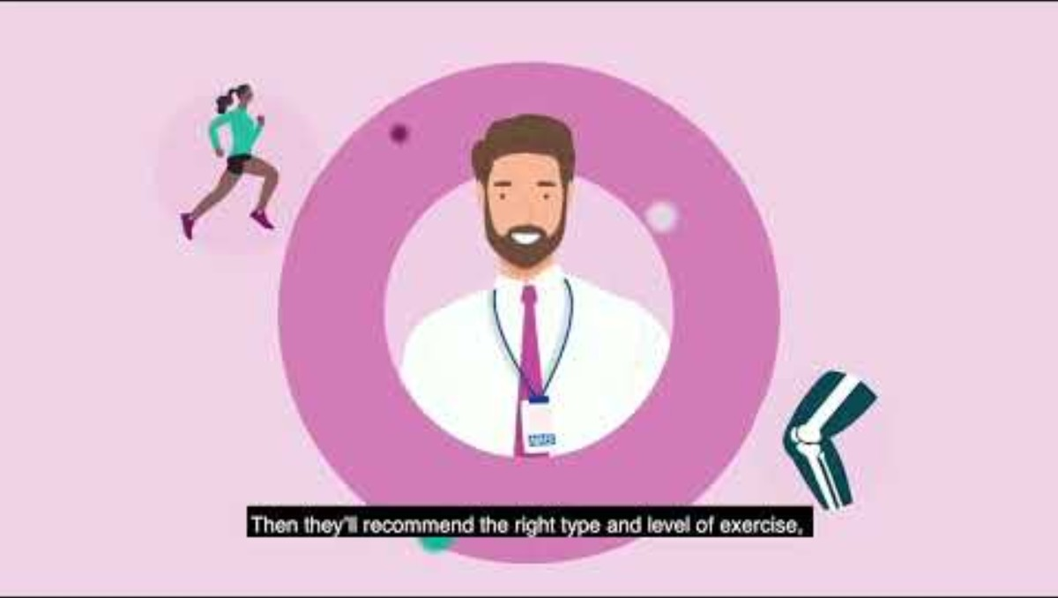
AHP Roles
First Contact Physiotherapist
Find out more about the Advanced Levels of Practice
Essential to develop to role
Development
within role
Supervision requirements
Key roles & responsibilities
Educated to either BSc or MSc degree level and registered with the Health and Care Professions Council (HCPC)
Post graduate experience of 2 years consolidation as a newly qualified physio followed by a minimum of 3 years MSK experience
Completion of the NHS England Physio Roadmap: CLICK HERE which demonstrates working at Level 7 (Masters) in the clinical pillar with competence and capability in MSK related practice as detailed in Musculoskeletal-framework.pdf
It is recommended that completion of Stage 1 of the Roadmap is completed before commencing work in Primary Care as an FCP but in reality, this is often completed whilst working in Primary Care. It is therefore advised that both Stage 1 & 2 are completed as soon as possible and within the first 6-12 months via the taught route at an HEI, details of which can be found here First Contact Practice FAQs | NHS England | Workforce, training and education.
A qualified FCP may wish to develop additional skills such as Supplementary or Independent Prescribing or MSK Ultrasound details of which can be found below.
MSK Modules
MSK Ultrasound/Medical Sonography-Brunel University | medtribe.com
Prescribing for physiotherapists | The Chartered Society of Physiotherapy​
​
Apply to the Training Hub for funding: Independent Prescribing (IP): Funding for Nurses, | medtribe.com
An FCP might want to develop their skills to Level 7 in all 4 pillars of practice and work at an Advanced Level. Advanced practitioners manage complete clinical episodes of care for patients with undifferentiated and undiagnosed conditions, utilising complex decision-making skills to inform diagnosis, investigation, and treatments within a broad scope of practice. For more information see Welcome - Advanced Practice or our Training Hub Website Advanced Practice (AP) : Surrey Training Hub.
Those on a learning pathway i.e. Roadmap or Trainee Advanced Practitioner should have the appropriate level of supervision as outlined in the relevant guidance documents This guide from Kent, Surrey, and Sussex Primary Care School provides local guidance on supervision requirements. First Contact Practitioners should have access to monthly supervision from a GP, consultant practitioner or advanced practitioner. They should also have an appropriate named individual in the PCN to provide general advice and support on a day-to-day basis.
Those no longer on a defined learning pathway training (ie. qualified FCP or AP) are expected to work independently
without day-to-day supervision but as with all professional clinicians will benefit from regular clinical supervision
Clinical supervision: a brief overview | The Chartered Society of Physiotherapy
Continued Professional Development can take many forms and may include a range of both accredited and non accredited post graduate courses covering many MSK related topics.
Assesses, diagnoses, treats and manages musculoskeletal (MSK) problems. Signposts / refers to other health and care services and audits own health and care practice
With further training may prescribe medication within scope, develop skills relating to injection therapy
This role leads to
Advanced Clinical Practitioner
As the demands on the healthcare system evolve, clinical professionals are supported to recognise and embrace opportunities to transition into leadership and management roles, broadening their contribution beyond direct patient care. The four pillars Clinical Practice, Leadership and Management, Education and Learning, and Research.
There are two aspects: the scope of the profession; and your individual scope. It is important to understand both as they will have implications for your practice.
Physiotherapy career framework | The Chartered Society of Physiotherapy
Physiotherapy scope of practice | The Chartered Society of Physiotherapy
CSP Service Standards

Slide 80

AHP Roles
First Contact Podiatrist
Find out more about the Advanced Levels of Practice
Supervision requirements
Essential to
develop to role
Development
within role
Key roles & responsibilities
This role leads to
Applicants to a podiatry role will usually have completed a degree course or masters degree in podiatry. This takes the usual two to three years full time and over four years part-time. To practice podiatry, you need to be registered with the HCPC. Apart from completing a degree, the other option is to apply for a degree apprenticeship (find out more on NHS health careers).
Registered with the Health and Care Professions Council (HCPC)
It is recommended that completion of Stage 1 of the Roadmap is completed before commencing work in Primary Care as an FCP but in reality, this is often completed whilst working in Primary Care. It is therefore advised that both Stage 1 & 2 are completed as soon as possible and within the first 6-12 months via the taught route at an HEI, details of which can be found here First Contact Practice FAQs | NHS England | Workforce, training and education.
An FCP might want to develop their skills to Level 7 in all 4 pillars of practice and work at an Advanced Level. Advanced practitioners manage complete clinical episodes of care for patients with undifferentiated and undiagnosed conditions, utilising complex decision-making skills to inform diagnosis, investigation, and treatments within a broad scope of practice. For more information see Welcome - Advanced Practice or our Training Hub Website Advanced Practice (AP) : Surrey Training Hub.
This guide from Kent, Surrey, and Sussex Primary Care School provides local guidance on supervision requirements. First Contact Practitioners should have access to monthly supervision from a GP, consultant practitioner or advanced practitioner. They should also have an appropriate named individual in the PCN to provide general advice and support on a day-to-day basis.
Diagnoses, treats and manages foot problems that arise from vascular, diabetic inflammatory or MSK disease
Performs minor surgery, e.g. to manage in-growing great toenails and verrucae
Prescribes, produces and fits orthotics and additional aids and appliances as appropriate
Advanced Clinical Practitioner
As the demands on the healthcare system evolve, clinical professionals are supported to recognise and embrace opportunities to transition into leadership and management roles, broadening their contribution beyond direct patient care. The four pillars Clinical Practice, Leadership and Management, Education and Learning, and Research.
Additional Useful Resources
Health Education England – AHP Career Pathways
HEE AHP Pathway Toolkit
eLearning for Healthcare (e-LfH) Modules for Podiatry
e-LfH AHP Modules
Royal College of Podiatry (membership body with resources, webinars, and CPD)
rcpod.org.uk

Slide 81

AHP Roles
First Contact Occupational Therapist
Find out more about the Advanced Levels of Practice
Essential to
develop to role
Development
within role
Supervision requirements
Key roles & responsibilities
This role leads to
Educated to bachelor / master’s degree level (or equivalent, eg diploma)
Registered with the Health and Care Professions Council (HCPC) with 3-5 years of post-registration experience
Further Development:
Enhanced practice is a level of practice within the healthcare workforce. It covers the graduate professional workforce delivering the majority of clinical activity, those who have moved beyond novice/competent and who are not yet working at the level of advanced practice.
For more detailed information and resources, you can visit the Health Careers NHS website and the NHS Learning Hub.
It is recommended that completion of Stage 1 of the Roadmap is completed before commencing work in Primary Care as an FCP but in reality, this is often completed whilst working in Primary Care. It is therefore advised that both Stage 1 & 2 are completed as soon as possible and within the first 6-12 months via the taught route at an HEI, details of which can be found here First Contact Practice FAQs | NHS England | Workforce, training and education.
An FCP might want to develop their skills to Level 7 in all 4 pillars of practice and work at an Advanced Level. Advanced practitioners manage complete clinical episodes of care for patients with undifferentiated and undiagnosed conditions, utilising complex decision-making skills to inform diagnosis, investigation, and treatments within a broad scope of practice. For more information see Welcome - Advanced Practice or our Training Hub Website Advanced Practice (AP) : Surrey Training Hub.
This guide from Kent, Surrey, and Sussex Primary Care School provides local guidance on supervision requirements. First Contact Practitioners should have access to monthly supervision from a GP, consultant practitioner or advanced practitioner. They should also have an appropriate named individual in the PCN to provide general advice and support on a day-to-day basis.
RCOT Supervision Standards Guide
Should have access to monthly supervision from a GP, consultant practitioner or advanced practitioner. Should also have an appropriate named individual in the PCN to provide general advice and support on a day-to-day basis.
Promoting health and wellbeing across all ages by empowering individuals and communities.
Supporting independent living through strengths-based approaches and technology in social care.
Providing urgent and proactive care to help people stay at or return home.
Expanding occupational therapy in primary care and public health to reduce health inequalities.
Enhancing occupational therapy’s role in mental health transformation.
Strengthening the evidence base and demonstrating the social value and impact of occupational therapy.
Advanced Clinical Practitioner
As the demands on the healthcare system evolve, clinical professionals are supported to recognise and embrace opportunities to transition into leadership and management roles, broadening their contribution beyond direct patient care. The four pillars Clinical Practice, Leadership and Management, Education and Learning, and Research.

Slide 82
DON’T MISS OUT
on Training & Development Opportunities
for the Primary Care Multi-Professional Workforce
CONTACT US
Subscribe to Surrey Training Hub Newsletter Subscription for monthly updates on sector news, training opportunities, events and resources
Acknowledgement of Support
Surrey Training Hub would like to sincerely thank Kent & Medway Training Hub for their generous support and collaboration in sharing resources in the original design, which have been instrumental in helping us to adapt and develop this career pathway for the Surrey Heartlands workforce.
www.surreytraininghub.co.uk
Email: Surrey Training Hub
Not to be replicated without consent V2.2

